Slide 1
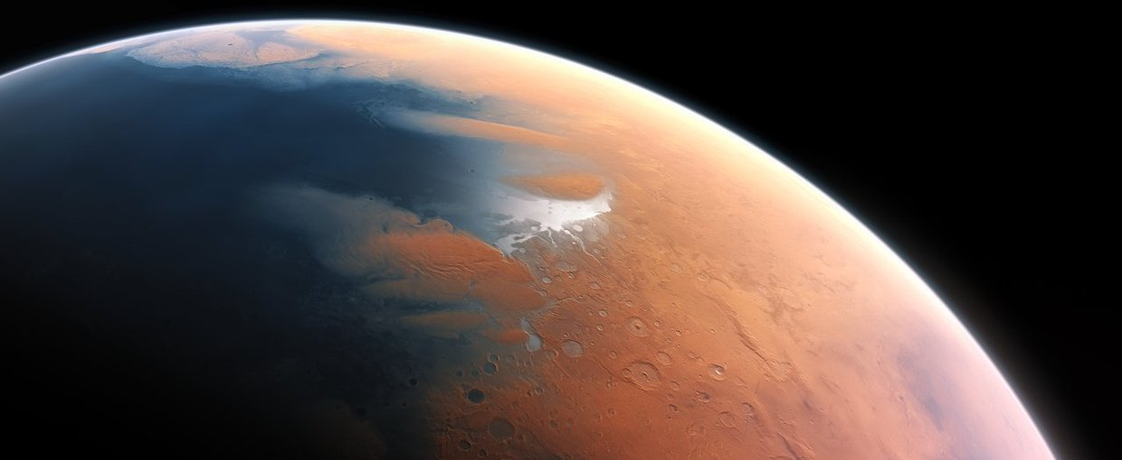
Water on Mars
Ryan Anderson
5/20/2019

Slide 2
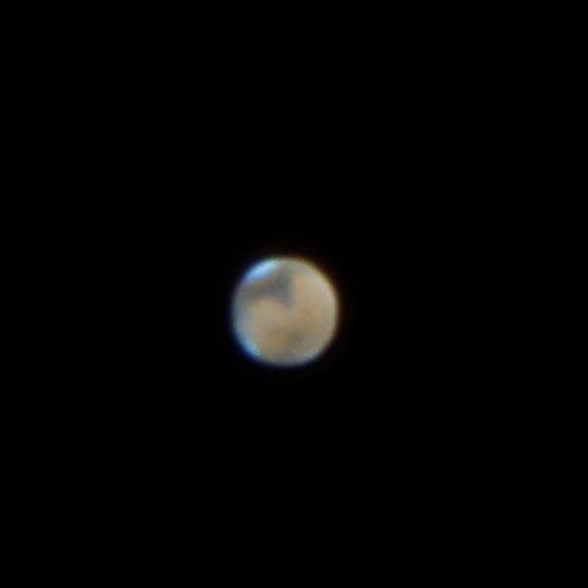

Slide 3
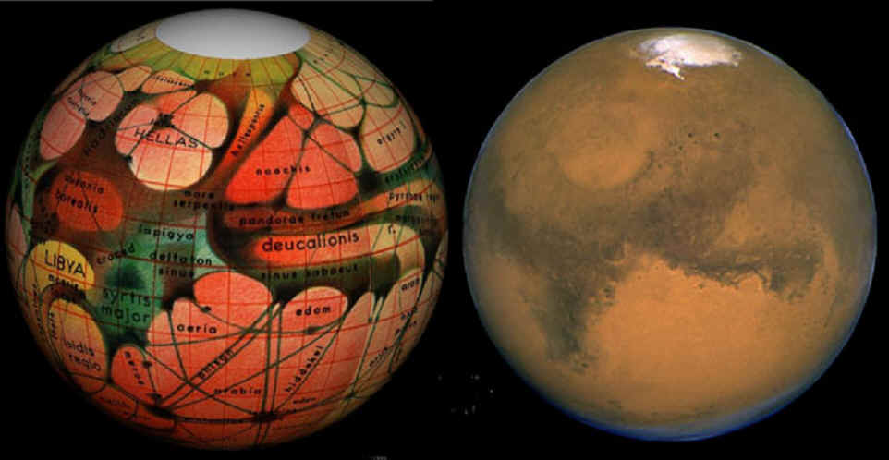
“Canals”
~1877: Giovanni Schiaparelli identifies “canali”
  “confirmed” by many other observers
1910: Percival Lowell
  Intricate drawings
  Book: “Mars as the Abode of Life”
  Canals were built by a dying civilization!

Slide 4
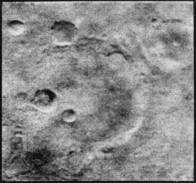
Mariner 4 – Mars is “Moon-like”
1965 – First spacecraft to visit Mars
Returned 21 pictures!
  No canals
  No vegetation
  Lots of craters
  It looks like the moon!

Slide 5
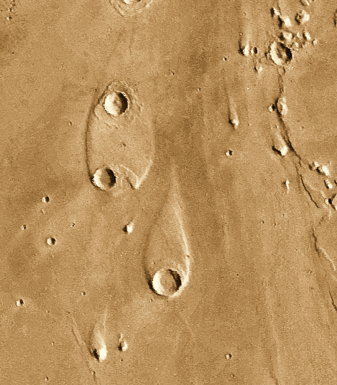
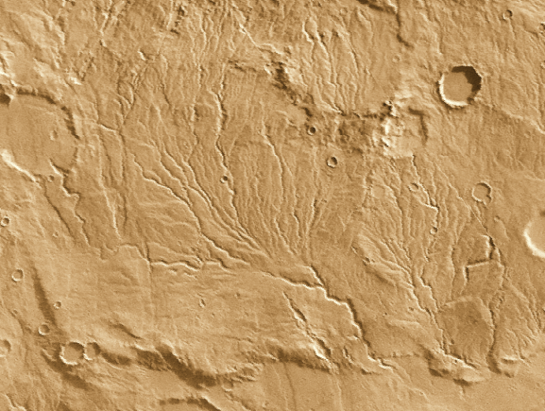
Late 1970s: Viking Orbiters find evidence for water

Slide 6
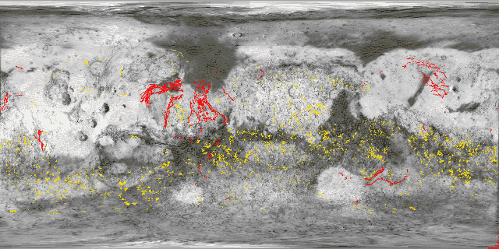
Valley Networks
Outflow Channels

Slide 7
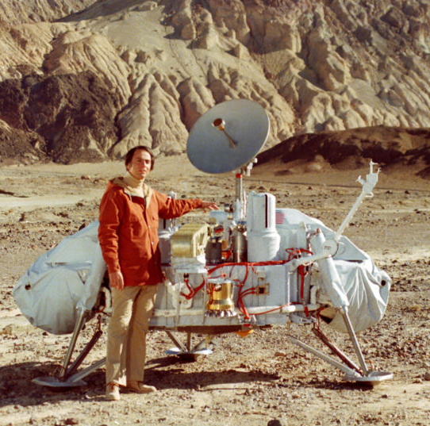
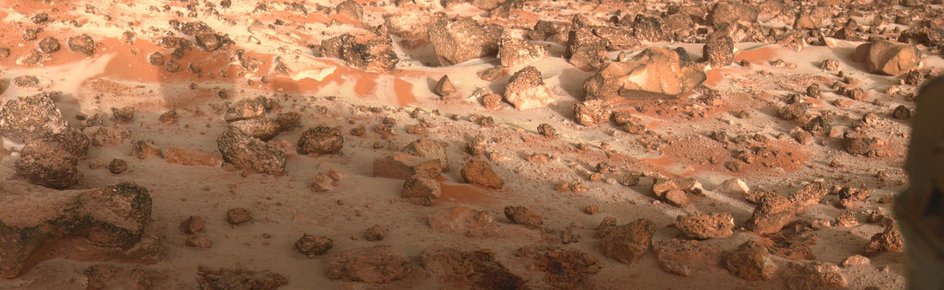
Viking Lander sees frost!

Slide 8
Intermission
No Mars missions for 20 years!

Slide 9
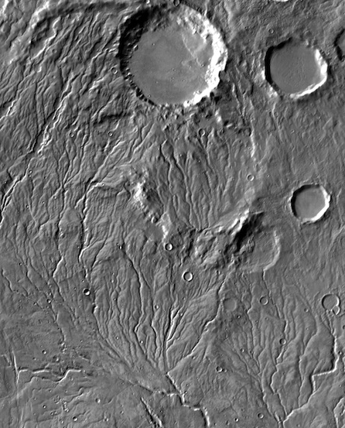
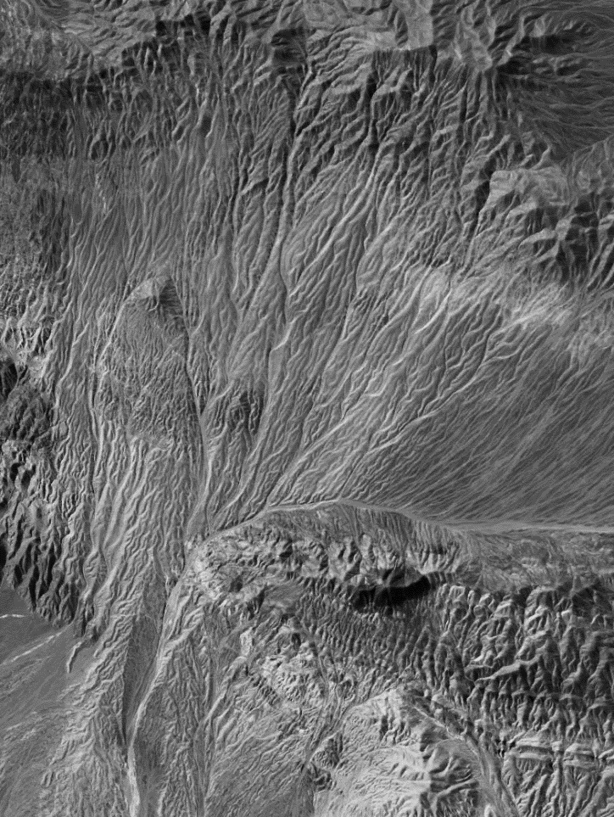
Earth
Mars

Slide 10
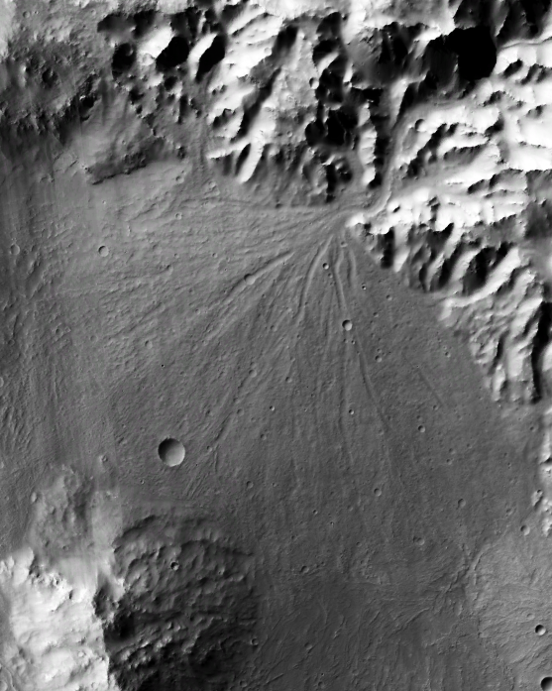
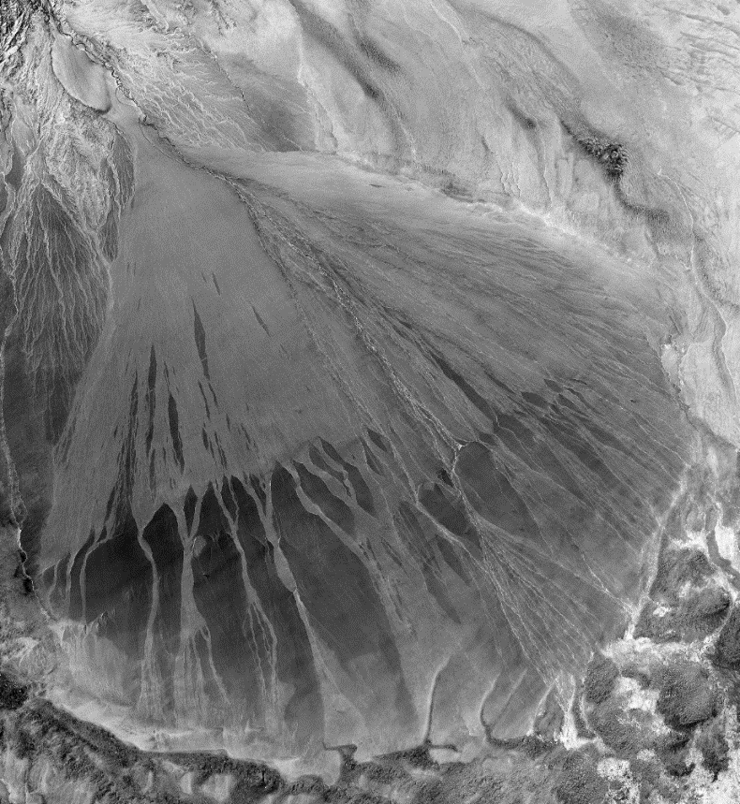
Mars
Earth

Slide 11
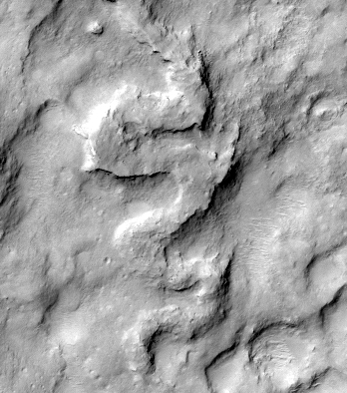
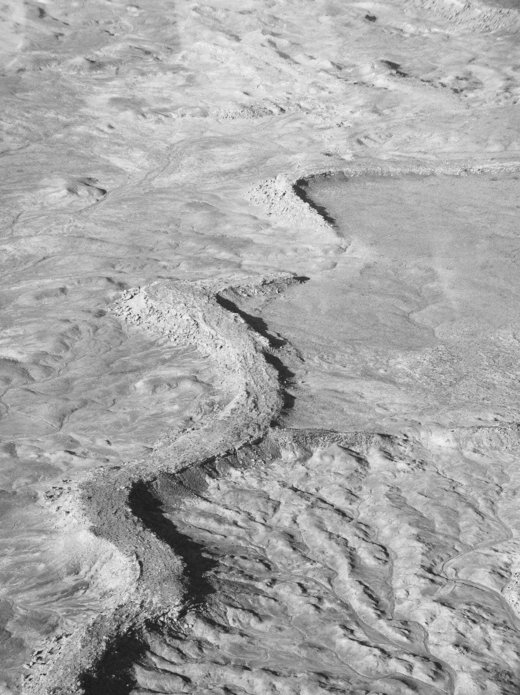
Mars
Earth

Slide 12
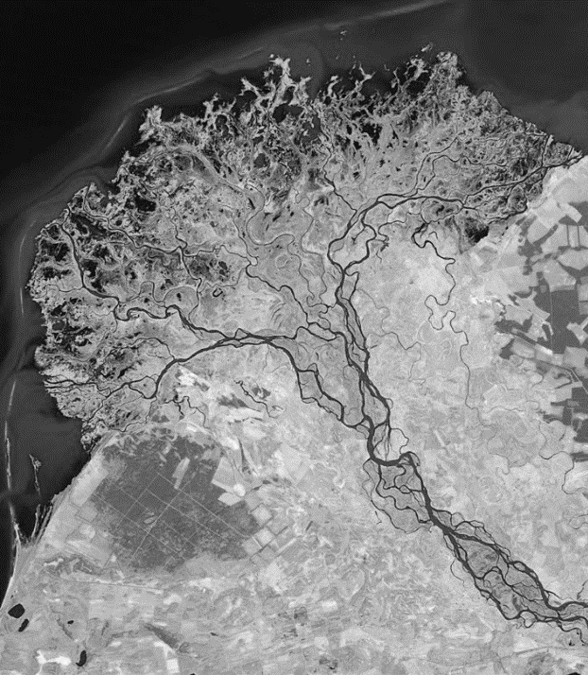
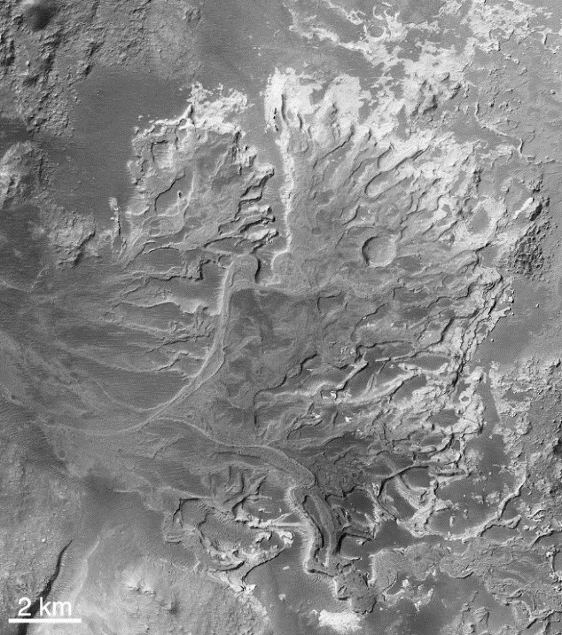
Earth
Mars

Slide 13
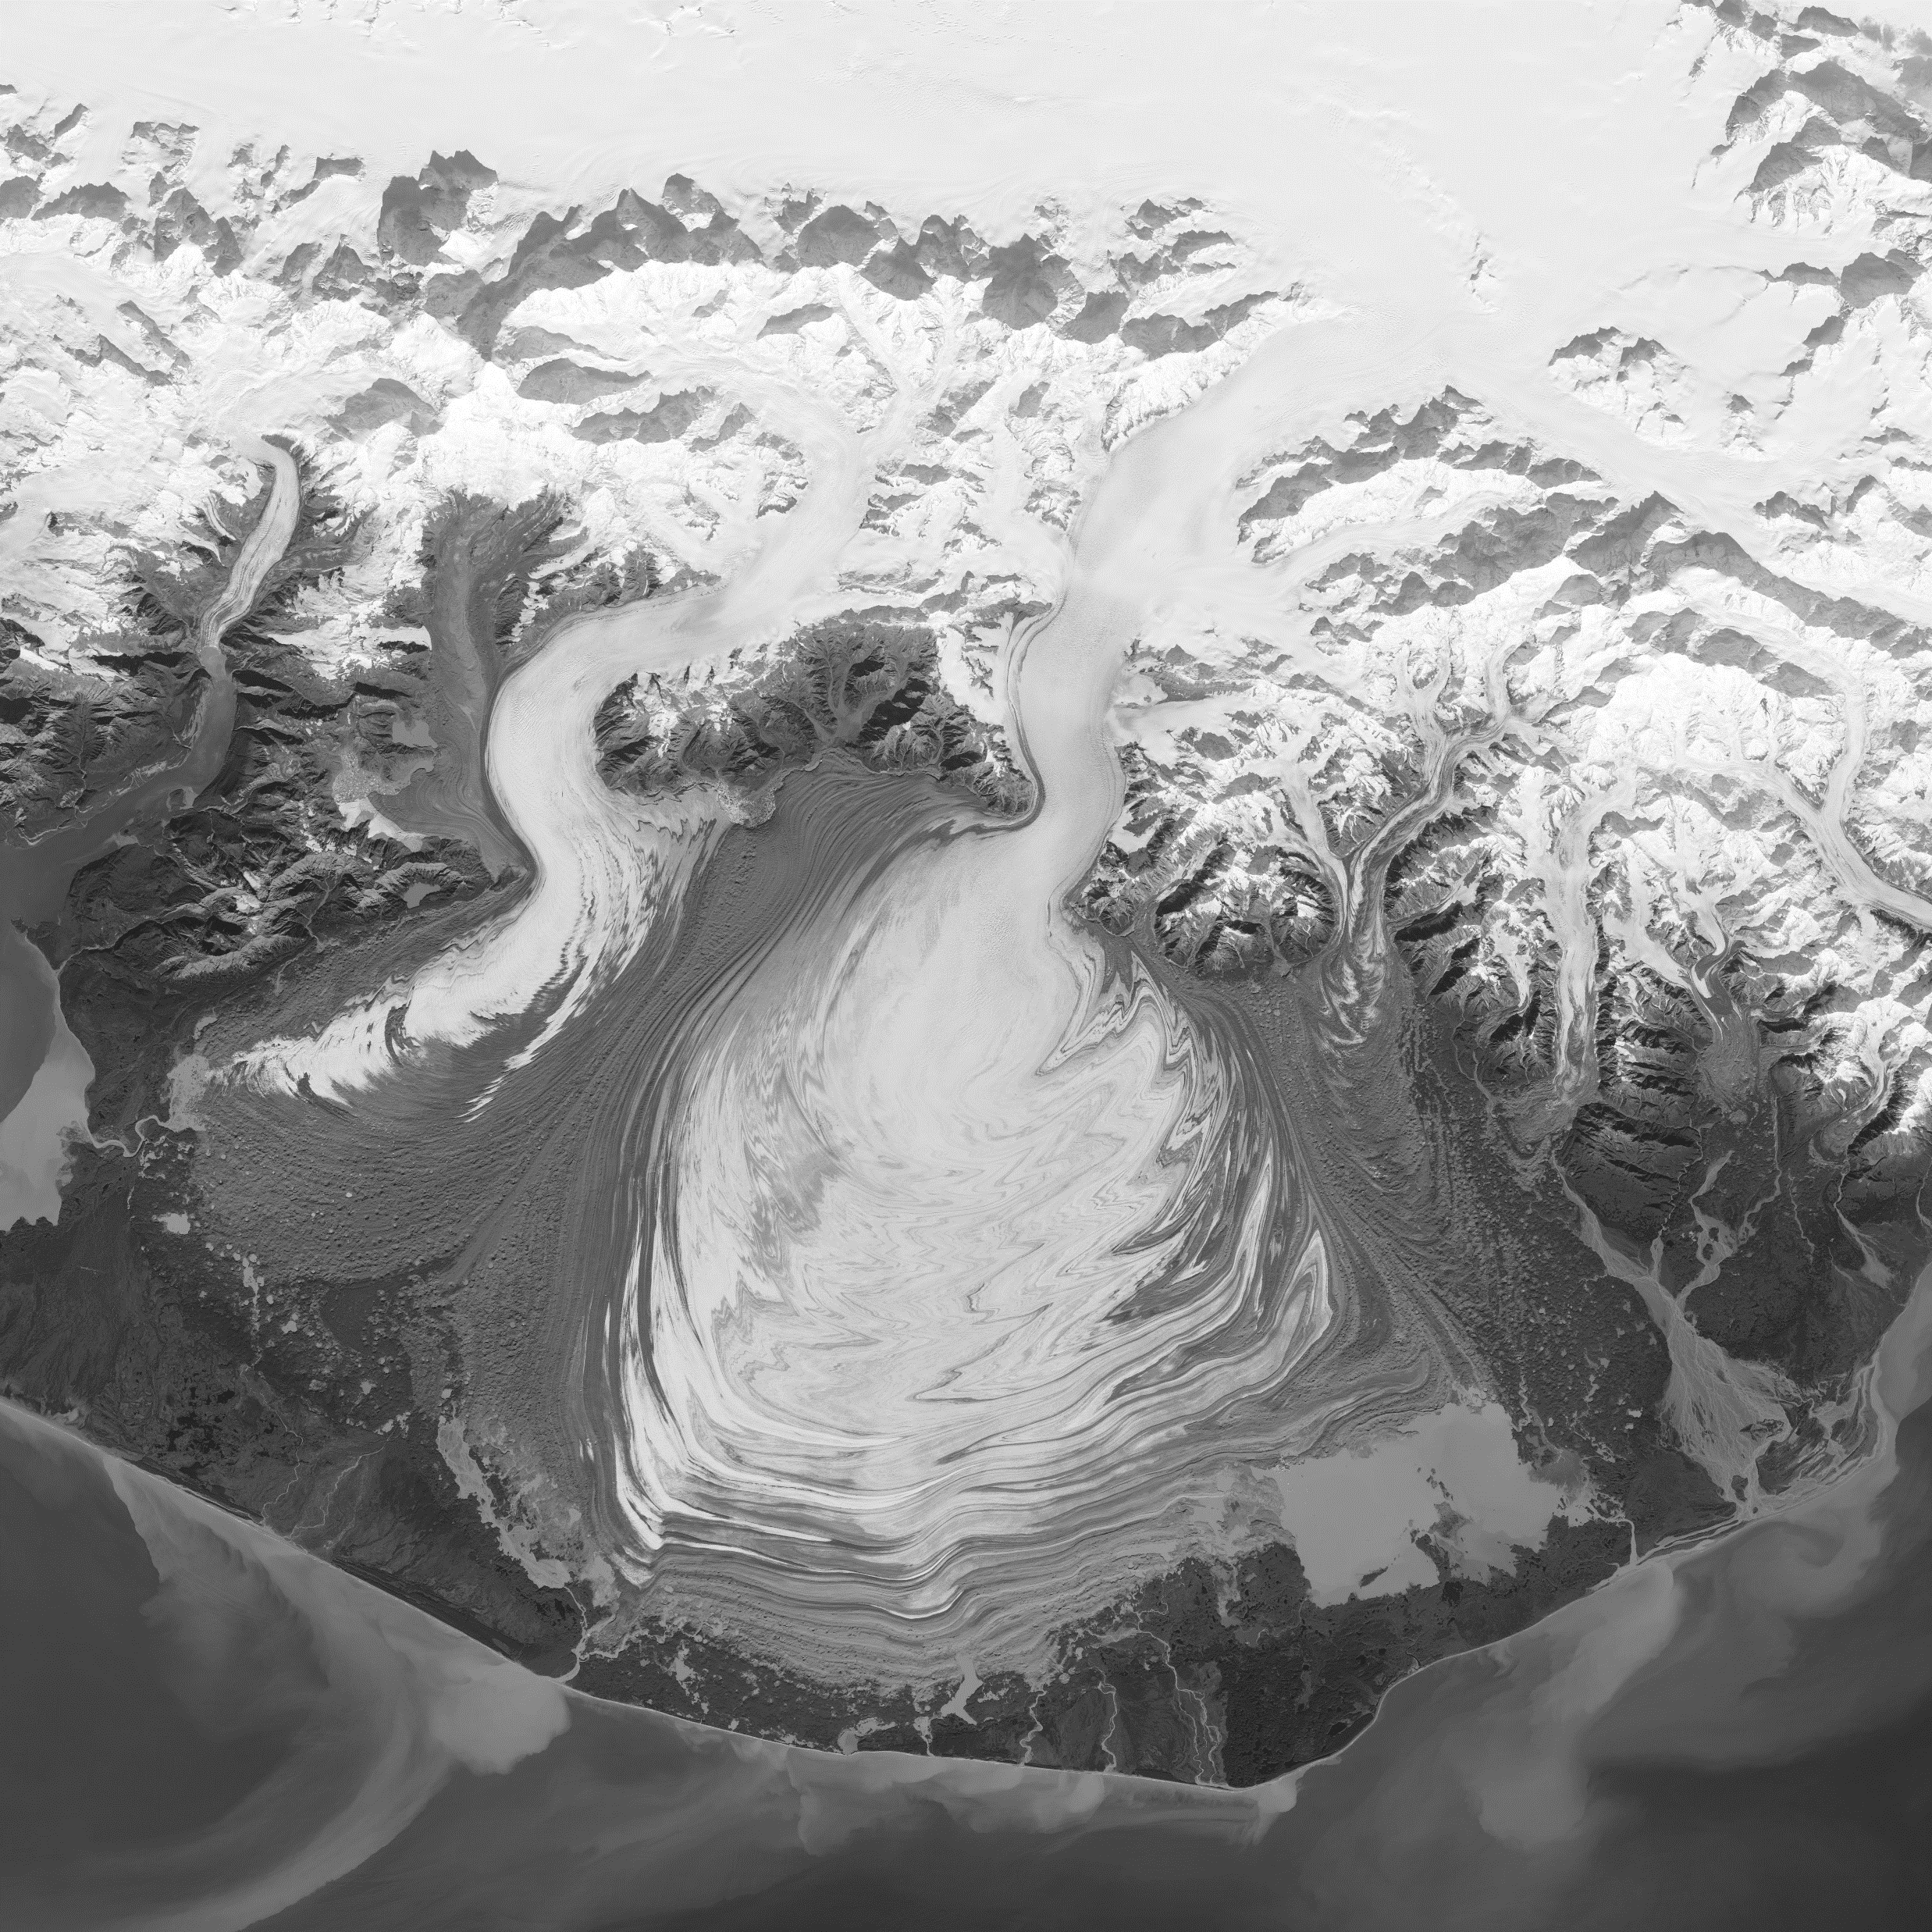
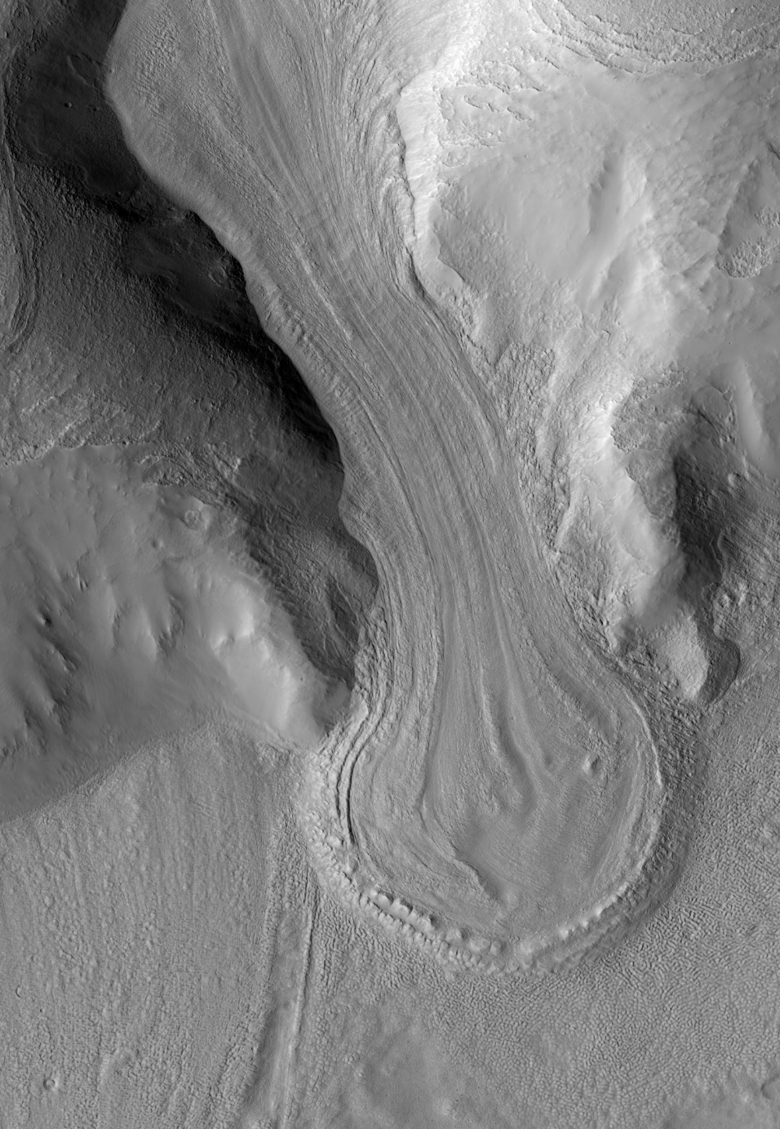
Earth
Mars

Slide 14
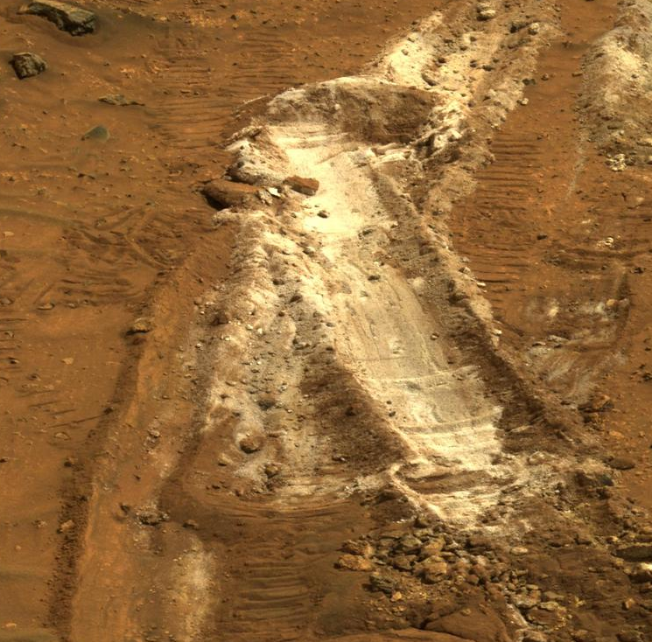
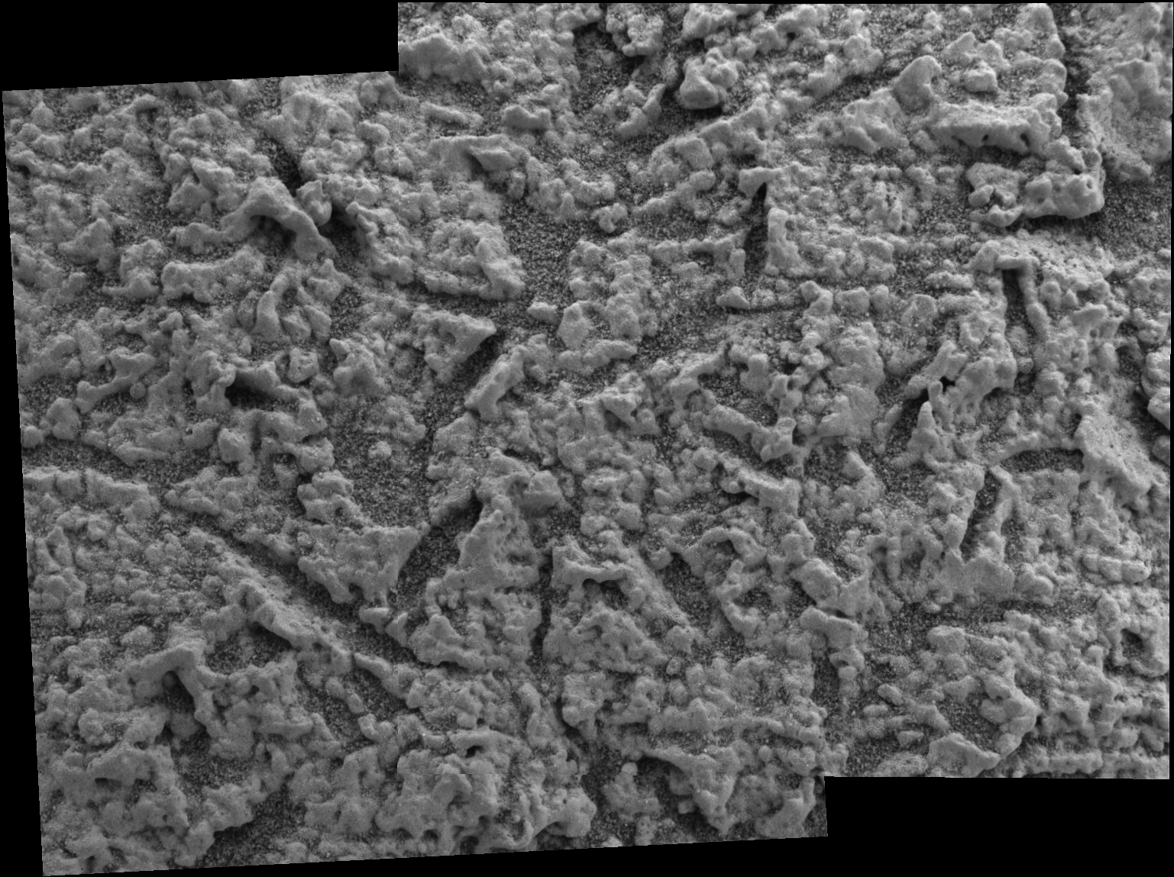
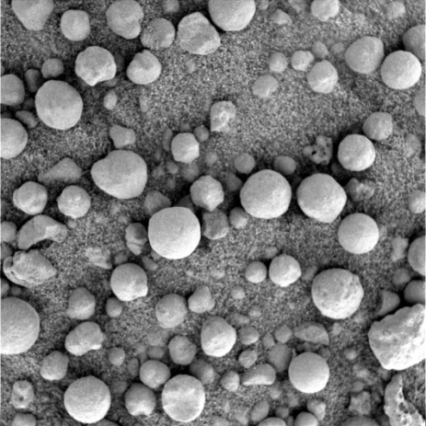
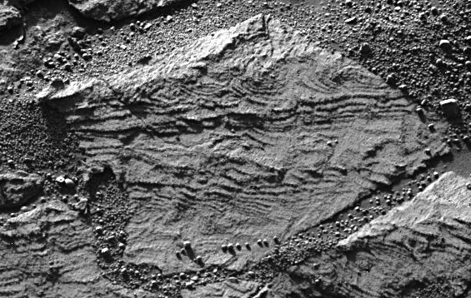
Mars Exploration Rovers
Spirit (2004 – 2010)
Opportunity (2004 – 2018)
Both rovers found evidence for past water on Mars!

Slide 15
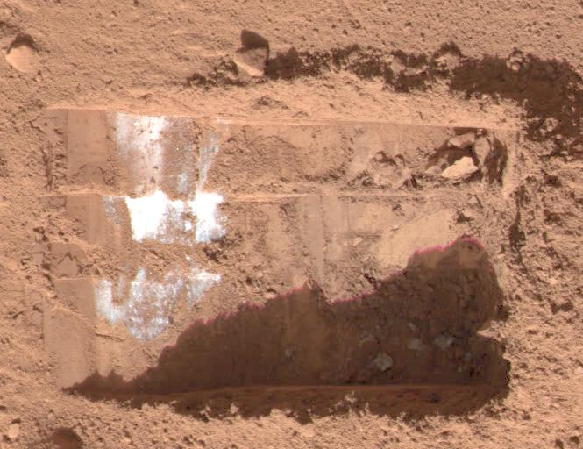
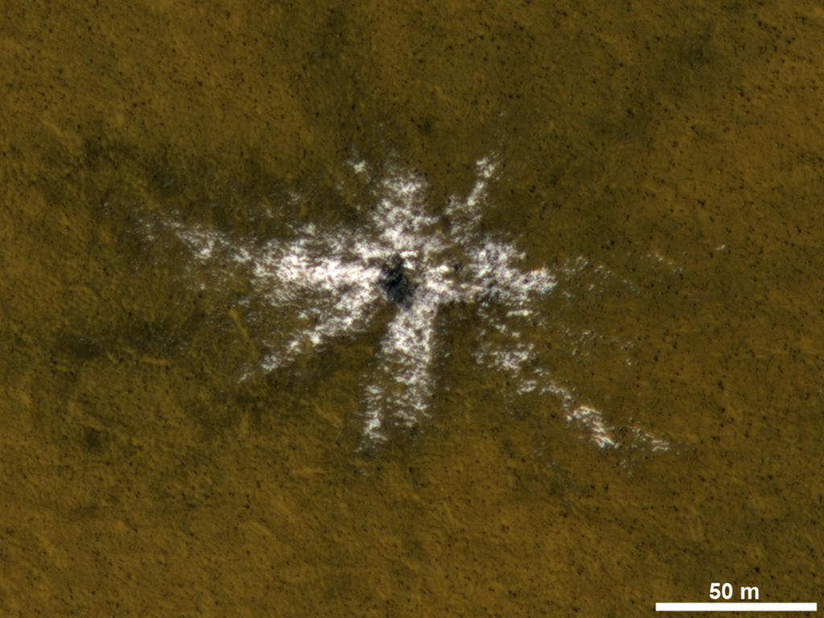
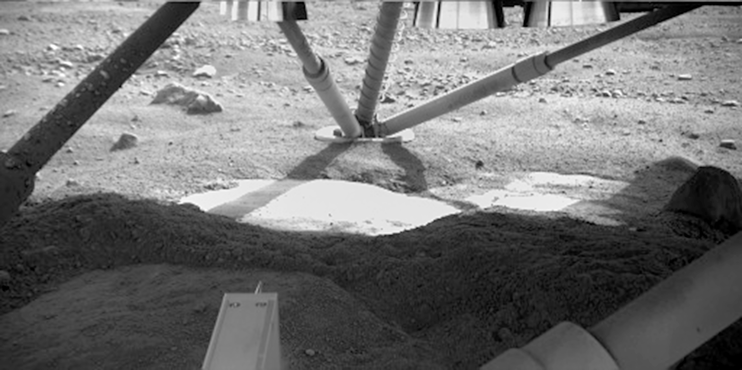
Buried ice!
Fresh impacts uncovered ice
Phoenix lander found ice just below the surface!

Slide 16
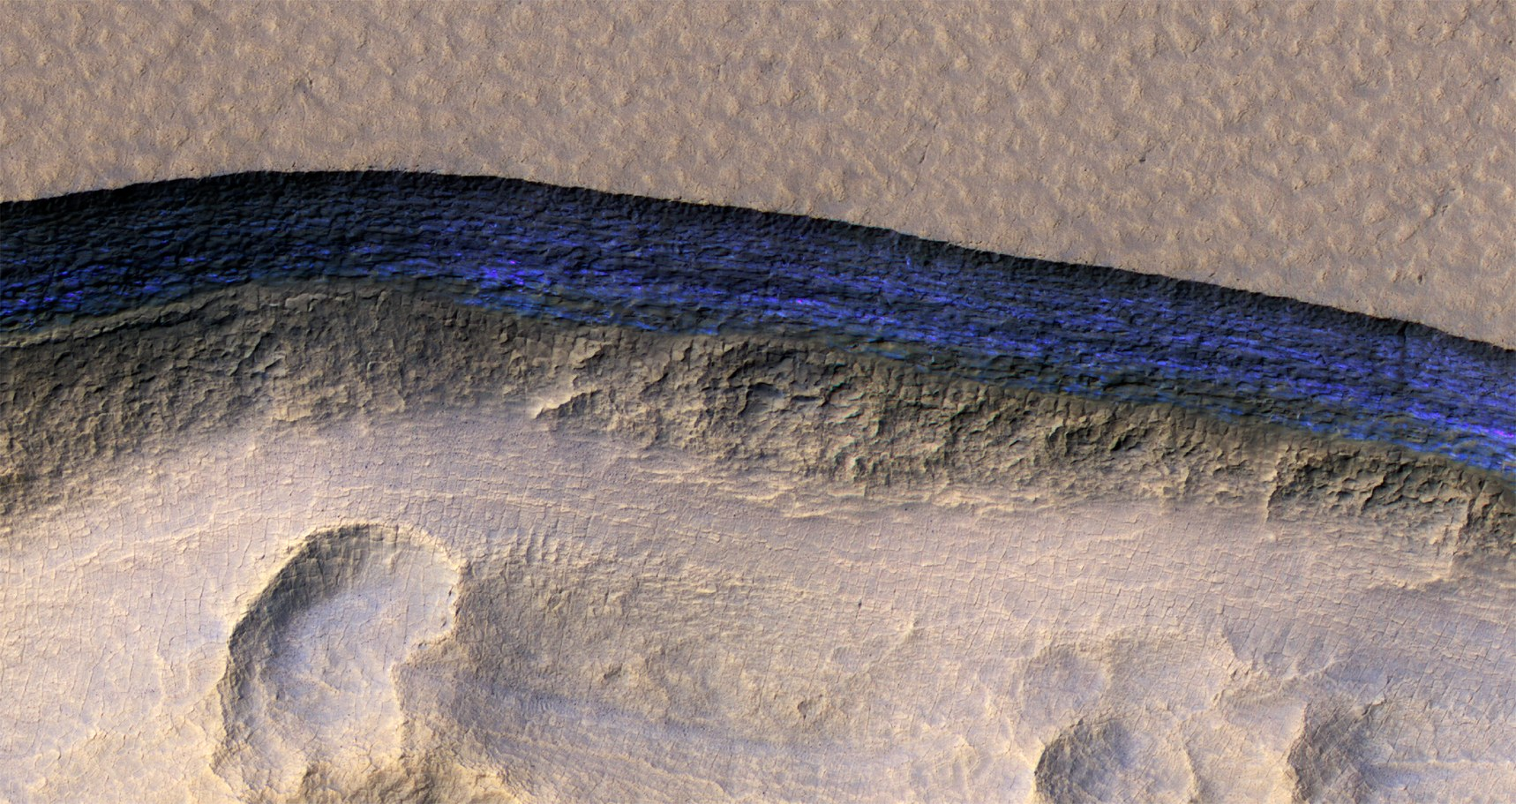

Slide 17
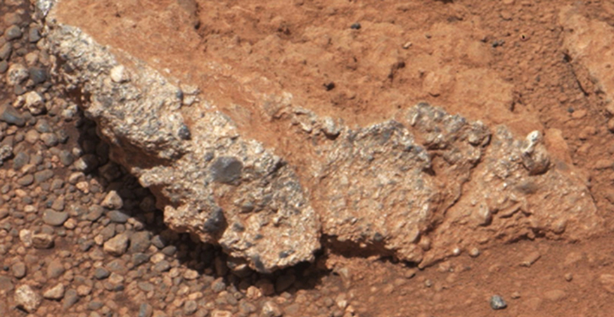
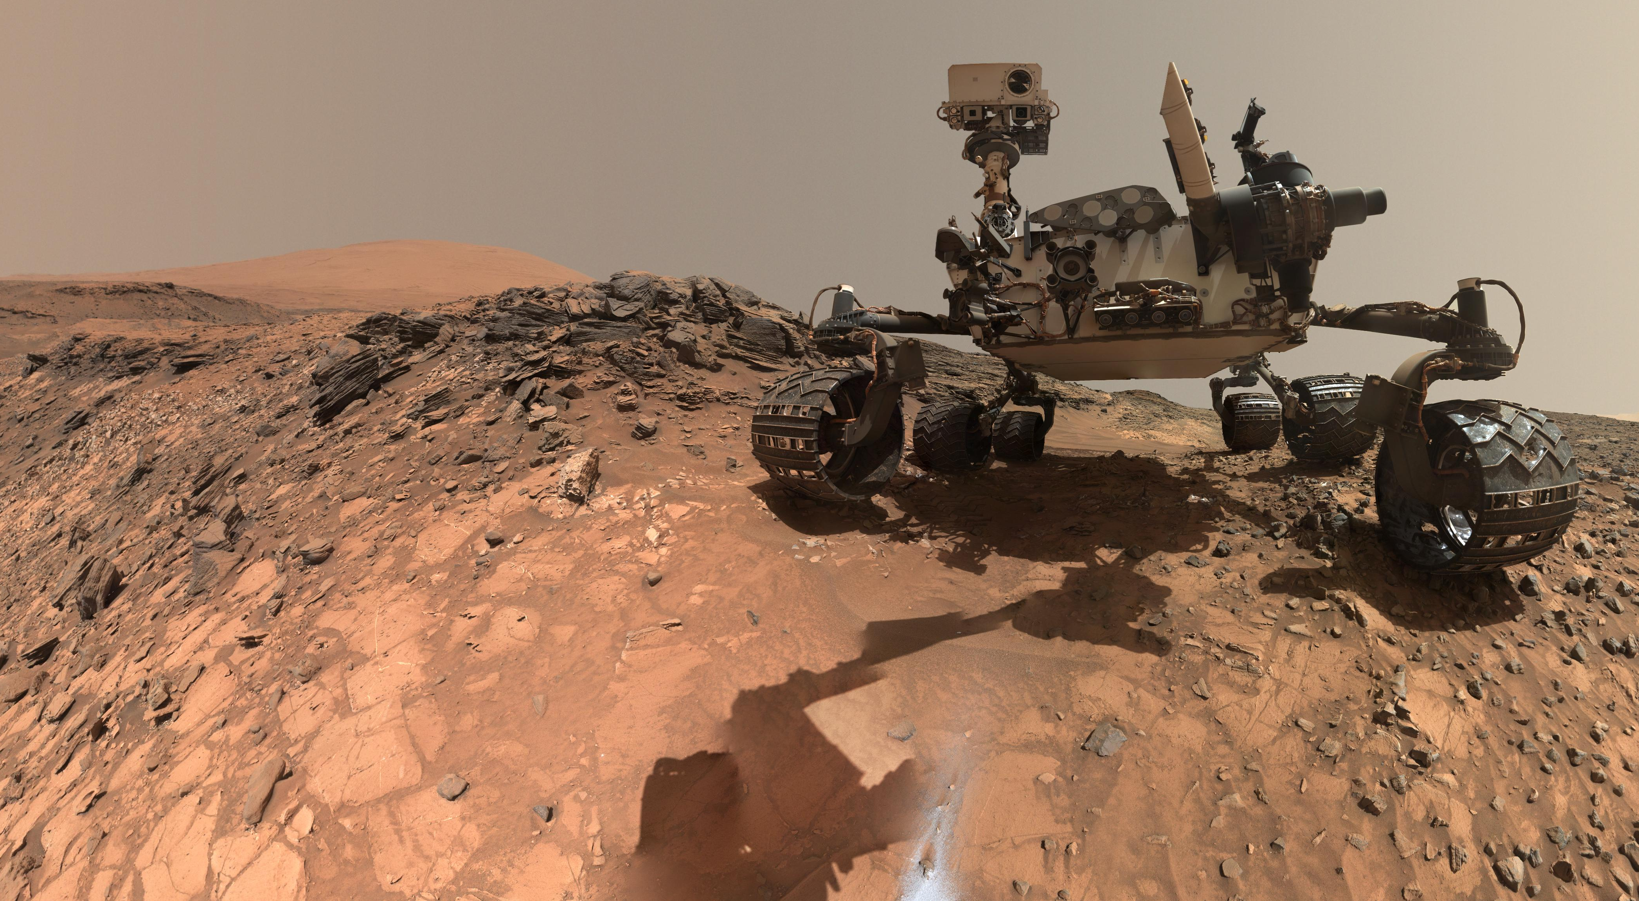
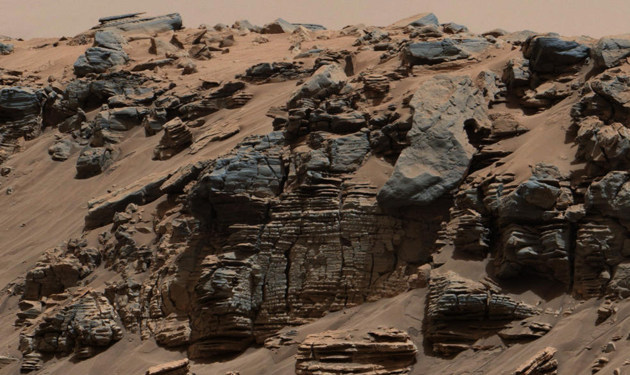
Curiosity Rover
Lots of evidence for water
  River and lake deposits
  Water-related minerals

Slide 18
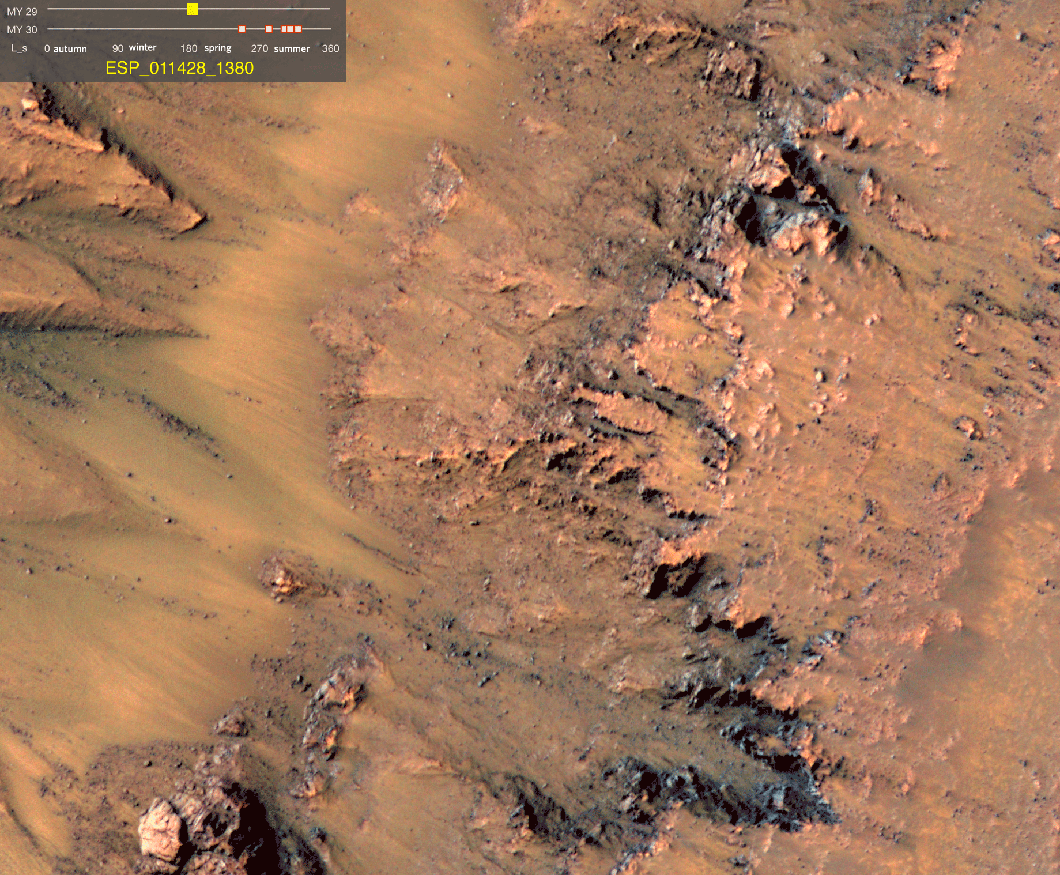
“Recurring Slope Lineae”
Are they dry or wet?

Slide 19
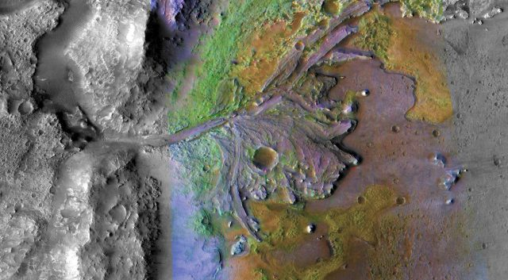
Water-related Minerals

Slide 20
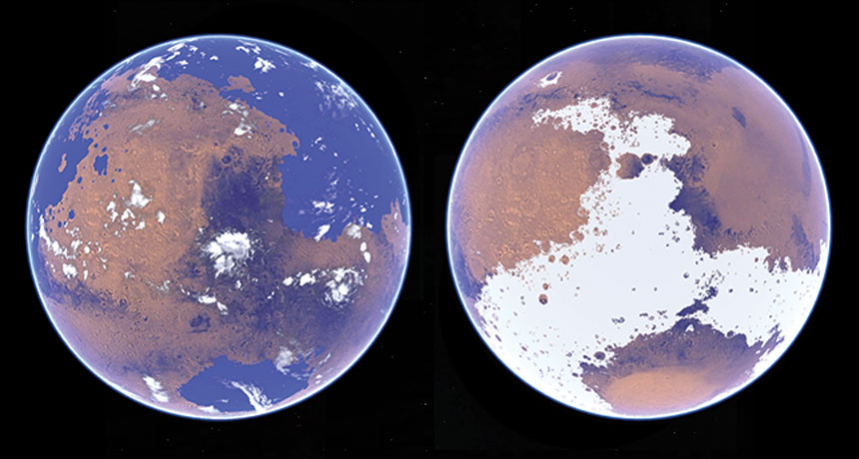
Is there water on Mars? Yes!
But was Mars ever warm and wet,
or was it always cold and dry?

