Slide 1
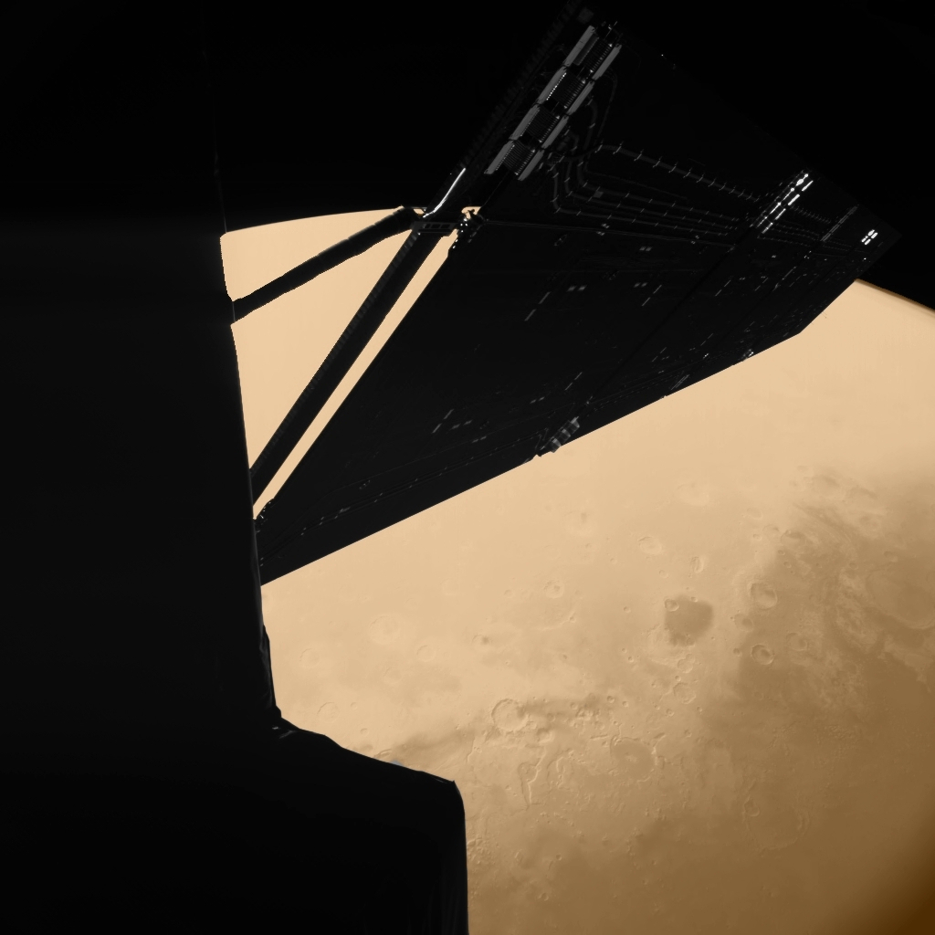
Science in Fiction
Ryan Anderson
USGS Astrogeology Science Center
Flagstaff Festival of Science
October 2, 2022

Slide 2
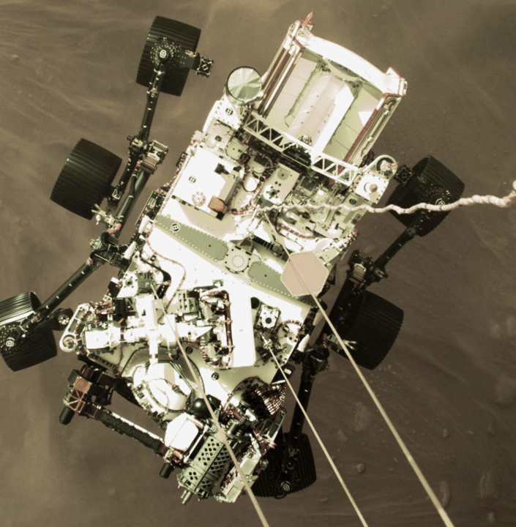
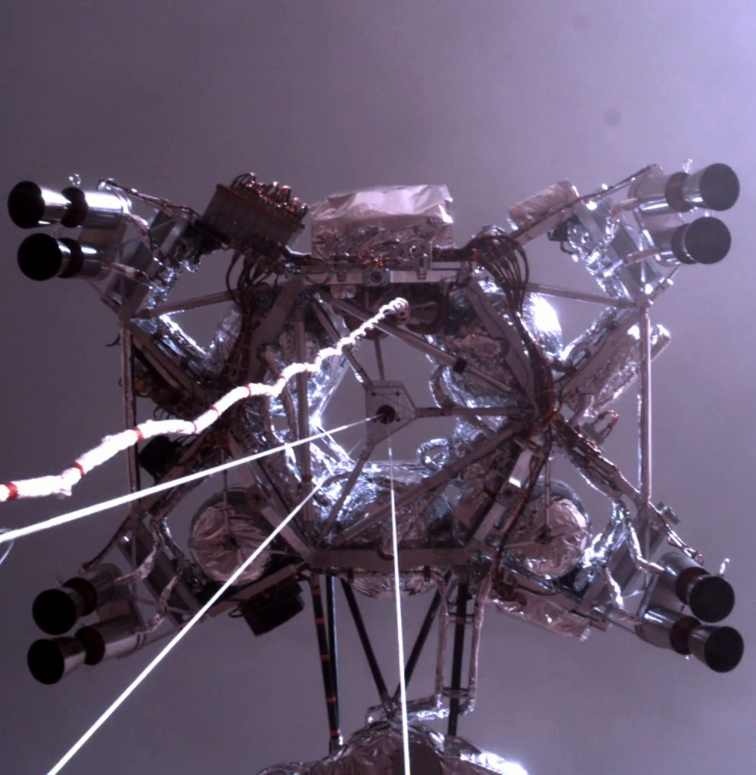
Space Travel

Slide 3
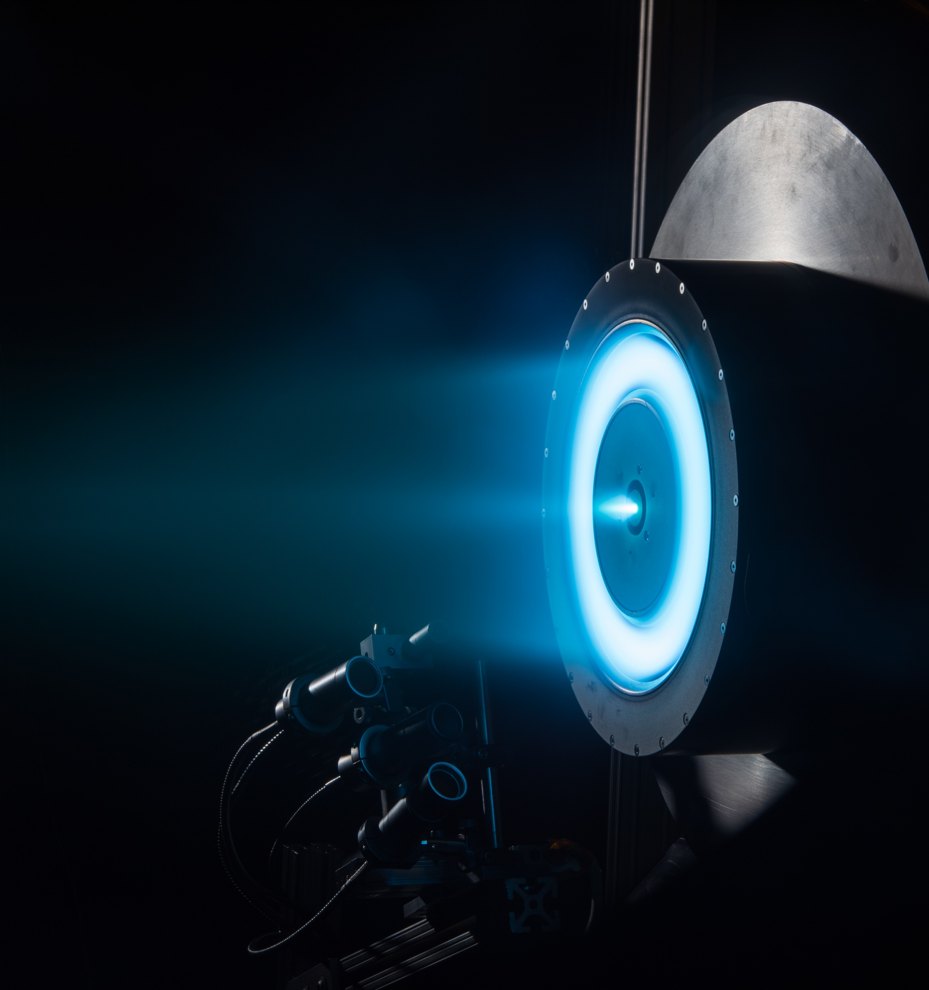
Infinite/Reactionless Thrust
Spacecraft that can accelerate indefinitely, have no apparent fuel tanks (or fuel is not a concern).
Plausibility:
  Ion/plasma thrusters are real!
    Extremely fuel-efficient, can fire for long periods of time
    But they are weak.
  Powerful reactionless engines that can fire forever, blast off into orbit, etc. are not plausible.
NASA

Slide 4
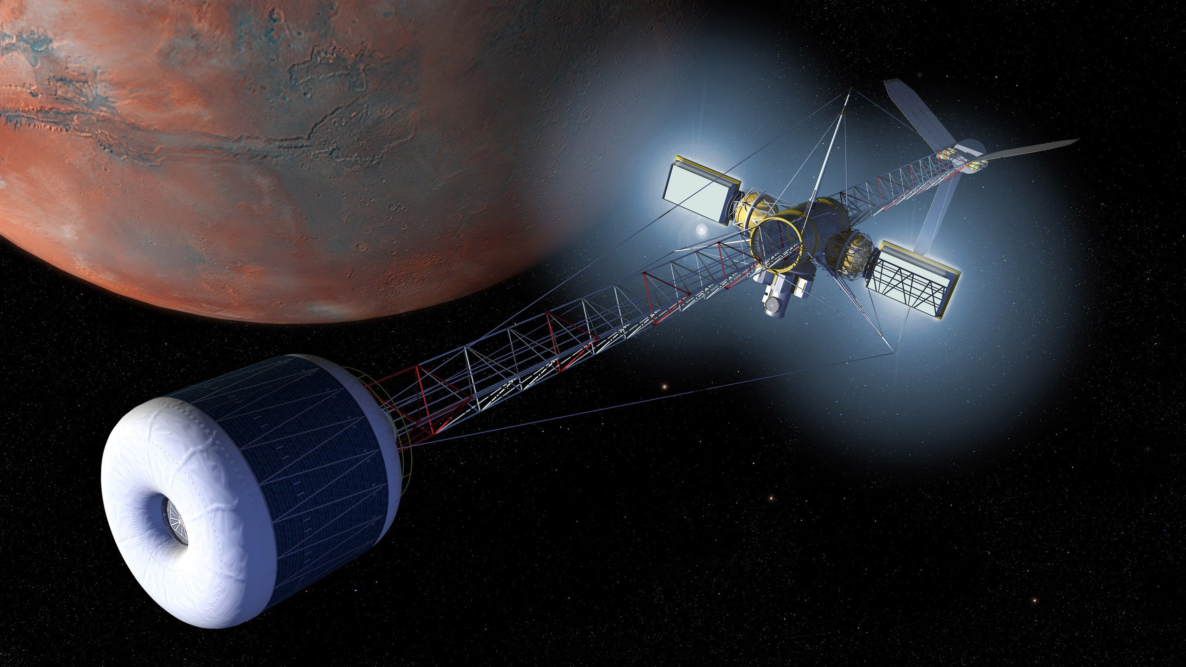
Artificial Gravity
People can walk around normally while flying through space
3 general types in sci-fi:
  Rotation
  Linear acceleration
  Magic
Plausibility
  Rotation: possible, though works better the larger the spacecraft, which is a challenge.
  Linear acceleration: Can’t maintain high-g acceleration forever
  Magic: not plausible

Slide 5
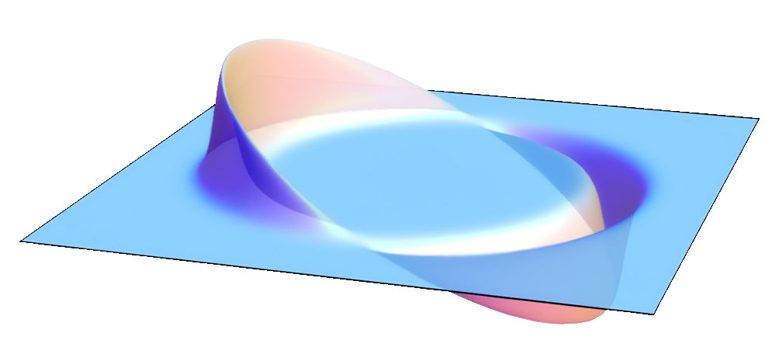
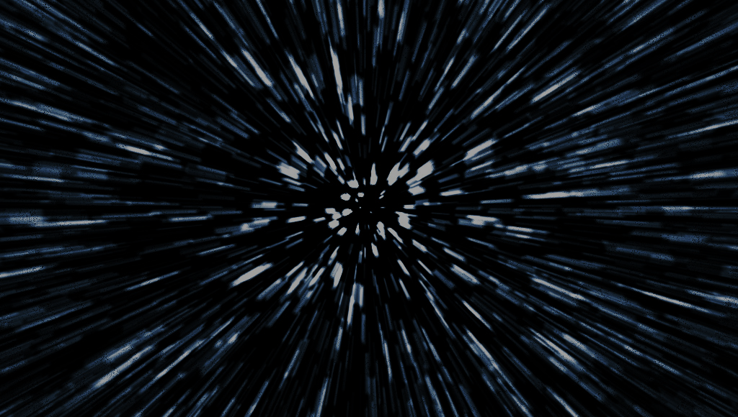
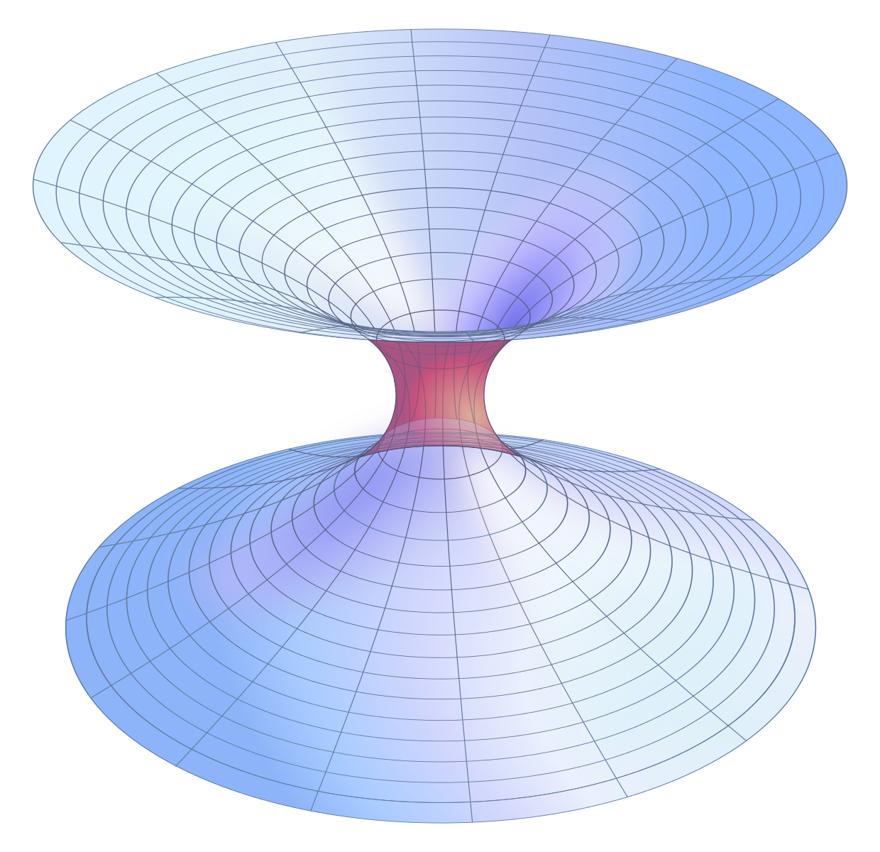
Faster Than Light Travel/Communication
Ships/signals can get from point A to point B faster than light could.
  Warp drive
  Hyperspace
  Worm holes/”gates” etc.
  Ansible, etc.
Plausibility
  Nope
  Physicists have studied these ideas a lot
    All would require exotic things like negative mass, and absurdly large amounts of energy.
  Faster than light communication? Also no.
    Maybe through atom-sized wormholes. But it’s a stretch.
Wikipedia/AllenMcC
Wikipedia/AllenMcC

Slide 6
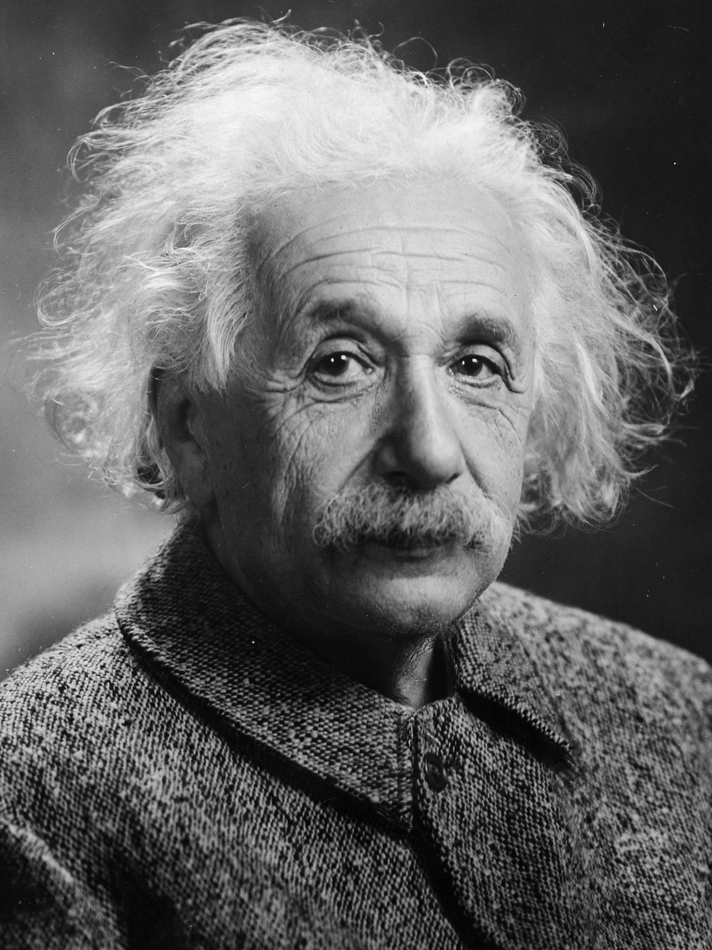
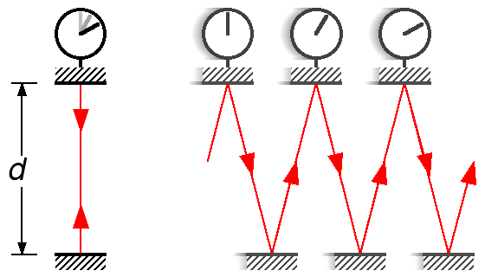
Relativistic Travel
Spaceships travel near the speed of light. Crew age slower than people at home.
Plausibility:
  Relativistic effects: True!
  Ability to actually do it: not likely.
    The closer you get to the speed of light, the more energy you need to go faster.
    Interstellar dust becomes a big hazard!
Wikipedia/Michael Schmid

Slide 7
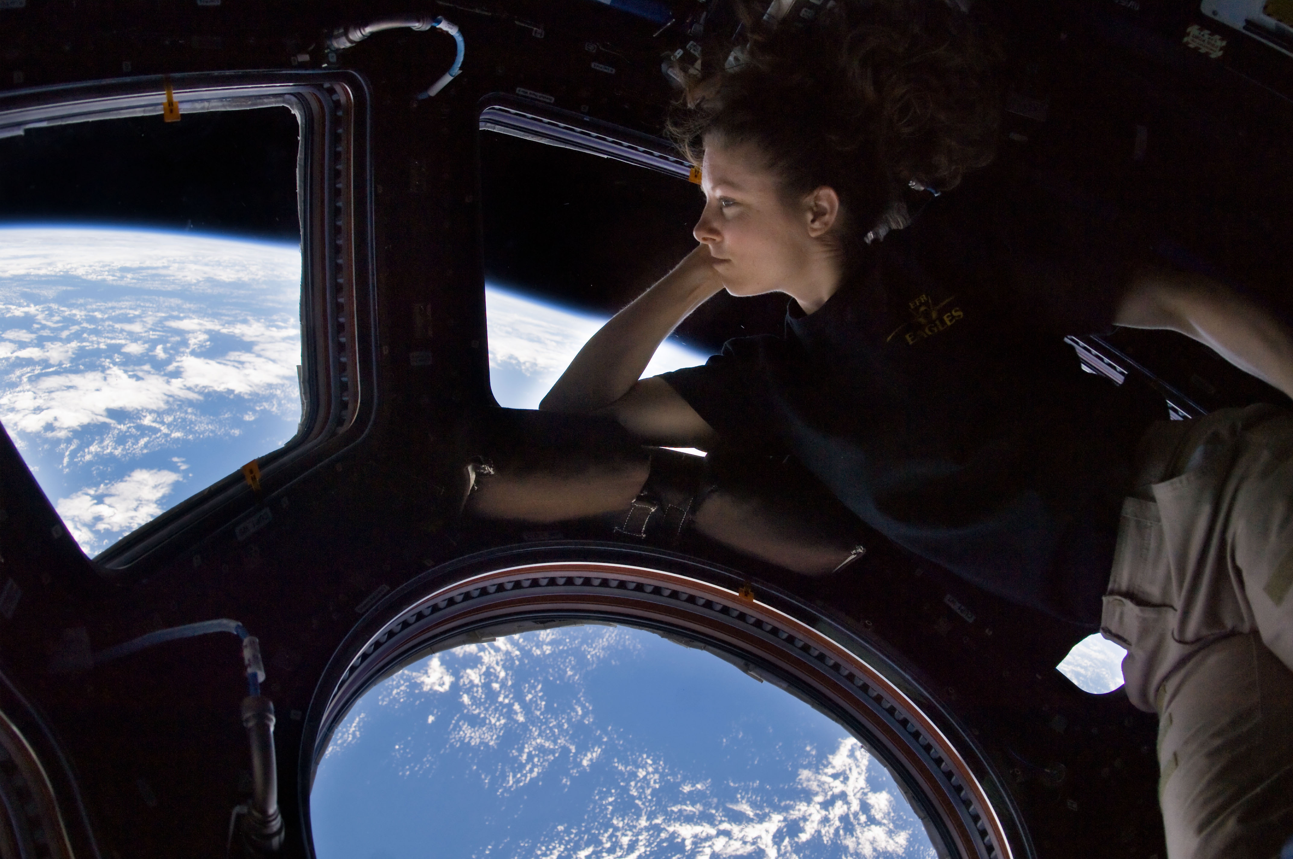
Living in Space

Slide 8
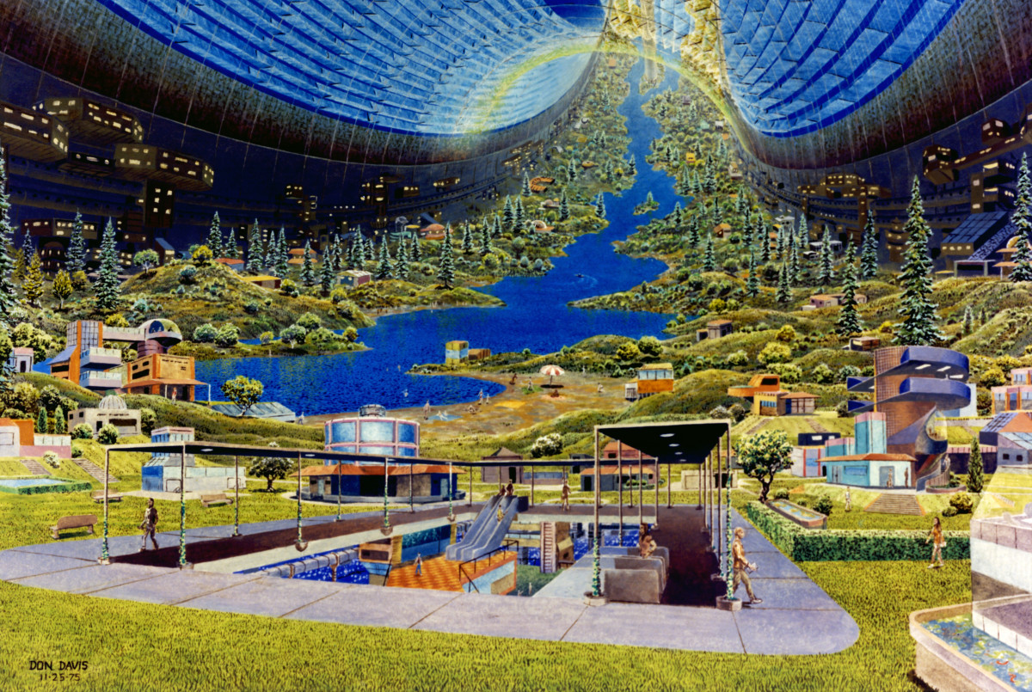
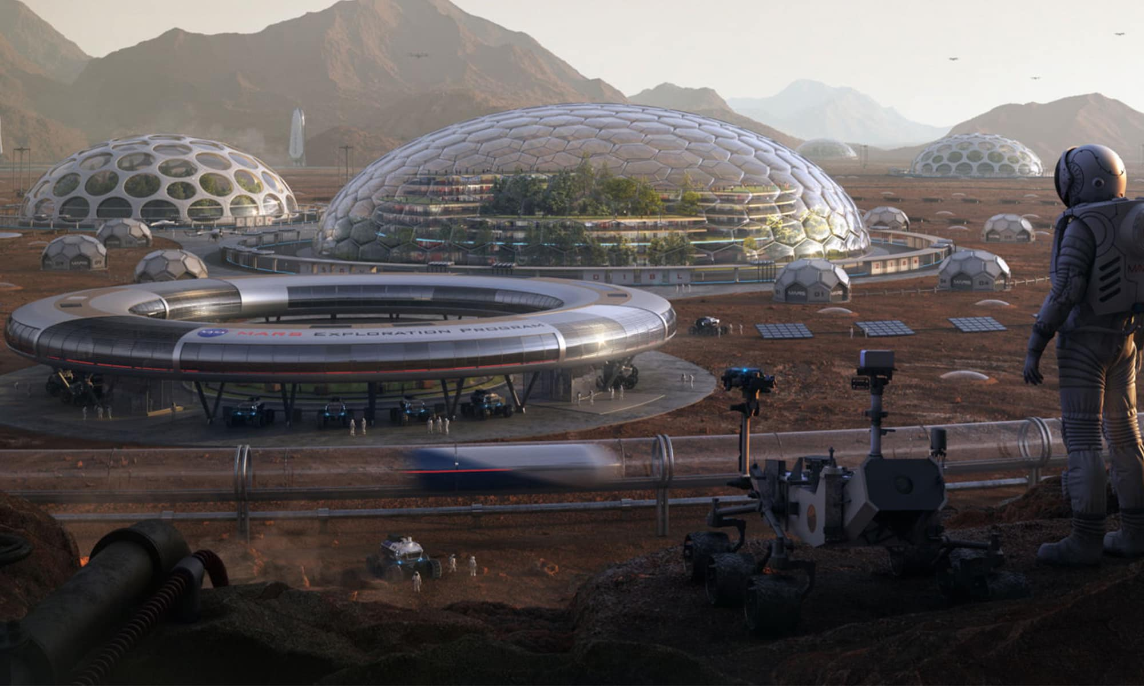
Space Colonies
People living long-term in space stations or on other planets
Plausibility:
  Possible, but difficult.
  Problems:
    Gravity
    Radiation
    Launch mass
    Air
    Water
    Food
    Etc.
NASA
Wikipedia/Spongy101010

Slide 9
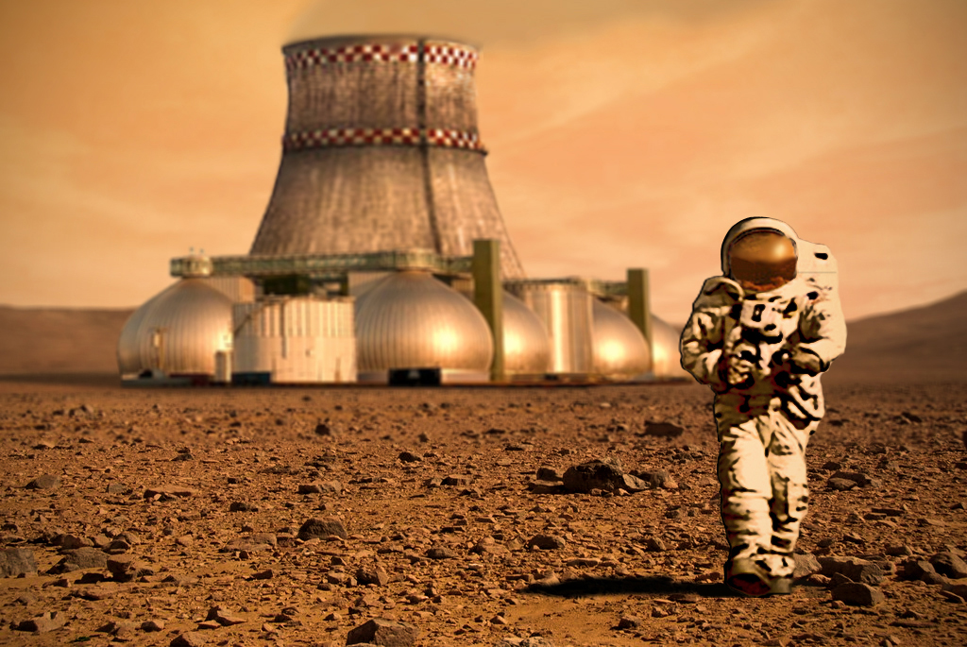
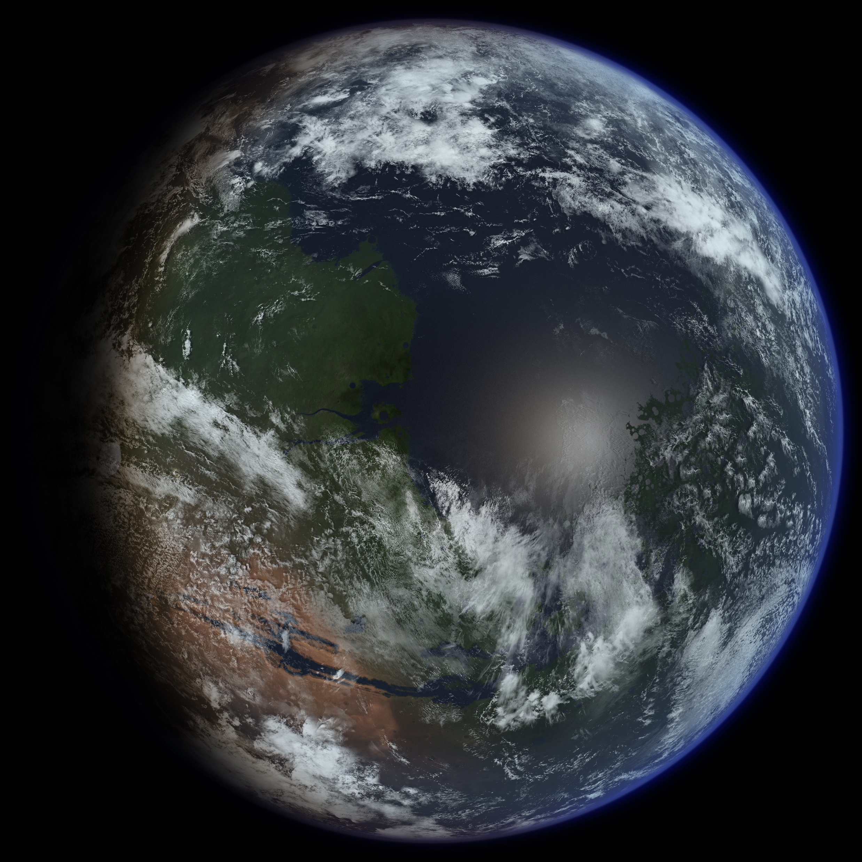
Terraforming
Making other planets more habitable for humans.
Plausibility:
  Very difficult.
  Mars and Venus are the main candidates.
  Things to change:
    Temperature: Reduce (Venus) / Increase (Mars)
    Atmospheric pressure: Reduce (Venus) / Increase (Mars)
    Add water
    Create magnetosphere
Wikipedia/D Mitriy
Wikipedia/Ittiz

Slide 10
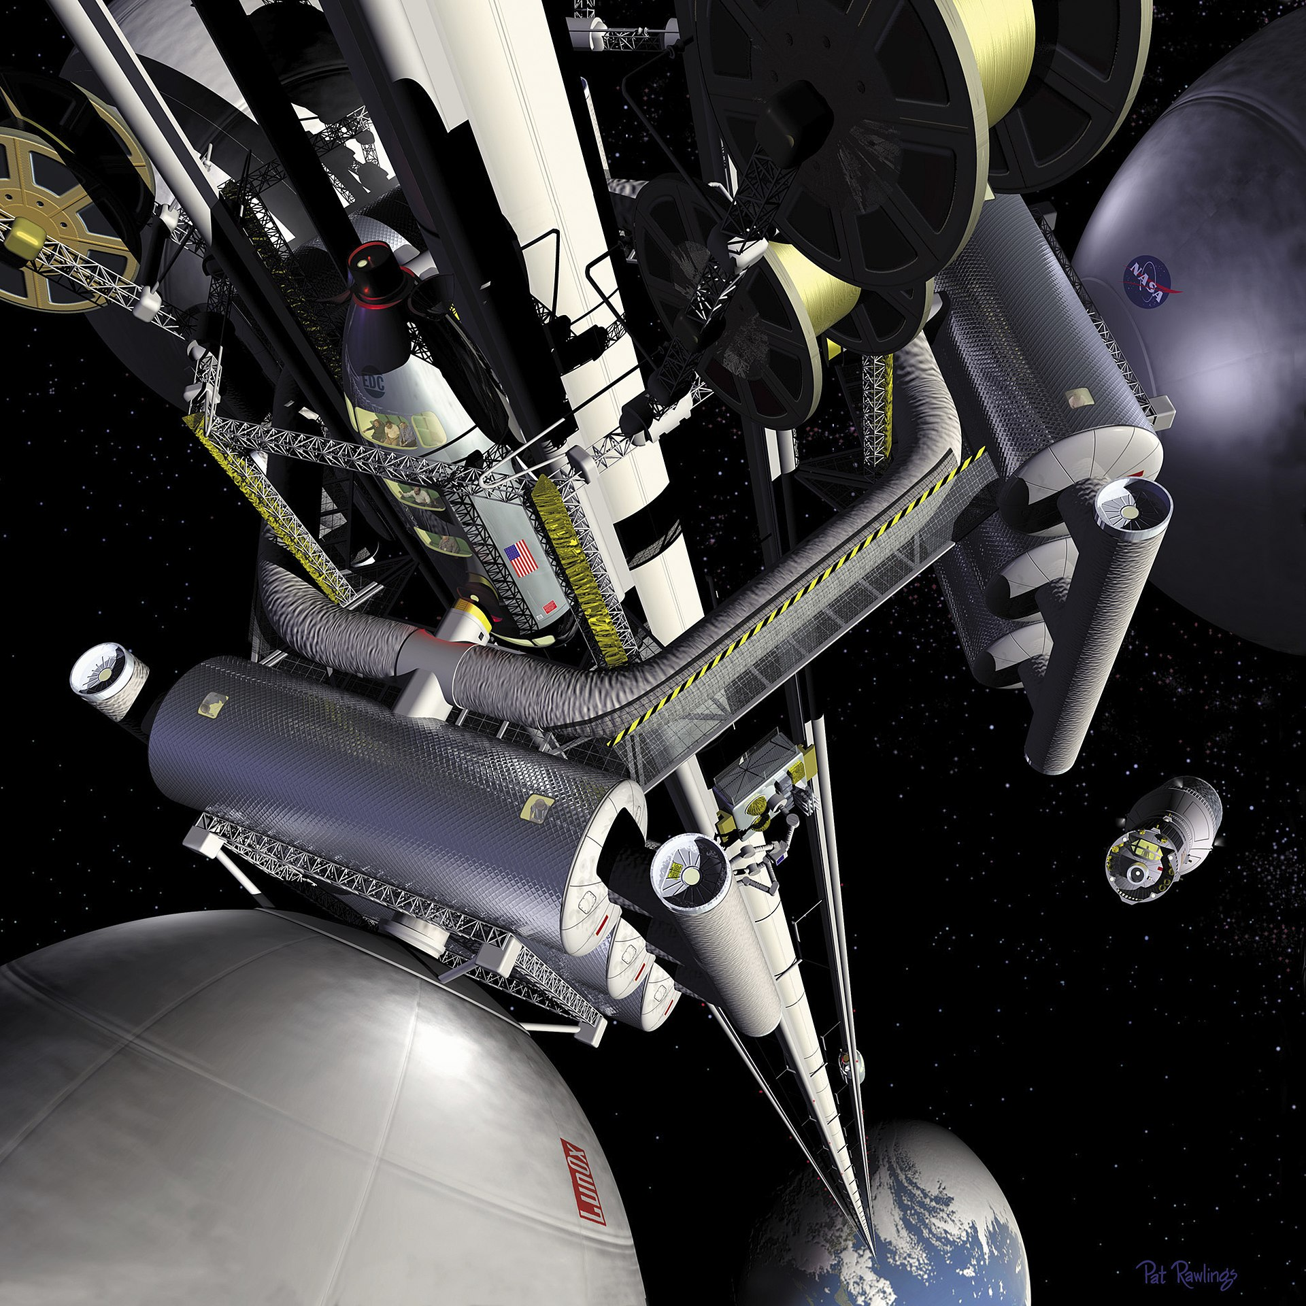
Space Elevator
A long cable from a planet’s surface to beyond geostationary orbit.
Plausibility:
  Theoretically possible, but we don’t know how to make a cable strong enough.
  Would be “easier” on bodies with lower gravity

Slide 11
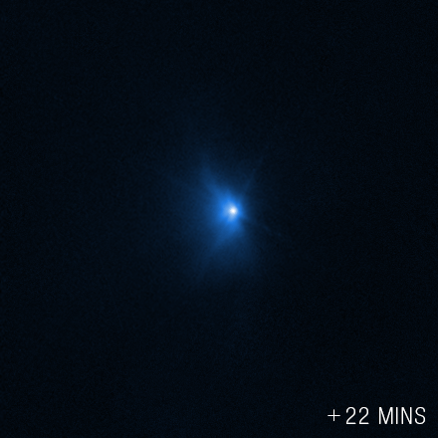
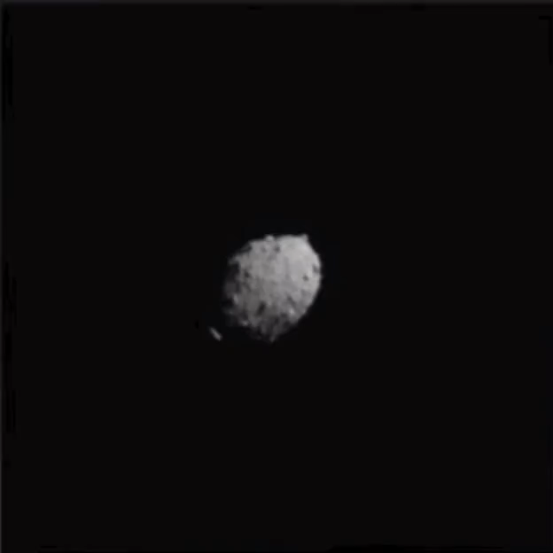
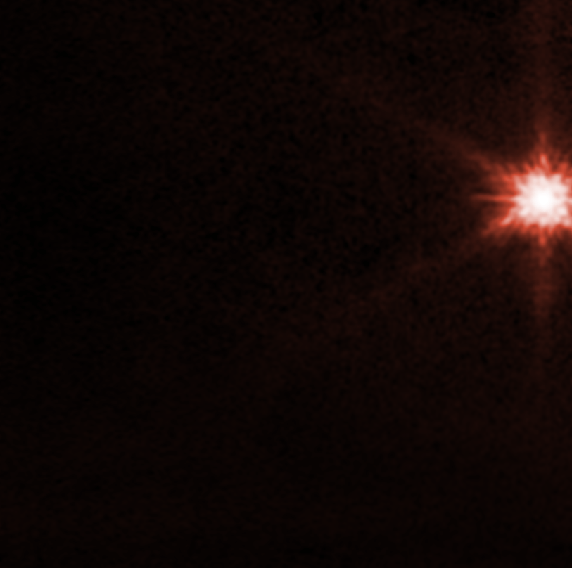
Diverting an Asteroid
Hubble
Changing an asteroid’s orbit to avoid (or hit) a planet.
Plausibility:
  Getting there, but lots to learn
  Recent NASA DART impact on Sept 26!
JWST
NASA/ESA/CSA/STScI

Slide 12
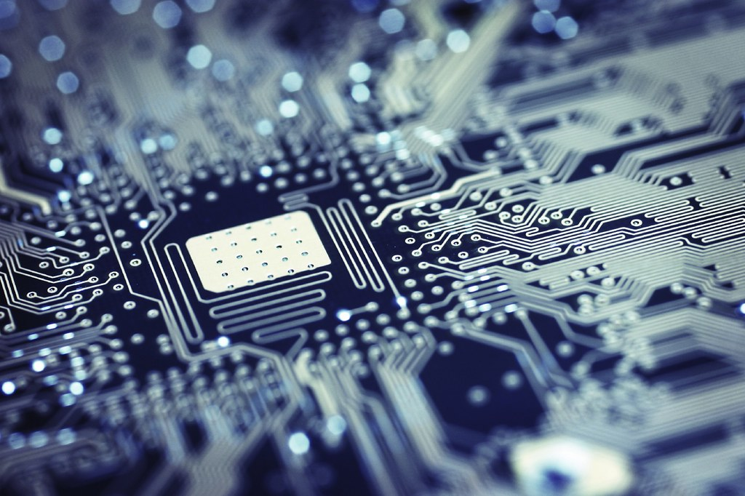
Future Technology
tec_estromberg

Slide 13
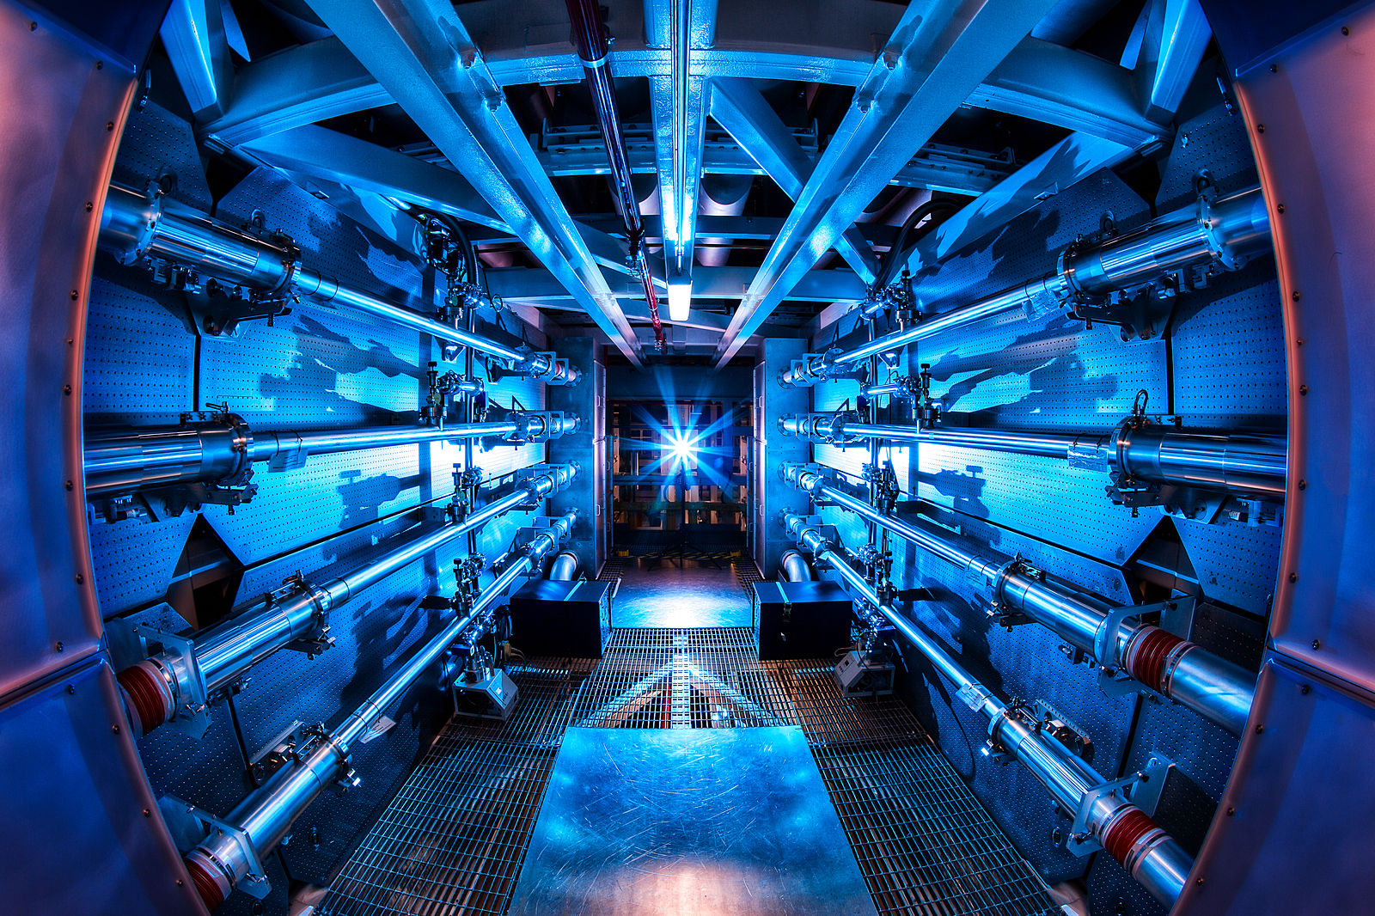
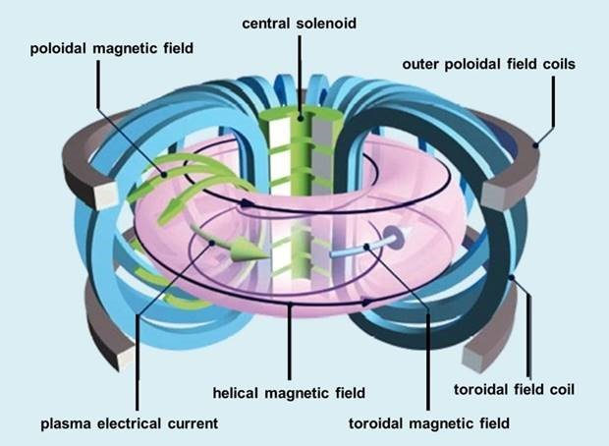
Fusion Power
Near-infinite clean energy by harnessing nuclear fusion.
Plausibility:
  We’re getting there!
  In 2021 the National Ignition Facility announced that it achieved “ignition”
  This month South Korea announced stable temperatures of 100 million K

Slide 14
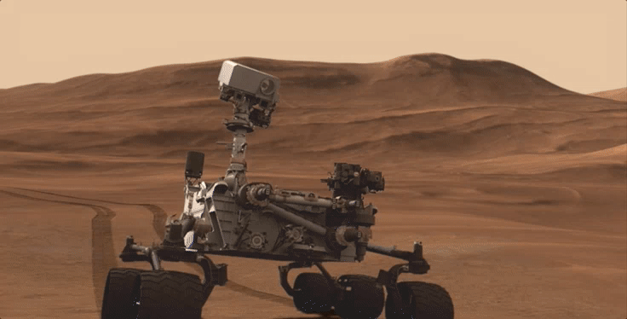
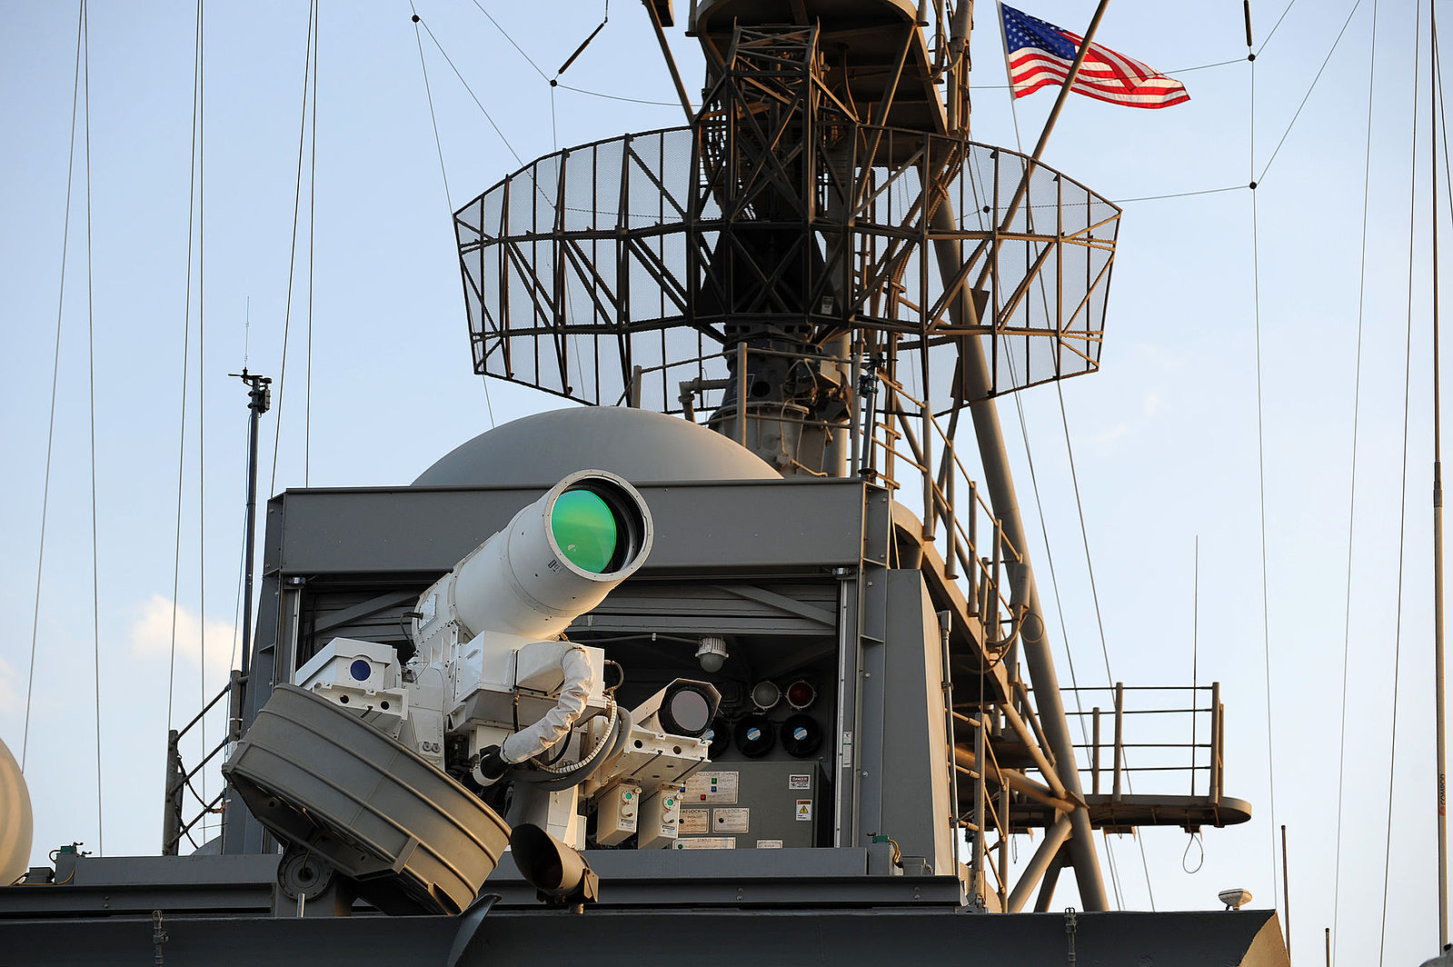
Energy Weapons
Weapons that shoot beams of energy rather than physical projectiles.
Plausibility:
  So-so
  Some large experimental lasers tested by the military for shooting down missiles, drones, etc.
    Challenges with keeping the laser focused over long distances in atmosphere
    High intensity can cause atmosphere to break down into a spark, absorbing laser energy

Slide 15
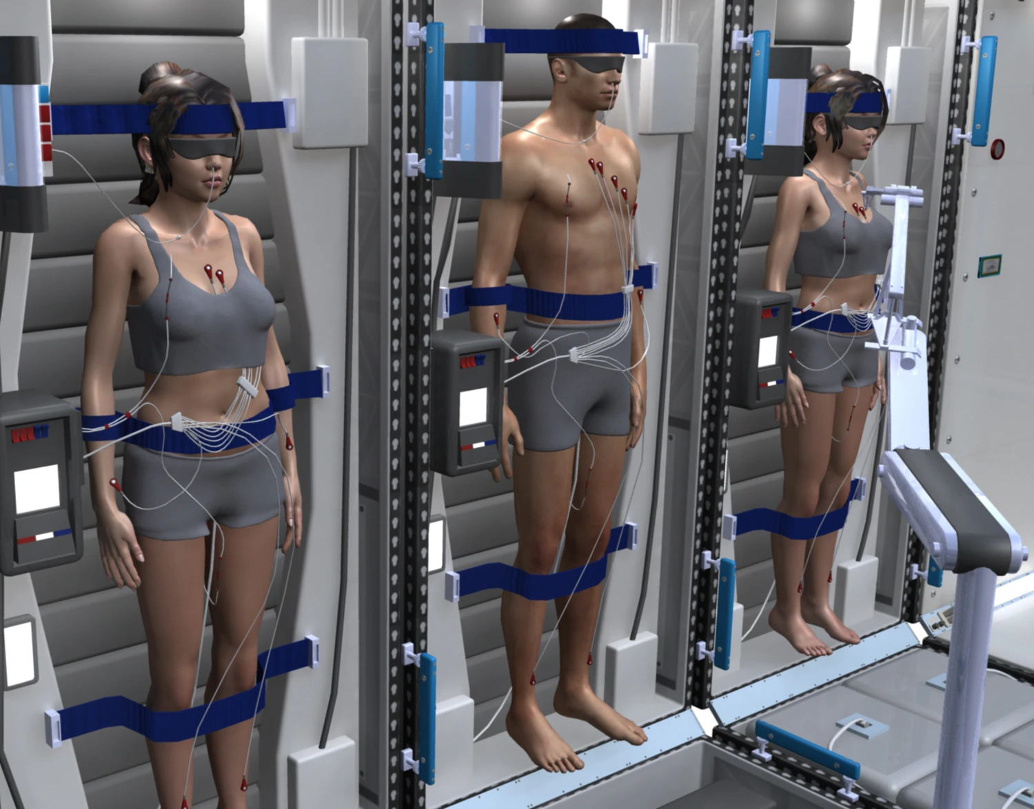
Hibernation/Cryosleep
Spaceship crew can hibernate during a long journey and wake up at the destination.
Plausibility:
  Some animals do it. Research ongoing in how to get humans to do it and survive…
  Actually freezing solid? Not so plausible
SpaceWorks

Slide 16
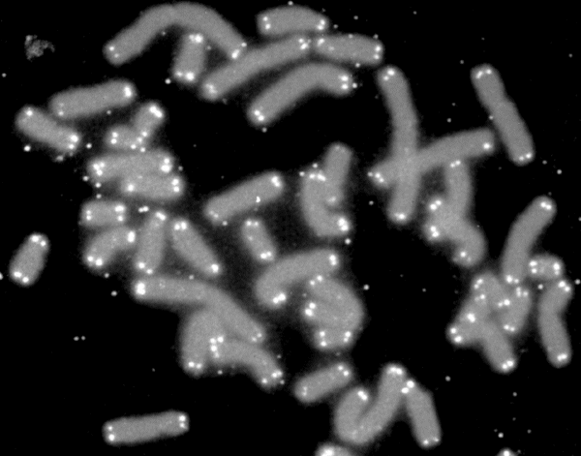
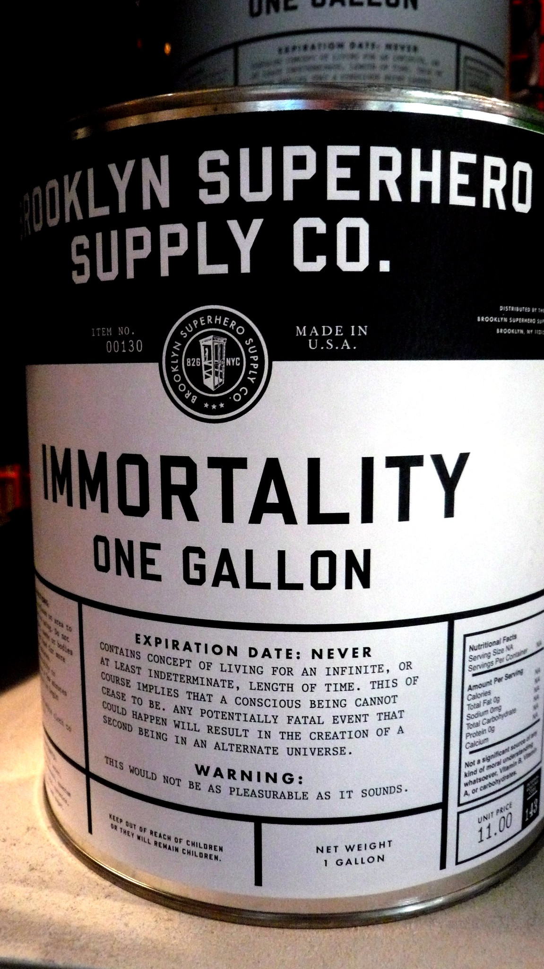
Immortality
The ability to live indefinitely without aging.
Plausibility:
  Unlikely
  Research into telomerase, but cancer is a problem.
  Nanotech? Seems a long way off
  Uploading your brain? Not possible any time soon
C. Doctorow

Slide 17
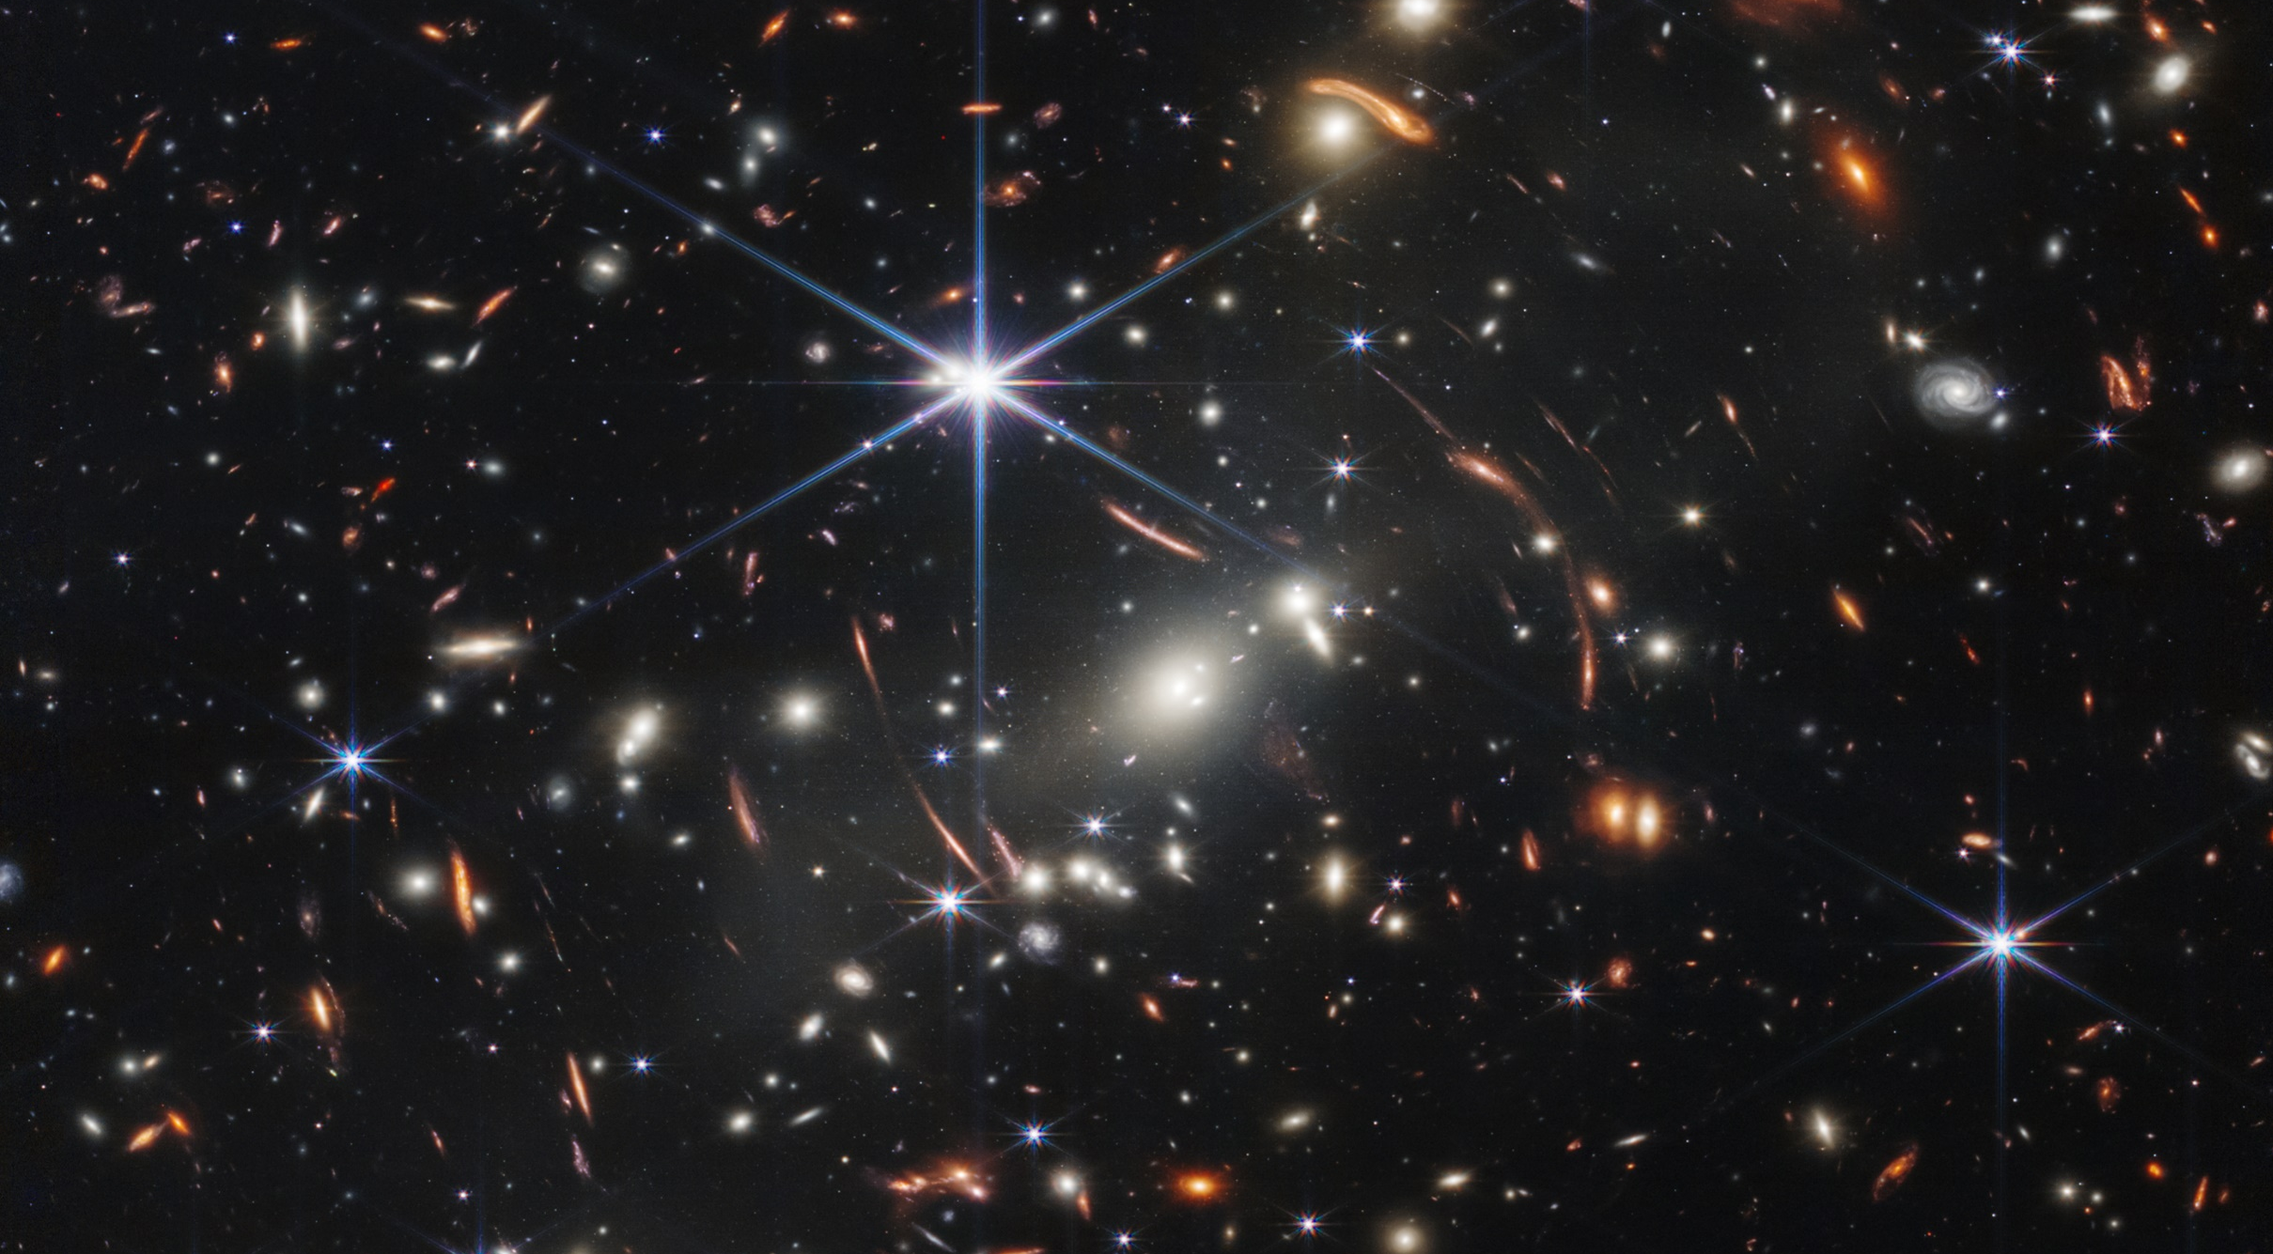
Are we alone?

Slide 18
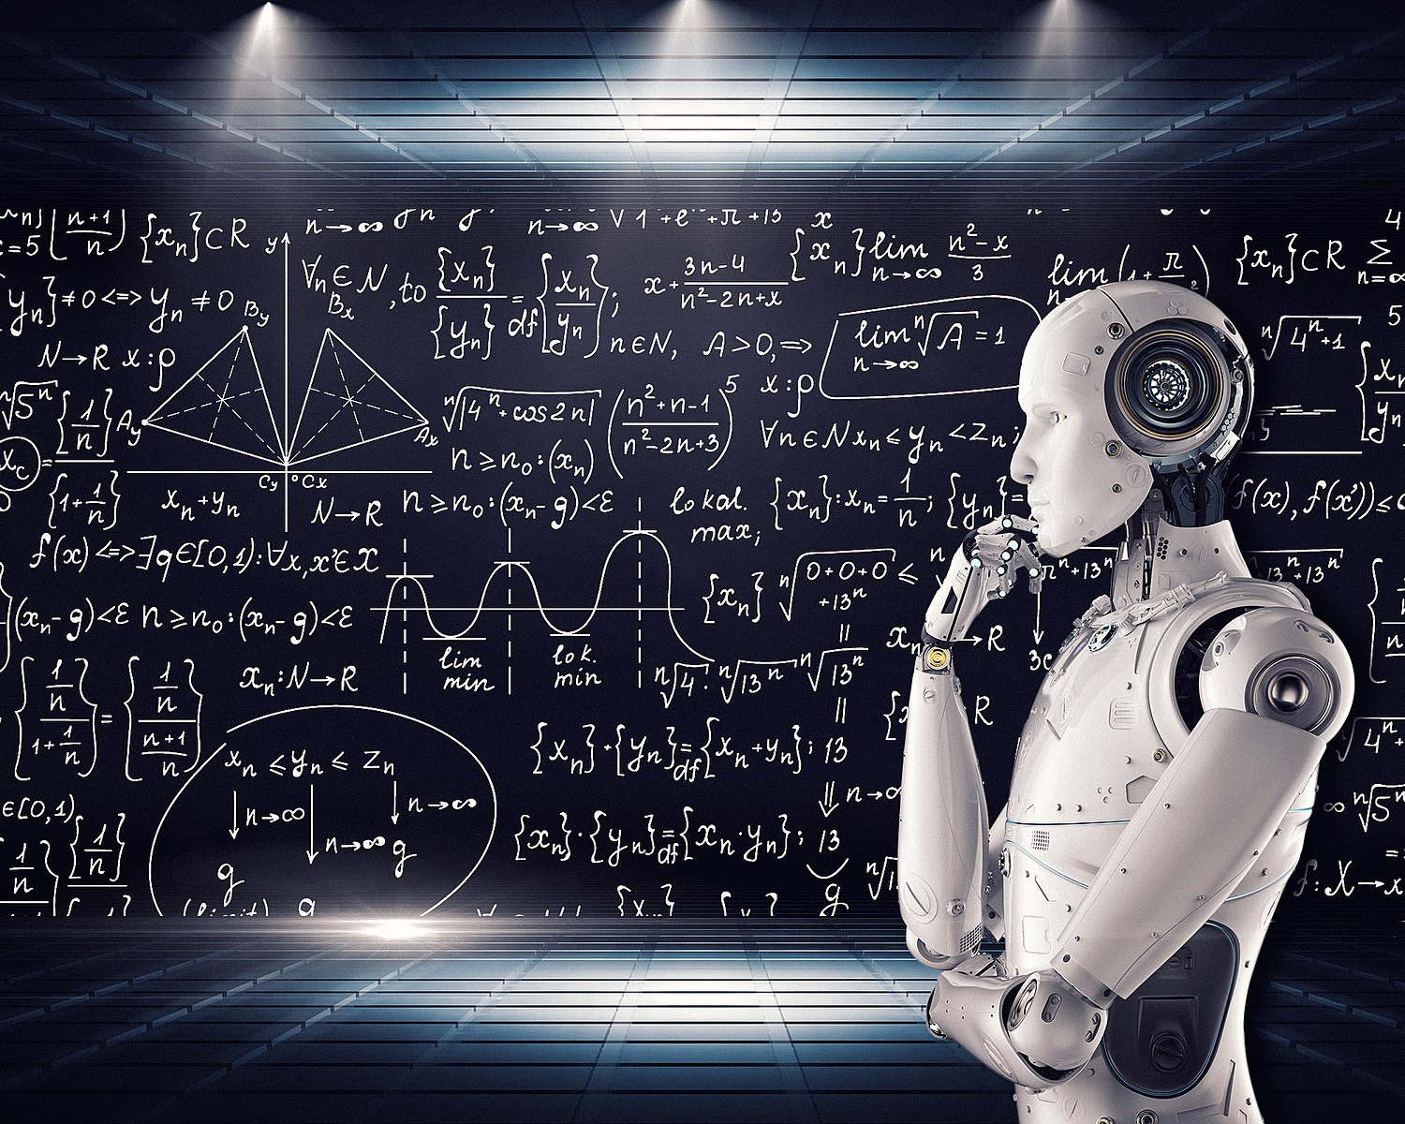
Artificial Intelligence
Computers that are sentient and/or intelligent
Plausibility:
  It depends…
  Most of what is called “AI” or “Machine Learning” is just statistics.
    Not “really” “thinking”, just solving math problems.
  Good for helping humans interpret complicated data, but it’s not going to think or be creative for you.
    “Garbage in, garbage out”
  Is it “intelligent” if you can’t tell the difference…?
Wikipedia / mikemacmarketing

Slide 19
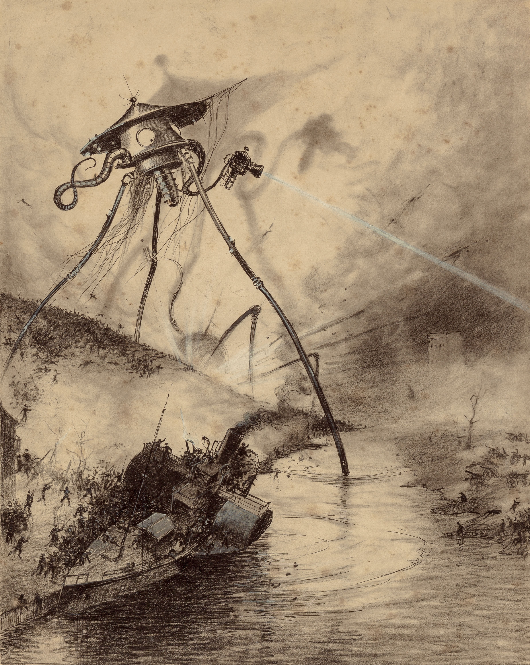
Aliens
Intelligent life that evolved somewhere other than Earth.
Plausibility:
  That it exists? ~100%
  That we will ever encounter them? ….low
  Space is bigger than you think.

Slide 20
Does scientific accuracy really matter?

Slide 21
Does scientific accuracy really matter?
Yes and no.
Scientific accuracy is not a proxy for quality.
  “Hard” sci-fi is not better than “soft” sci-fi (and the distinction is not particularly useful)
  You can have great realism but terrible writing, characters, etc.
  You can have almost total disregard for science but tell a great story.
My preference: Don’t “break the rules” unless the story requires it.
  Realism doesn’t have to hinder the story, it can drive it. Constraints make things more interesting. If anything goes, nothing is meaningful.
  Avoid misconceptions.

