Slide 1
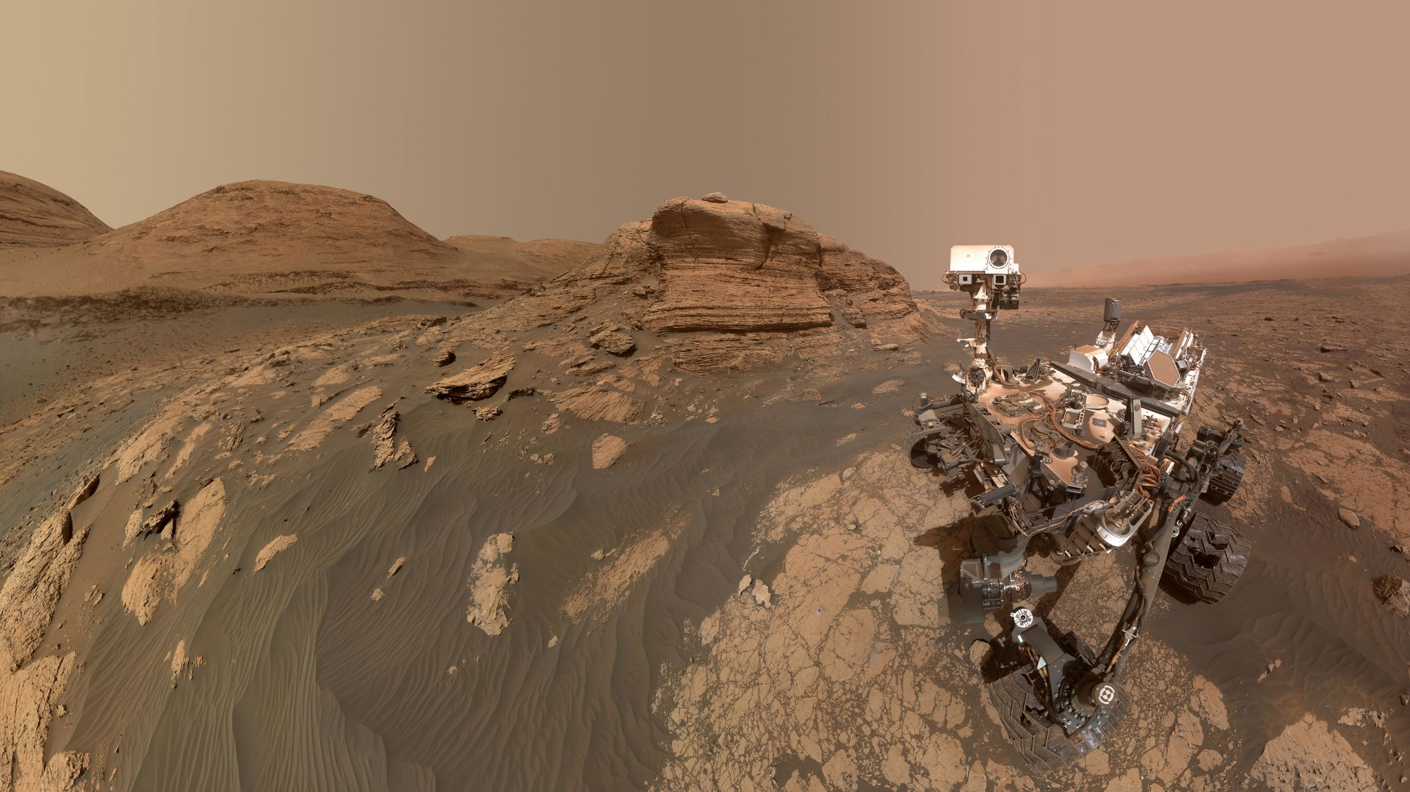
Exploring Mars with Robotics
Ryan Anderson
USGS Astrogeology
May 20, 2023
2023 Lunar Legacy Invitational

Slide 2
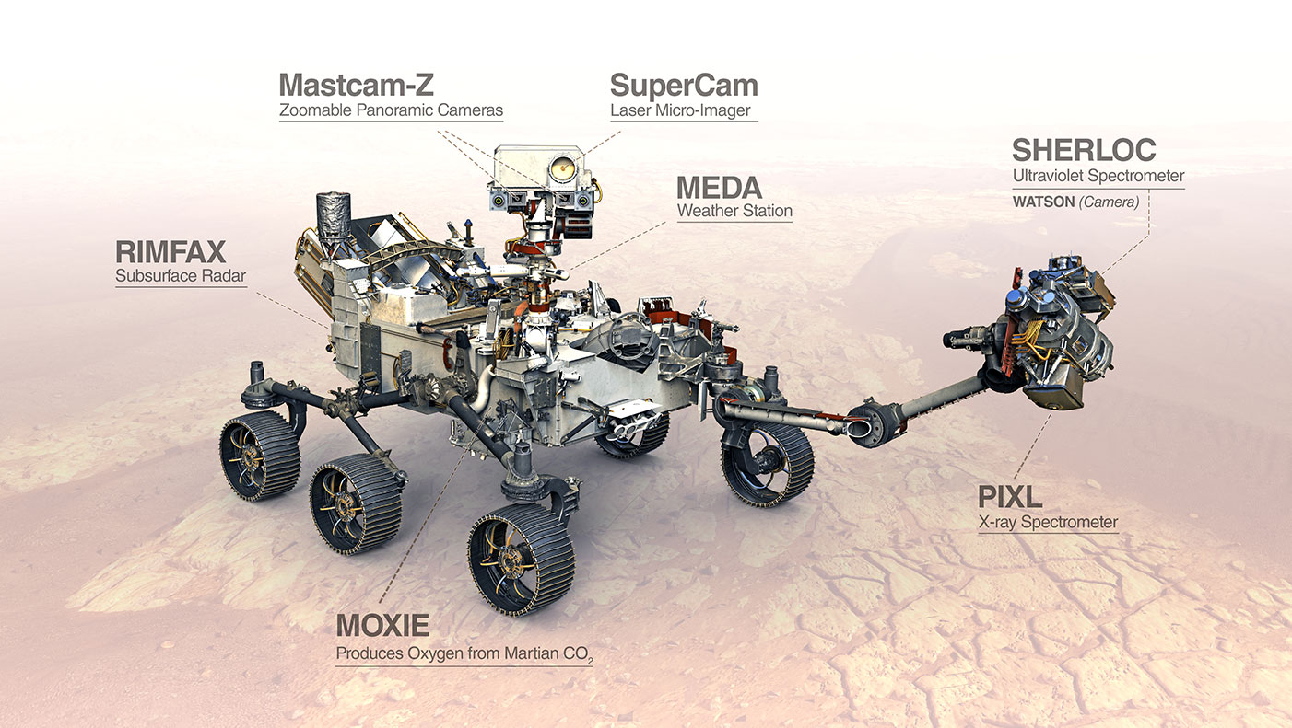



Sturdier wheels
23 cameras!
Helicopter
Primary goals:
Did life ever exist on Mars?
Select and cache rock/soil samples for potential return to Earth
Notes:
Wheels are thicker, 23 cameras total. Helicopter carried below belly

Slide 3
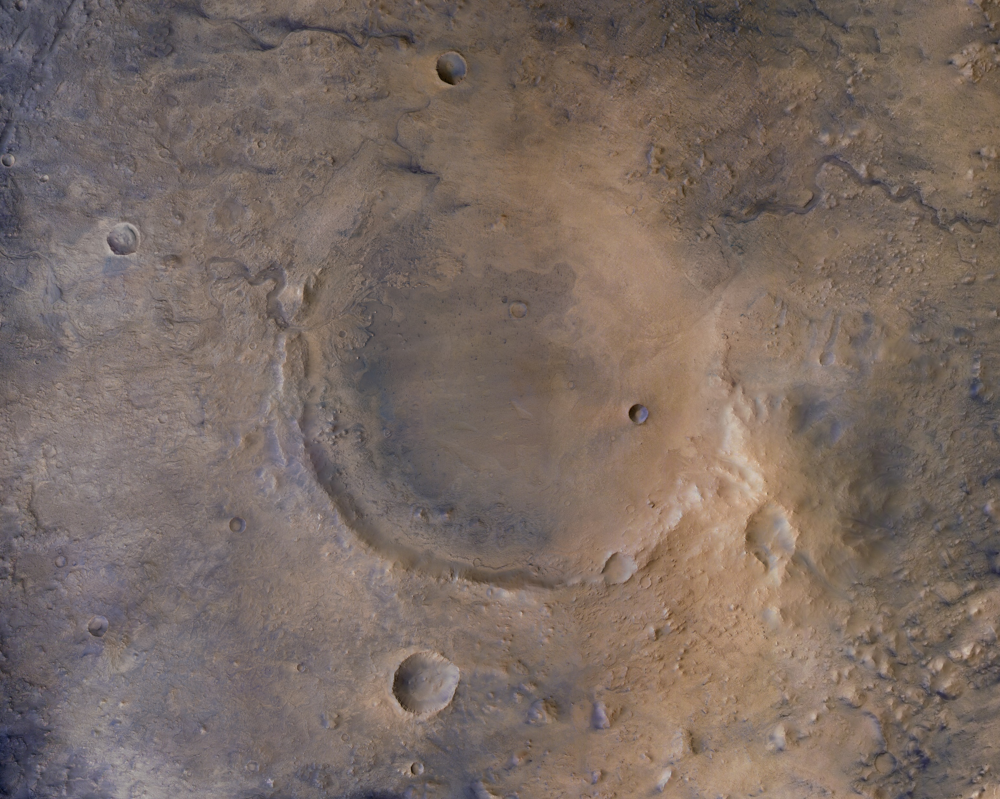

Slide 4
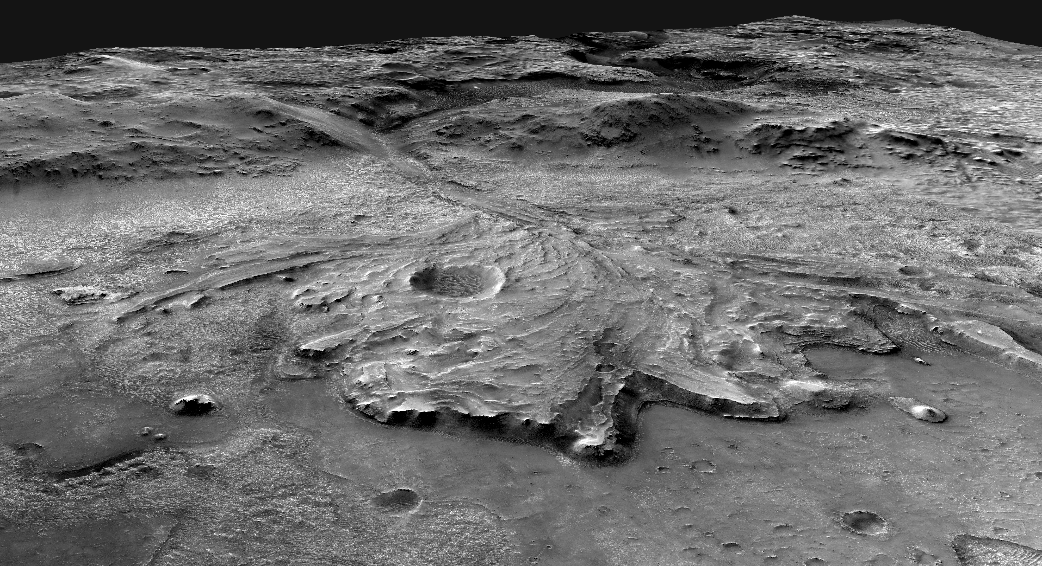

Slide 5
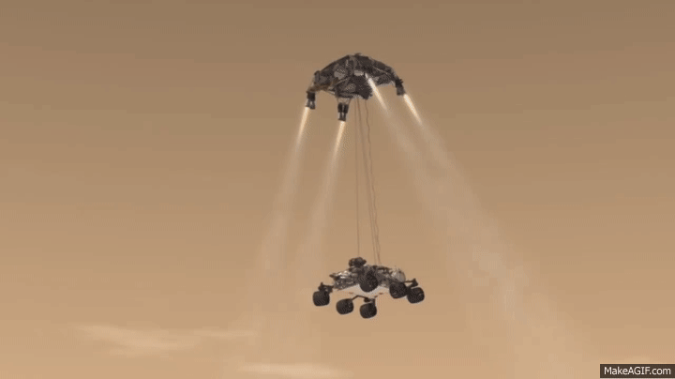
Notes:
First use of sky crane maneuver

Slide 6
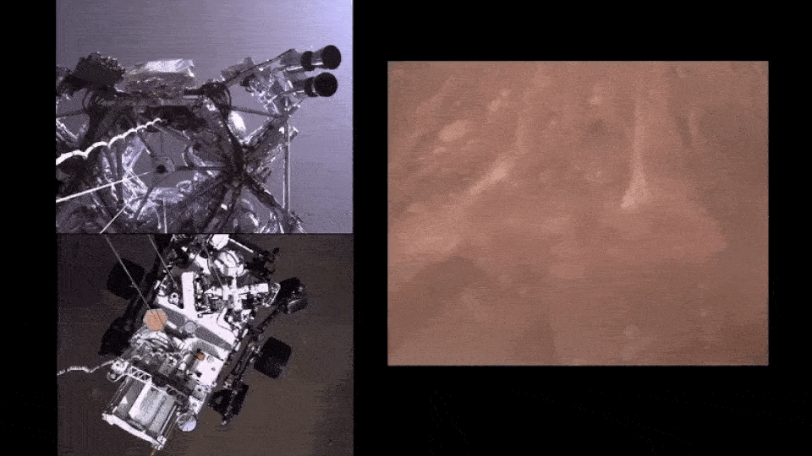

Slide 7
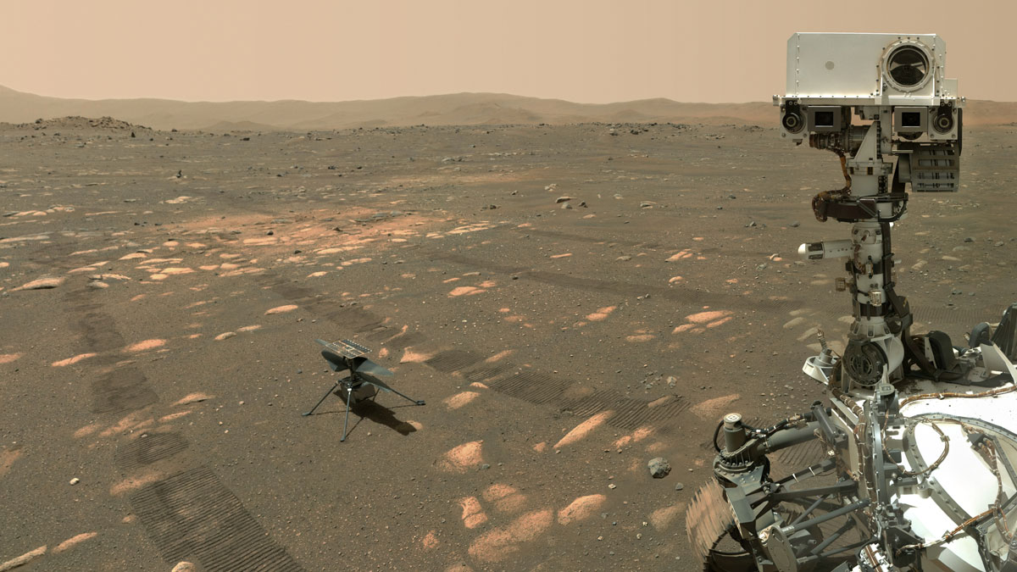
Ingenuity: the first Mars helicopter!

Slide 8
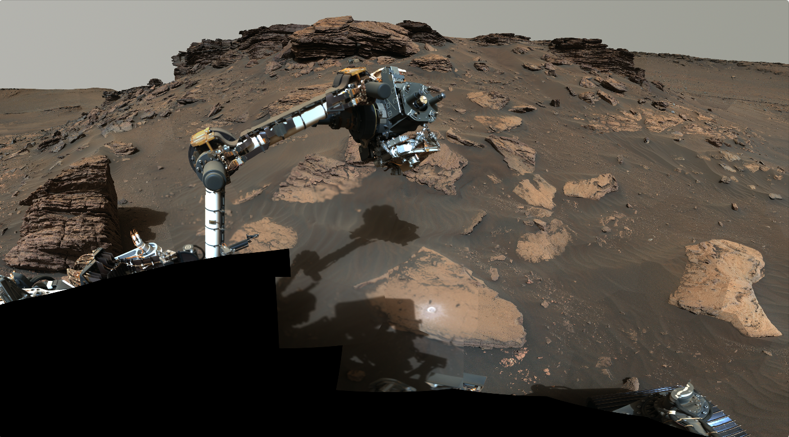
Robotic arm drills and collects samples

Slide 9
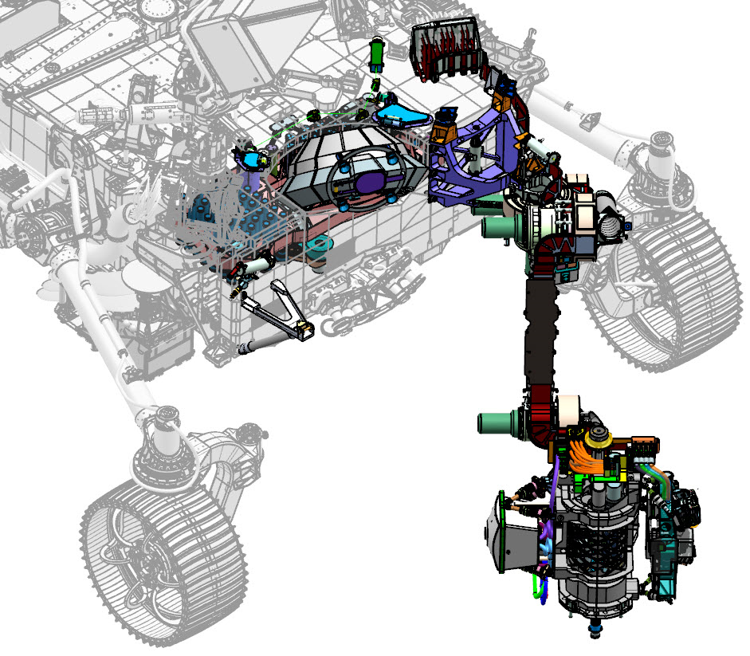
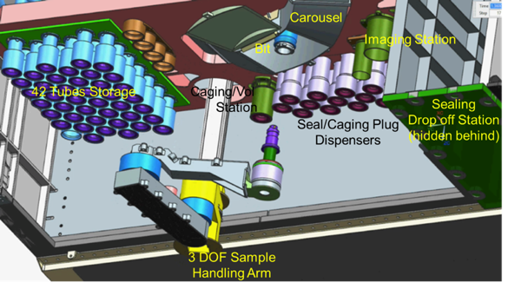
Mars 2020 Sampling & Caching Subsystem
Bit Carousel
(part of ACA)
Caching Assembly
Adaptive Caching Assembly (ACA)
(internal to Rover)
~ 42 sample tubes
Robotic Arm
Turret
Coring drill
SHERLOC / WATSON Instrument
PIXL Instrument
Image Credit: NASA/JPL-Caltech

Slide 10
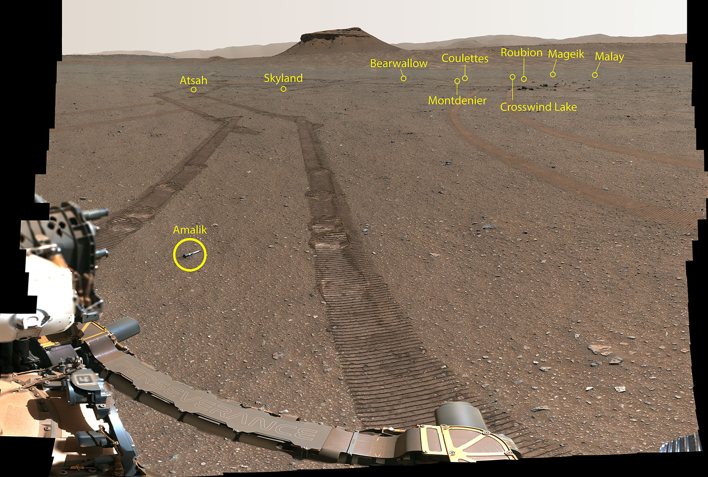
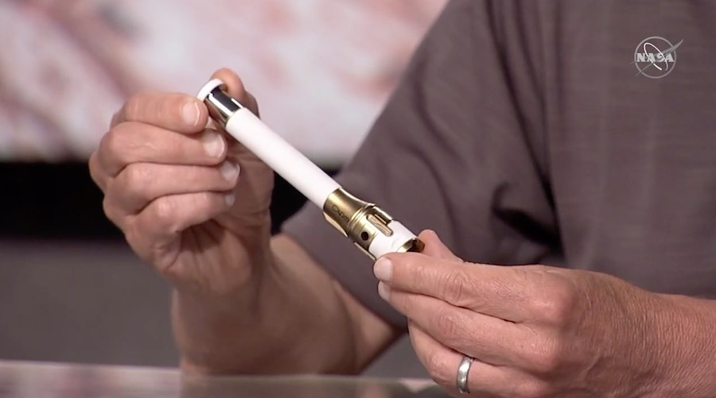
Sample Cache – Ready to Return to Earth

Slide 11
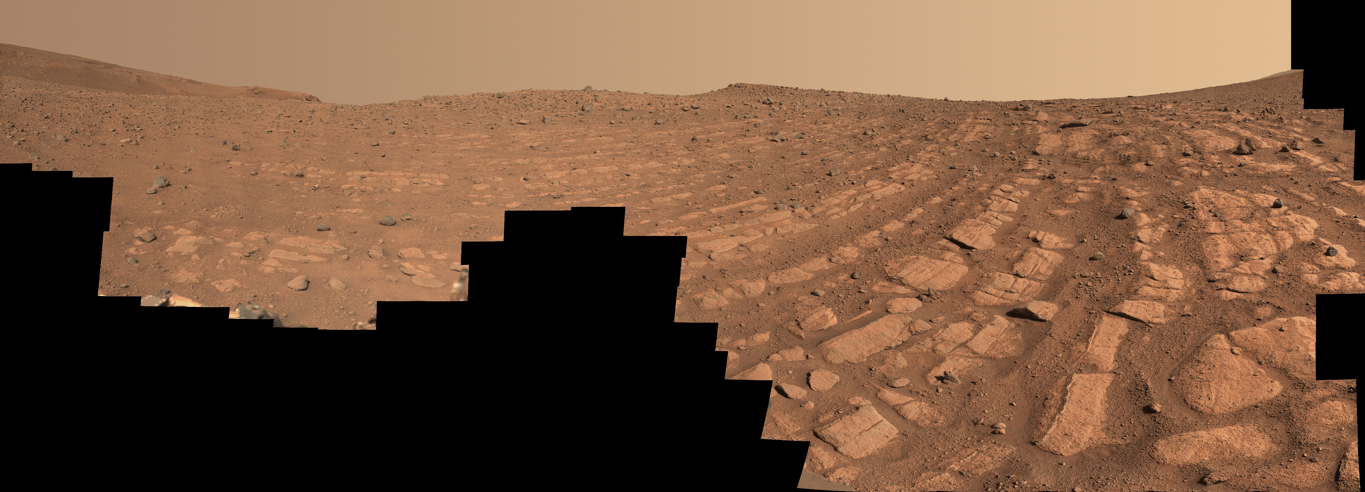
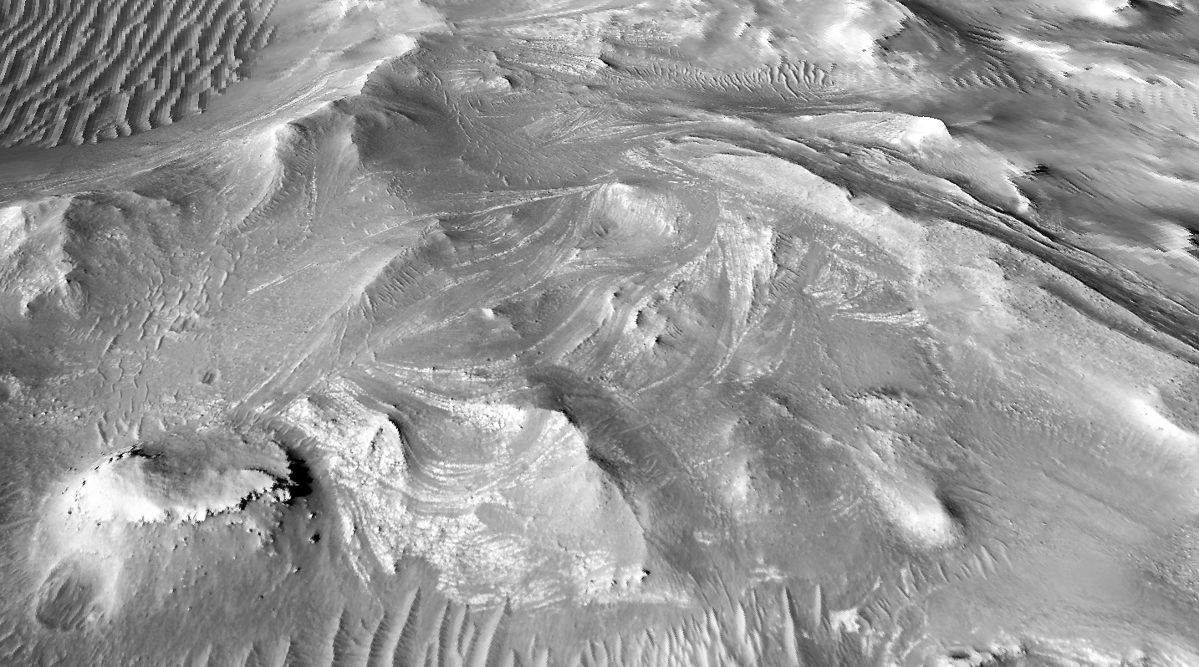
Curved layers formed by a river!
Satellite view

Slide 12
