Slide 1
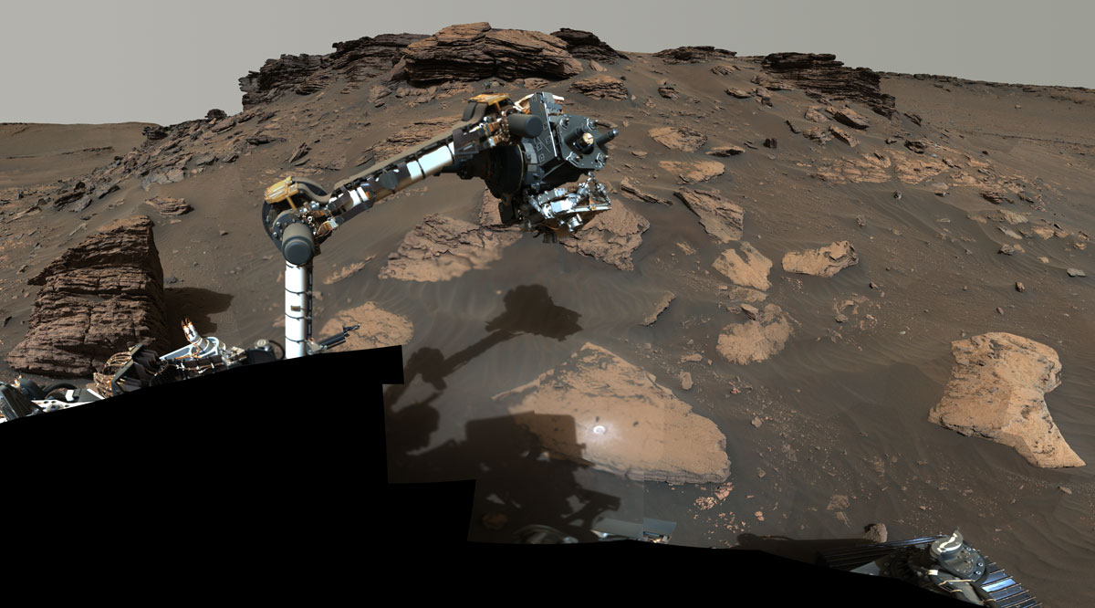
Current Events in the Solar System
Ryan Anderson
USGS Astrogeology Science Center
October 17, 2022

Slide 2
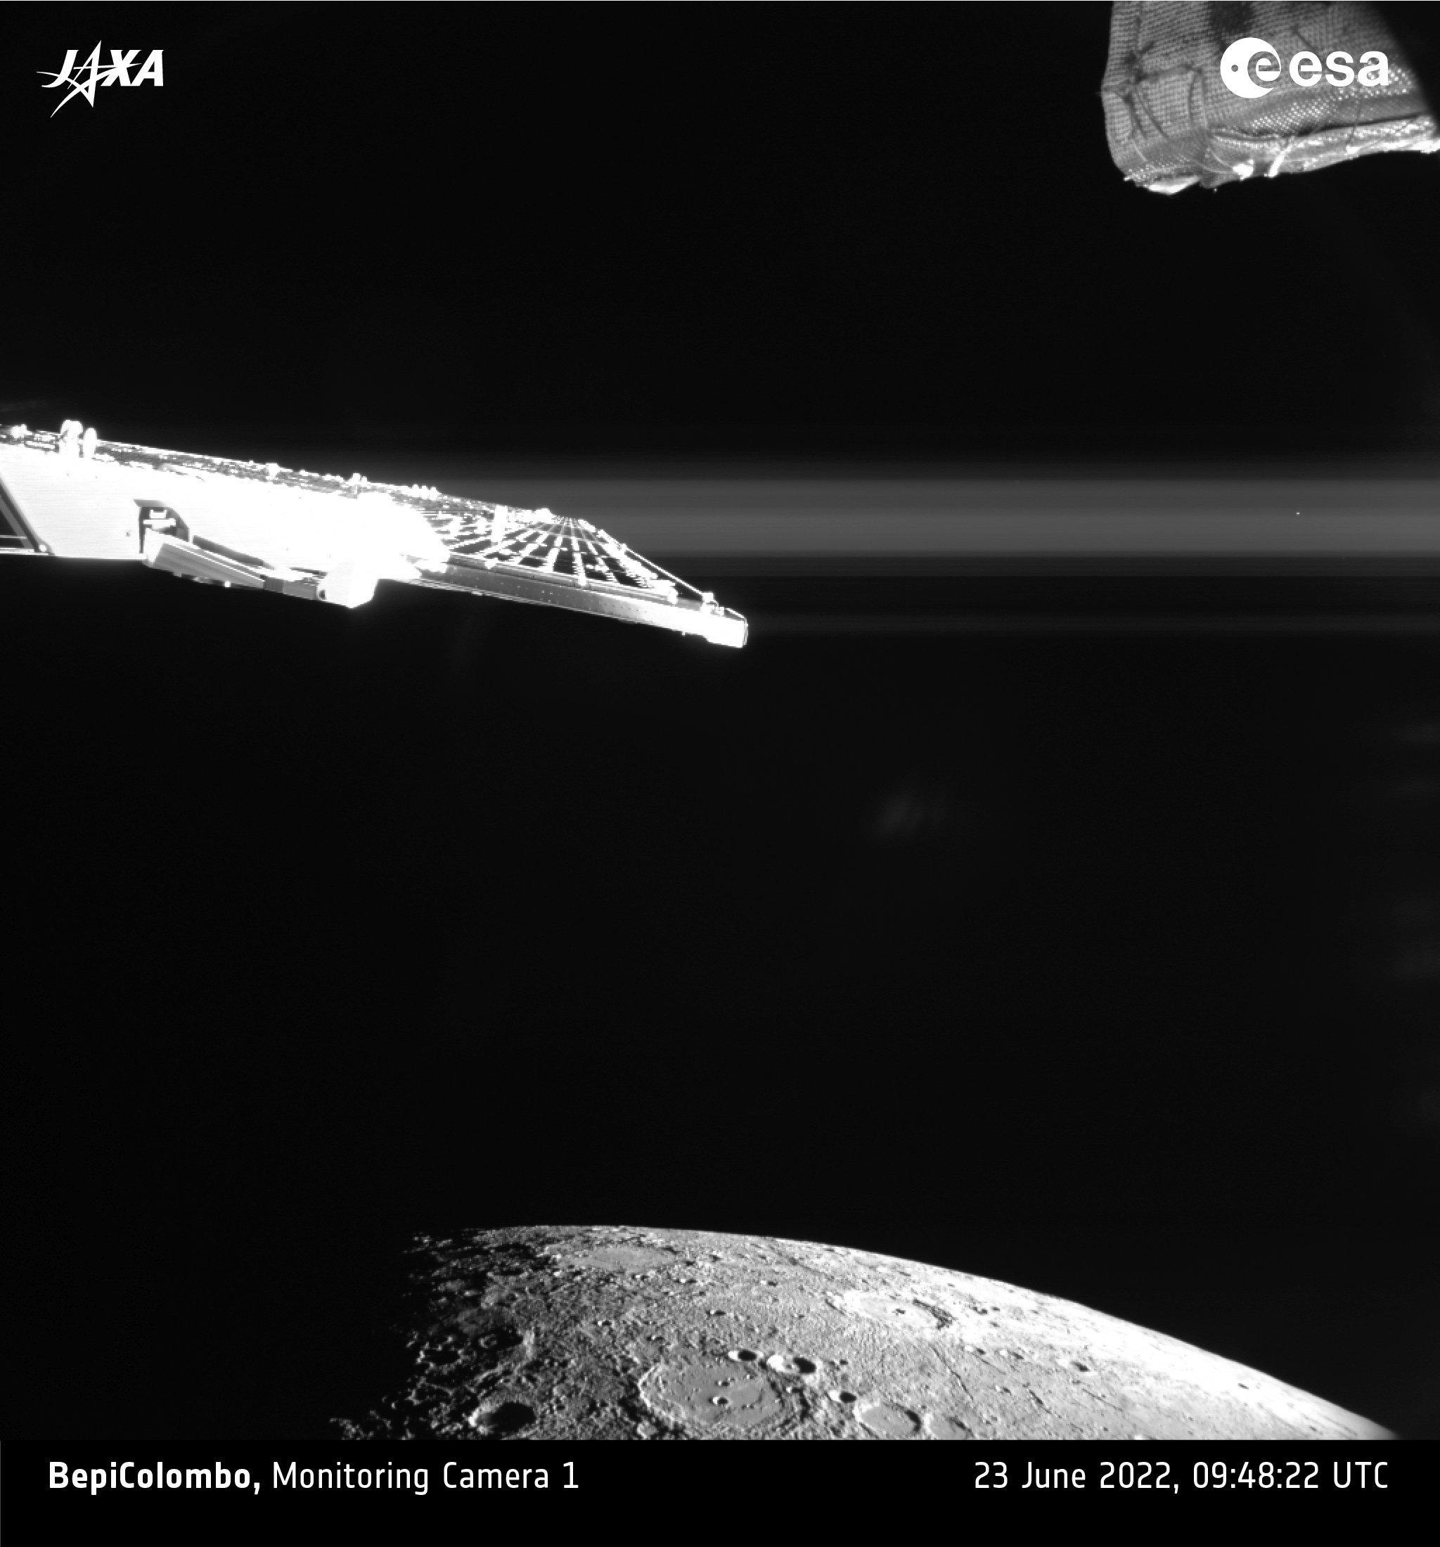
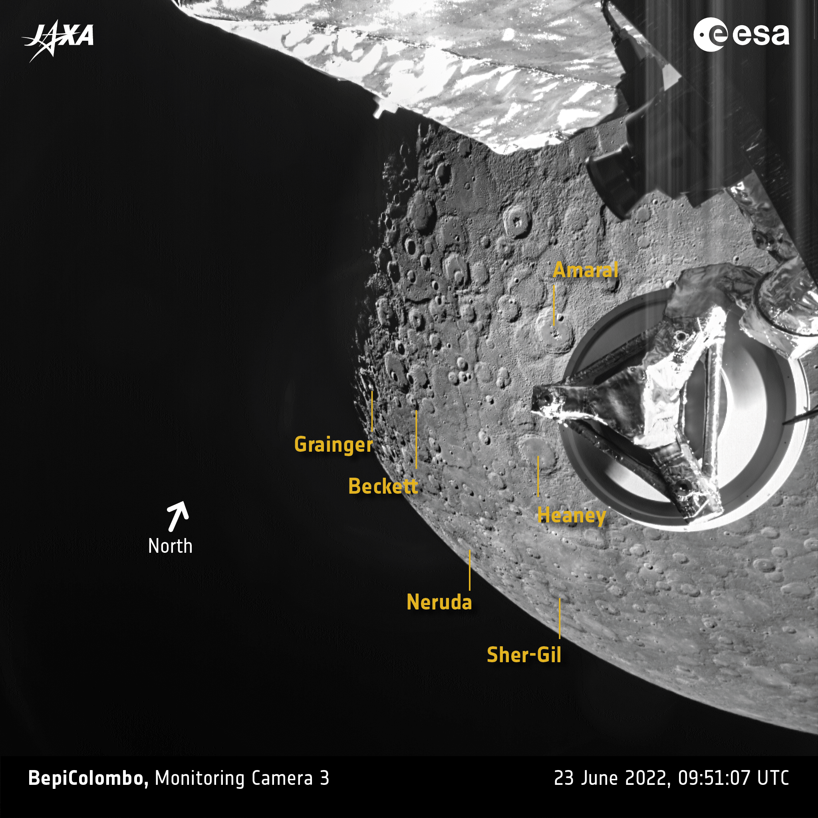

Slide 3
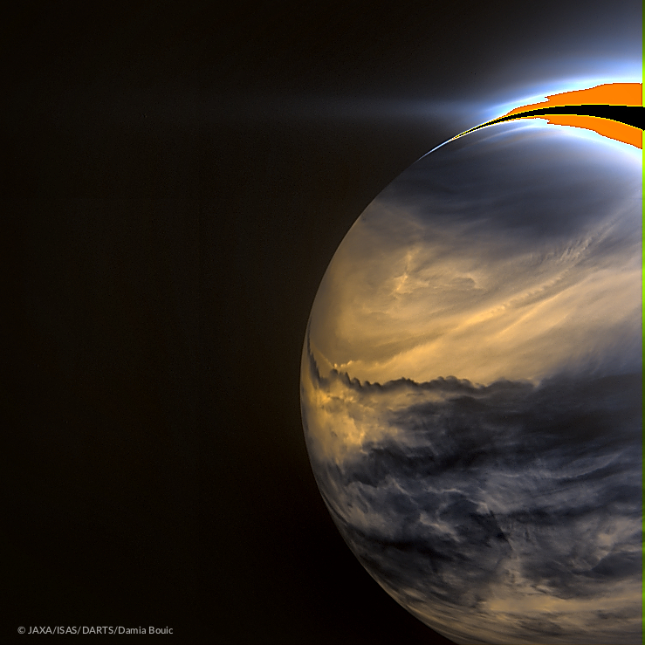
Venus night side in infrared as seen by Akatsuki
Two NASA missions to Venus will launch around 2030:
DAVINCI+ (Deep Atmosphere Venus Investigation of Noble gases, Chemistry, and Imaging)
VERITAS (Venus Emissivity, Radio Science, InSAR, Topography, and Spectroscopy)

Slide 4
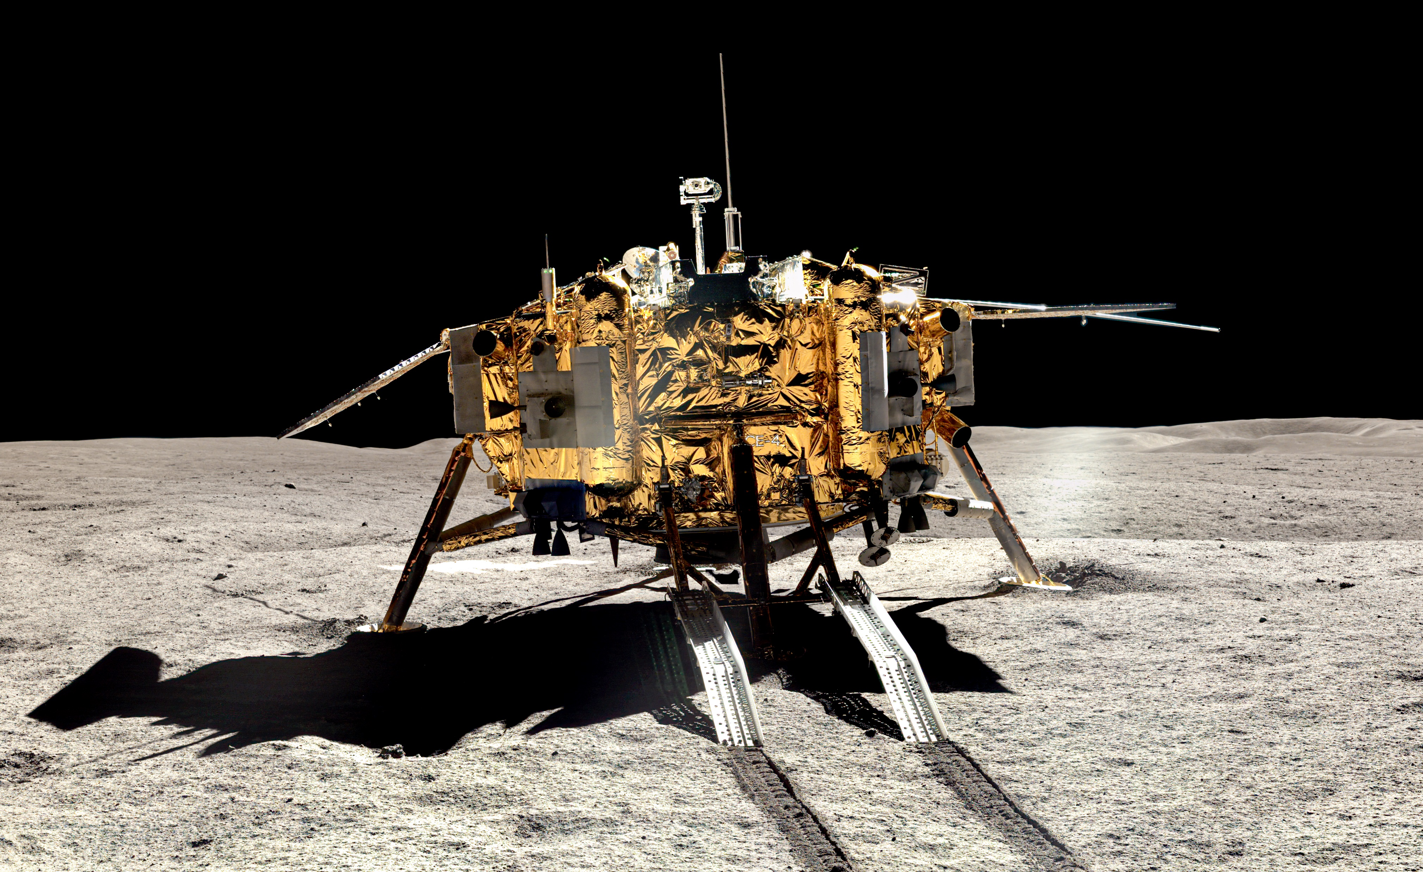
Chang’e 4 landed in January 2019
CSNA/Siyu Zhang/Kevin M. Gill

Slide 5
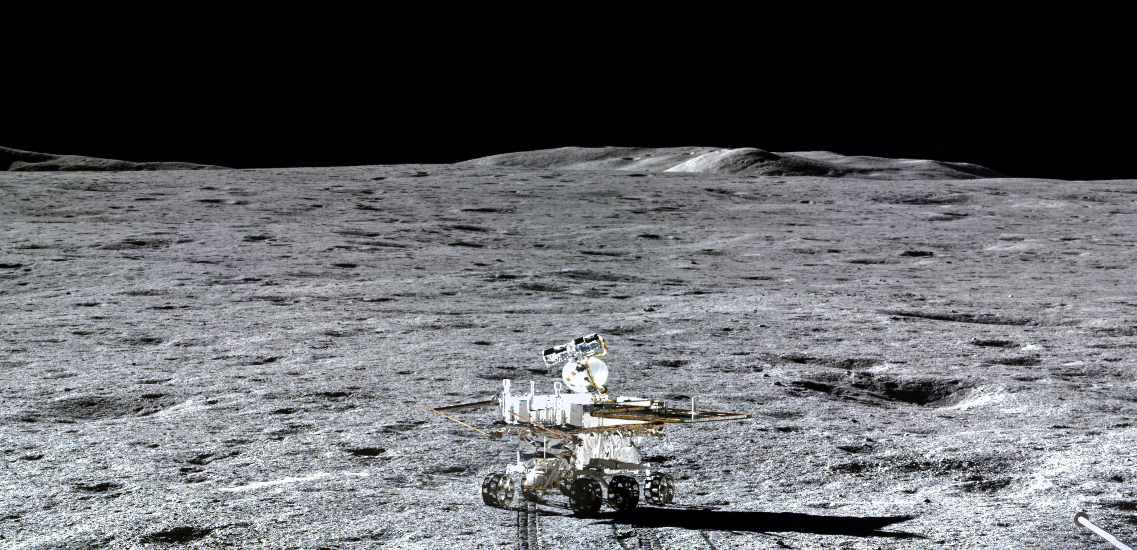
Yutu rover
CSNA/Siyu Zhang/Kevin M. Gill

Slide 6
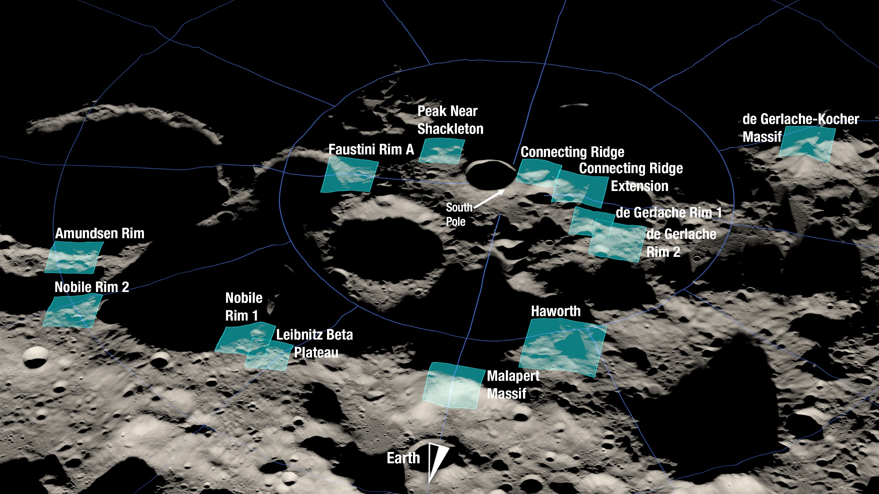
Artemis landing sites near lunar south pole

Slide 7
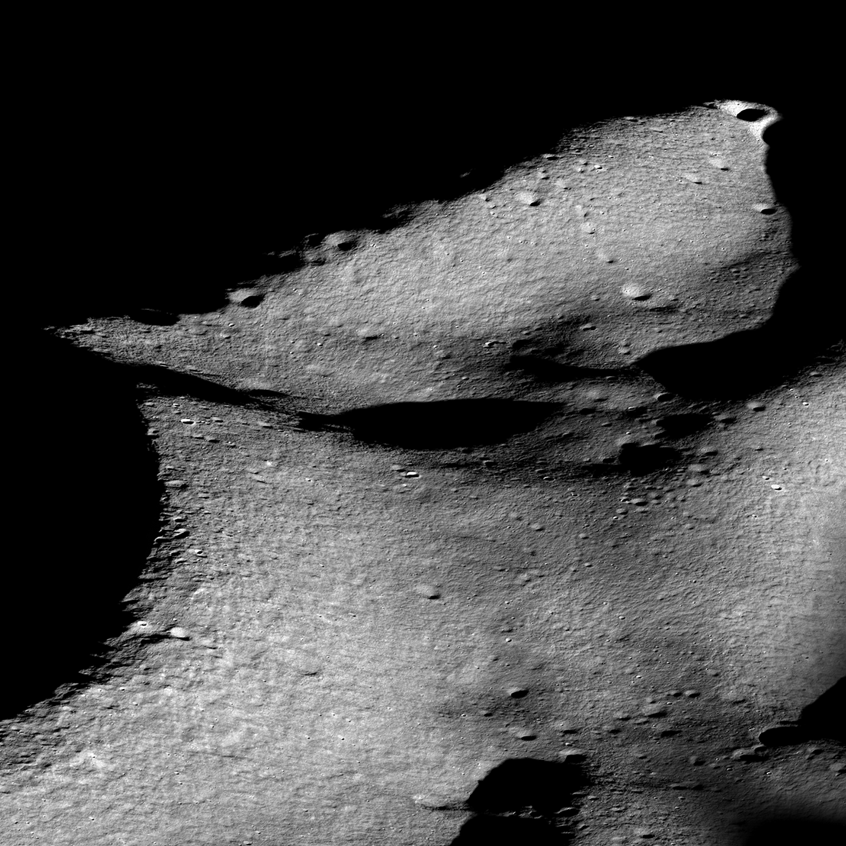
LROC image of lunar south pole and Shackleton crater
NASA/GSFC/ASU

Slide 8
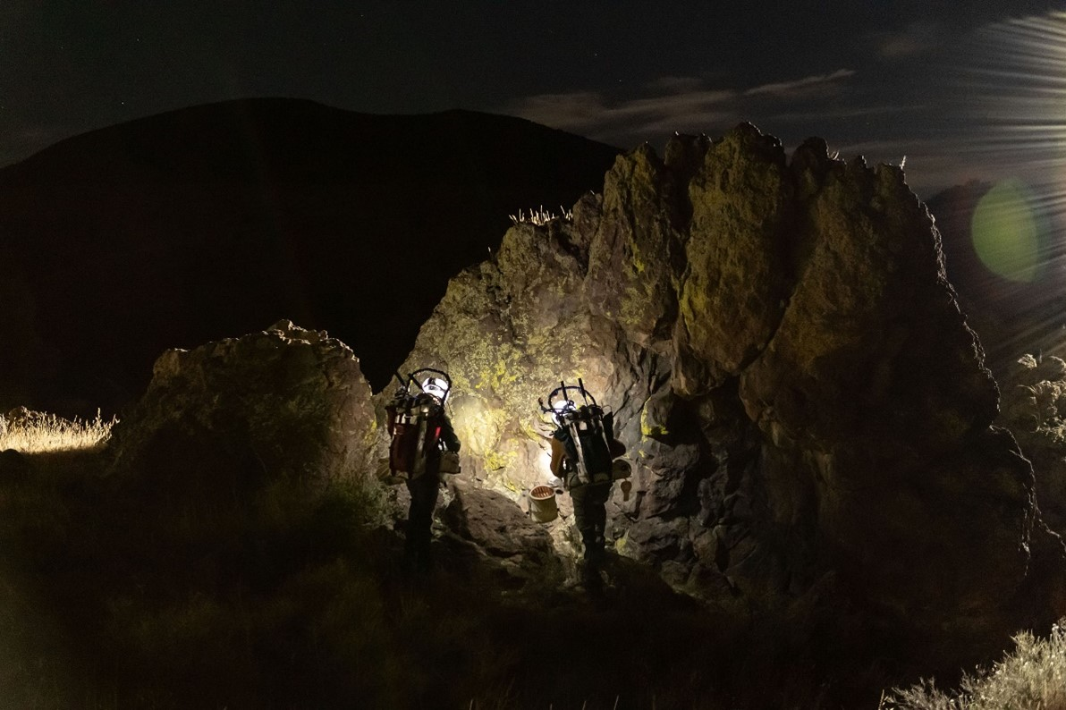
NASA is working with USGS and Babbitt Ranches this month to test space suits and rovers near Flagstaff.
NASA suited subjects during a 2021 test run making field observations in a simulated shadowed region in northern Arizona. (image credit: NASA Johnson Space Center)

Slide 9
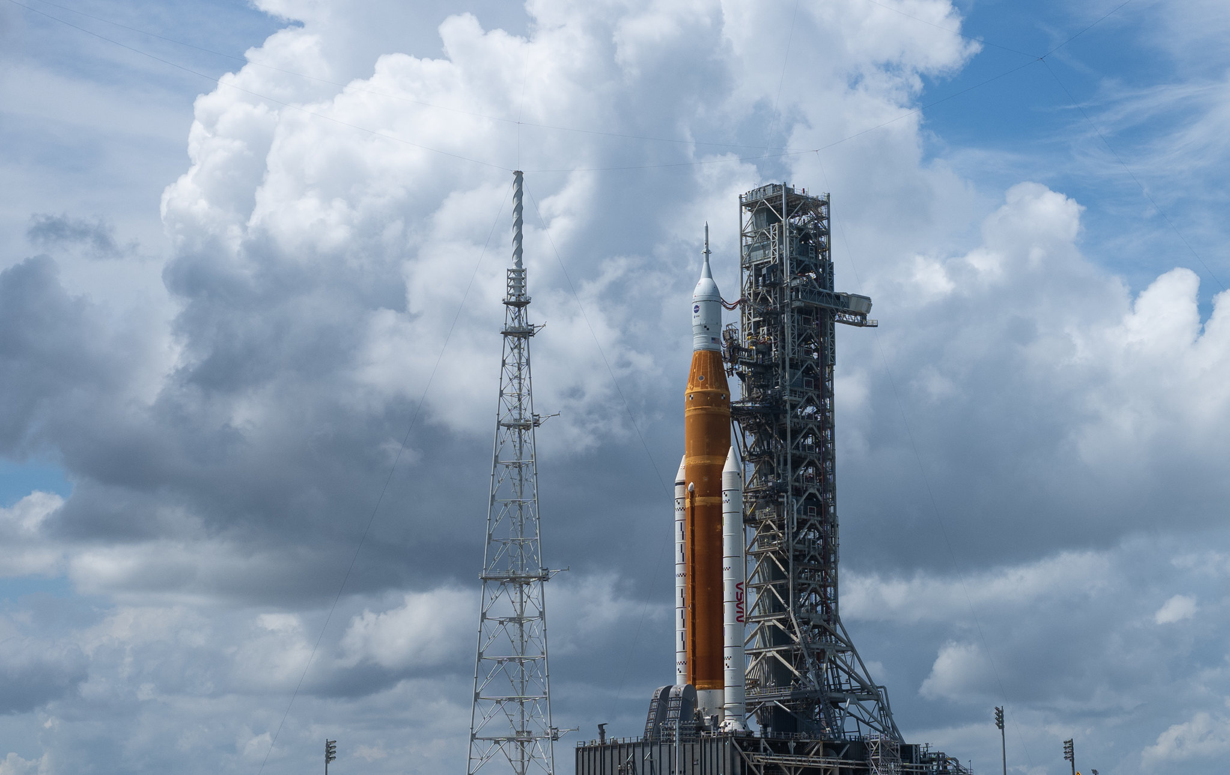
Artemis I launch planned for Nov. 14
NASA/Joel Kowsky

Slide 10
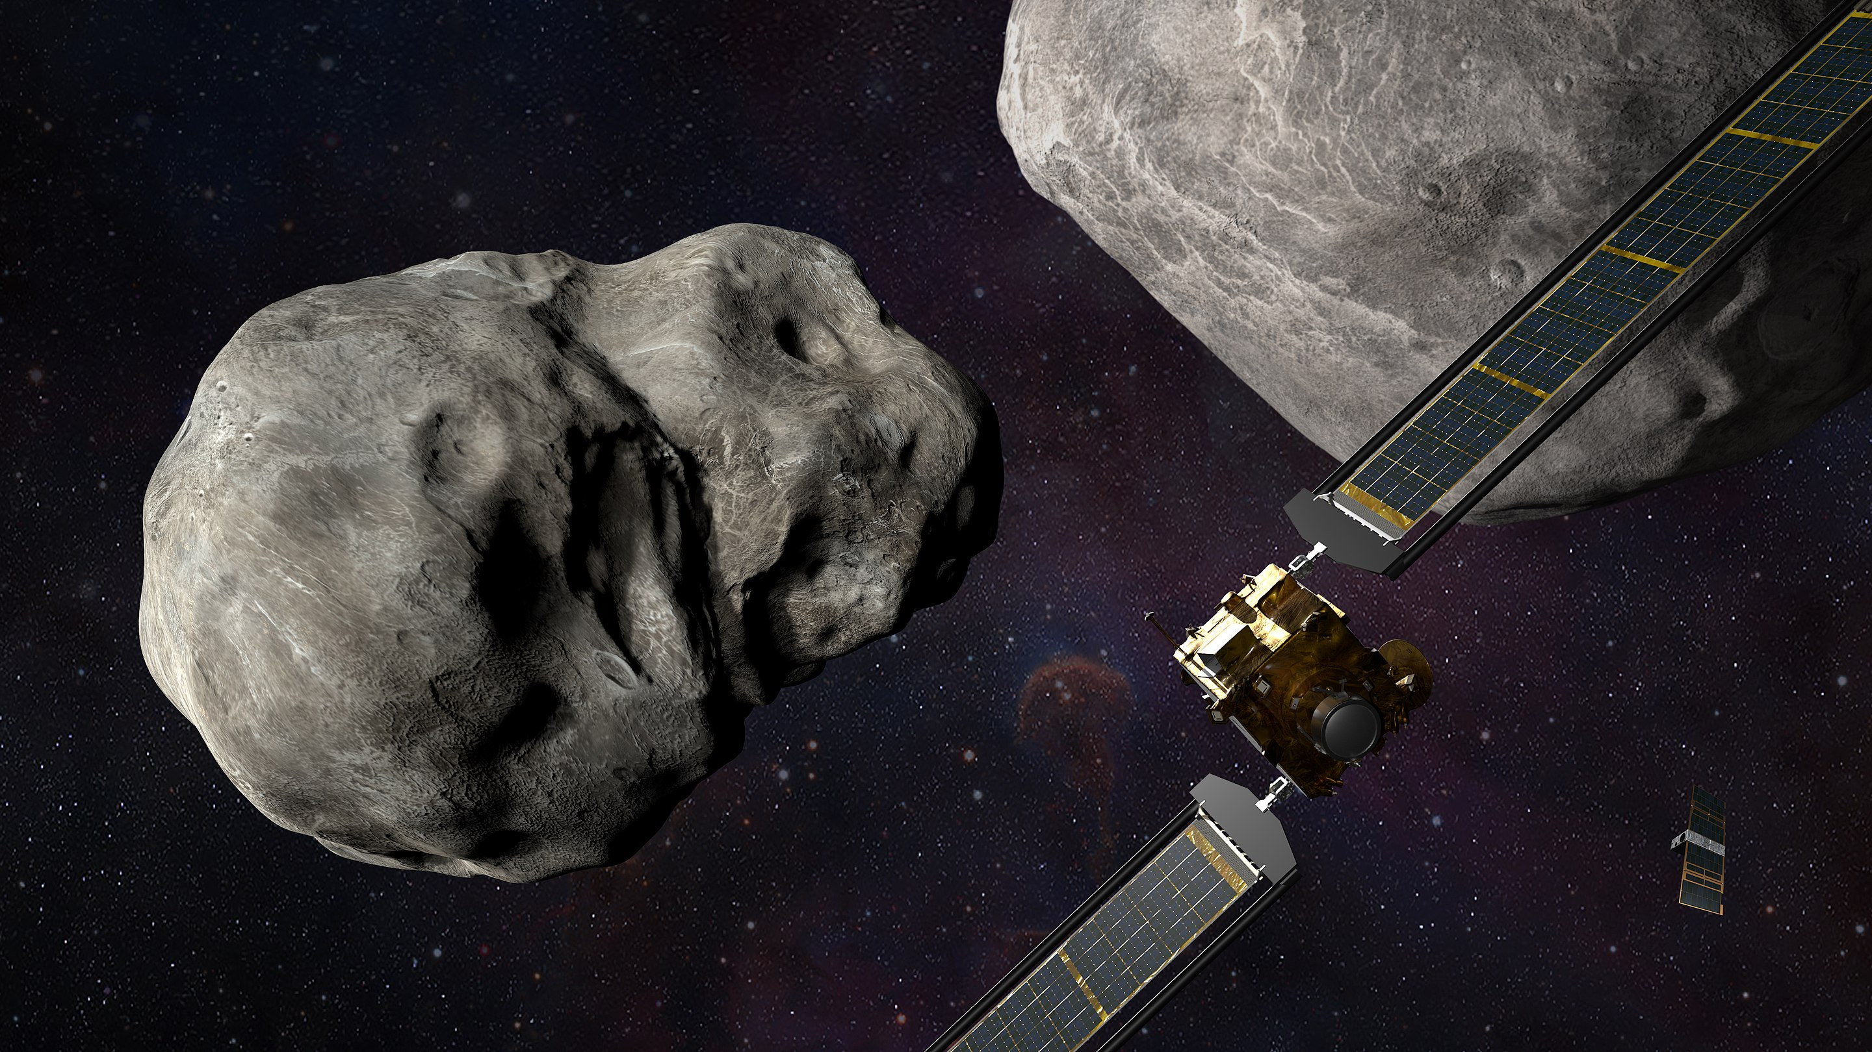
DART impact was on Sept 26!
NASA/JHUAPL/Steve Gribben

Slide 11
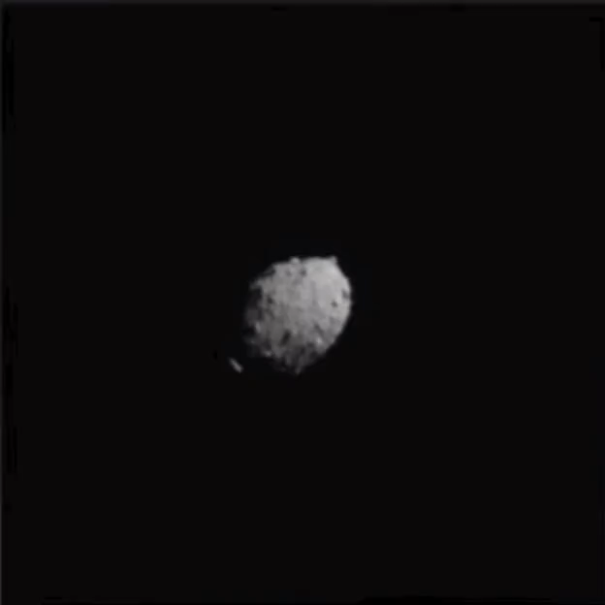

Slide 12
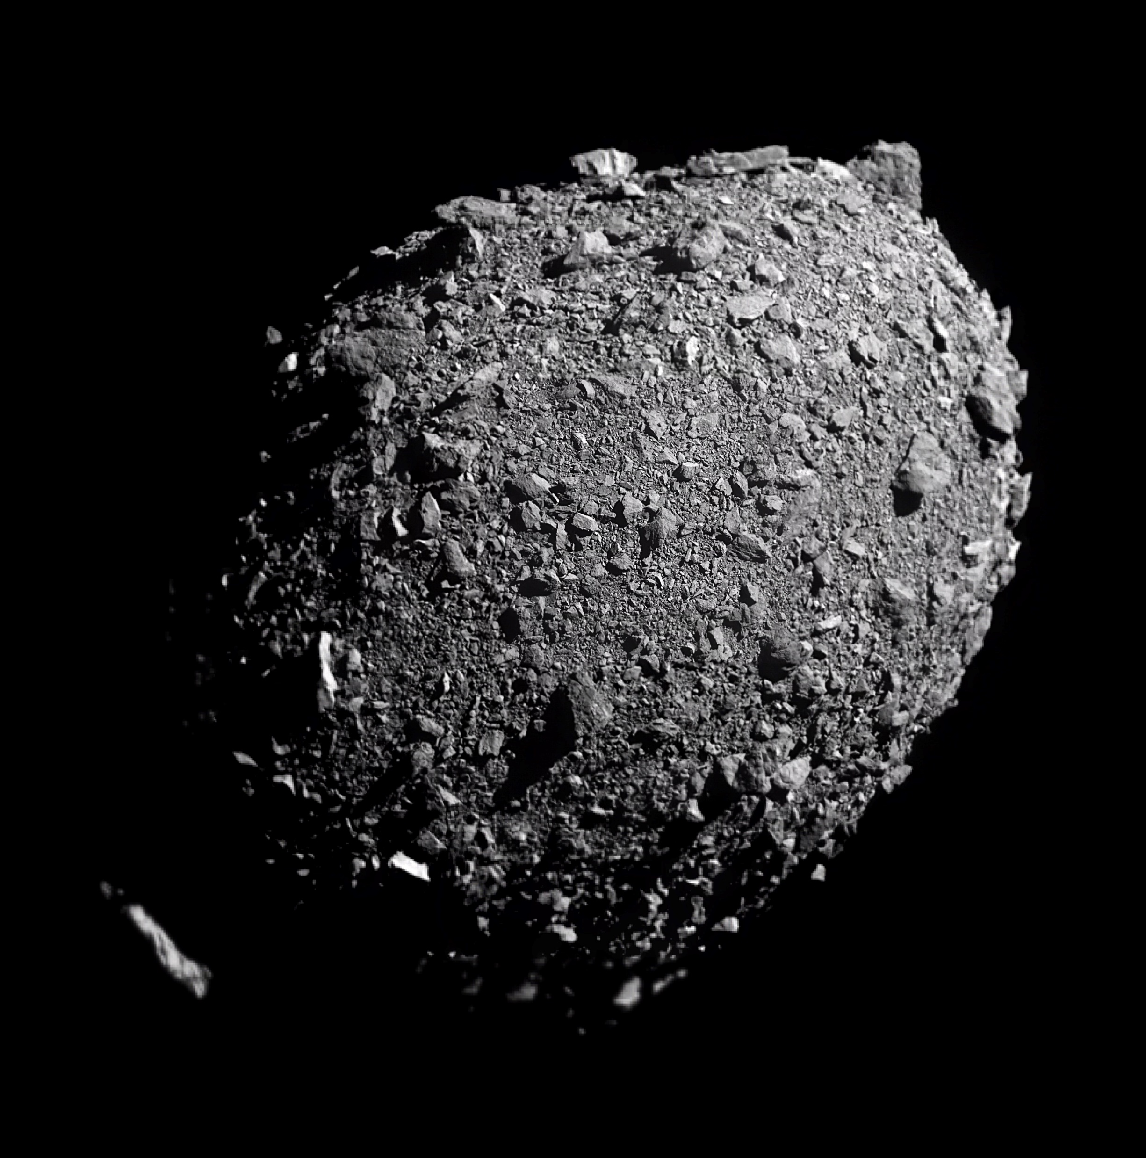
NASA/Johns Hopkins APL/Doug Ellison

Slide 13
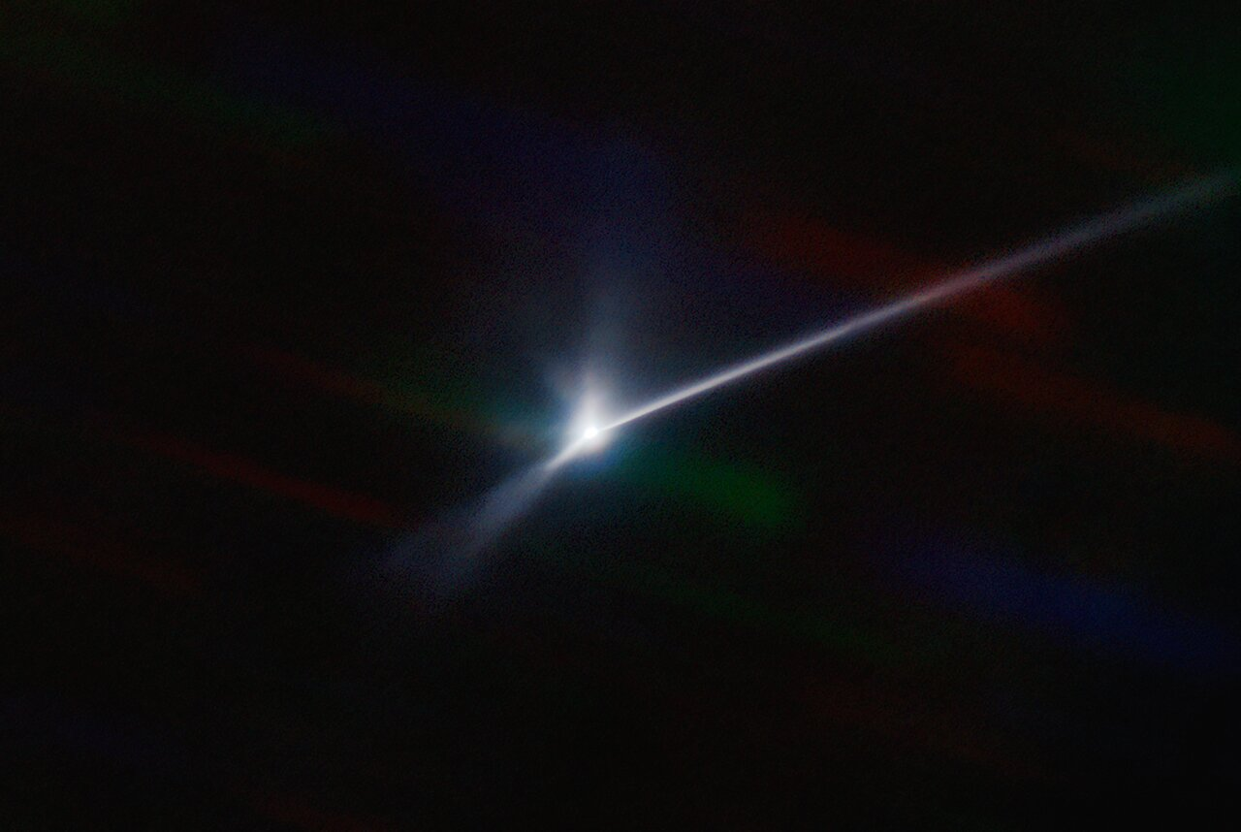
CTIO/NOIRLab/SOAR/NSF/AURA/T. Kareta (Lowell Observatory), M. Knight (US Naval Academy)

Slide 14
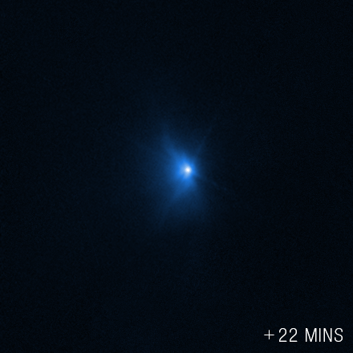
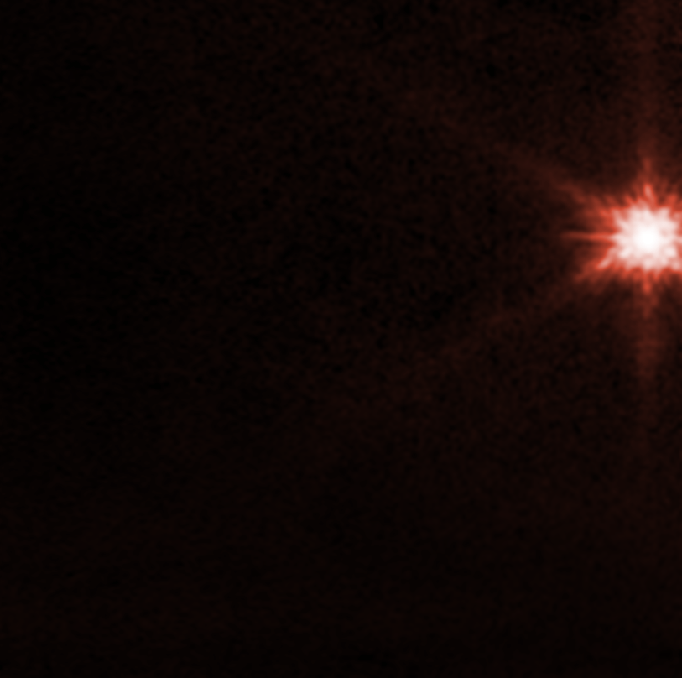
Hubble
JWST
Science: NASA, ESA, CSA, Jian-Yang Li (PSI), Cristina Thomas (Northern Arizona University), Ian Wong (NASA-GSFC); image processing: Joseph DePasquale (STScI), Alyssa Pagan (STScI)

Slide 15
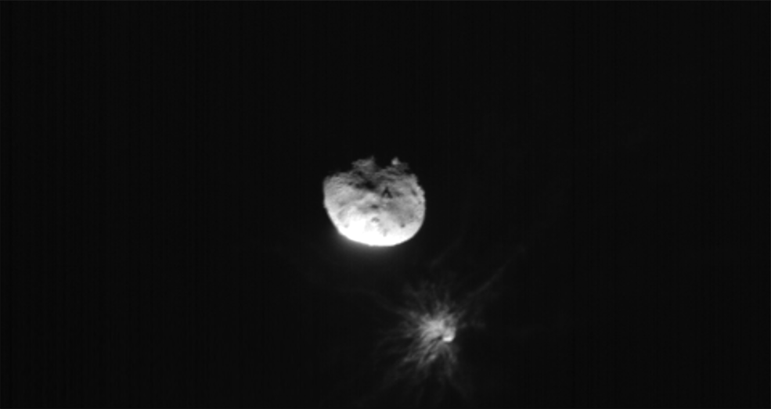
ASI/NASA

Slide 16
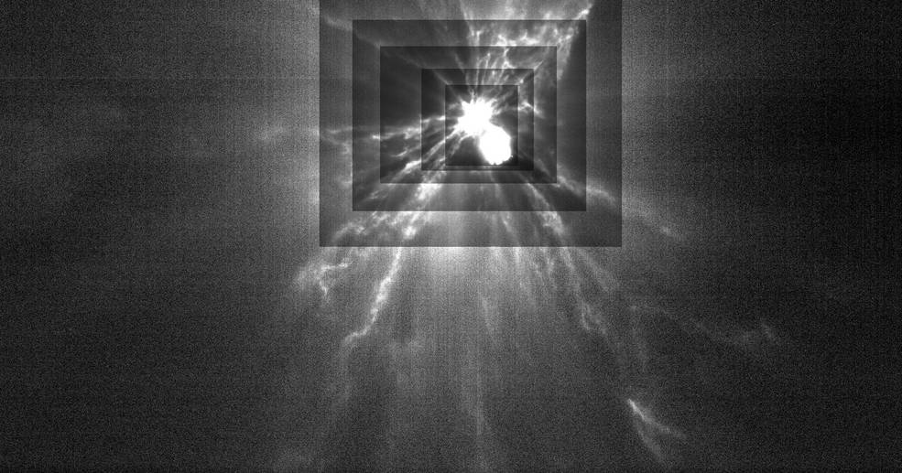
ASI/NASA/AP

Slide 17
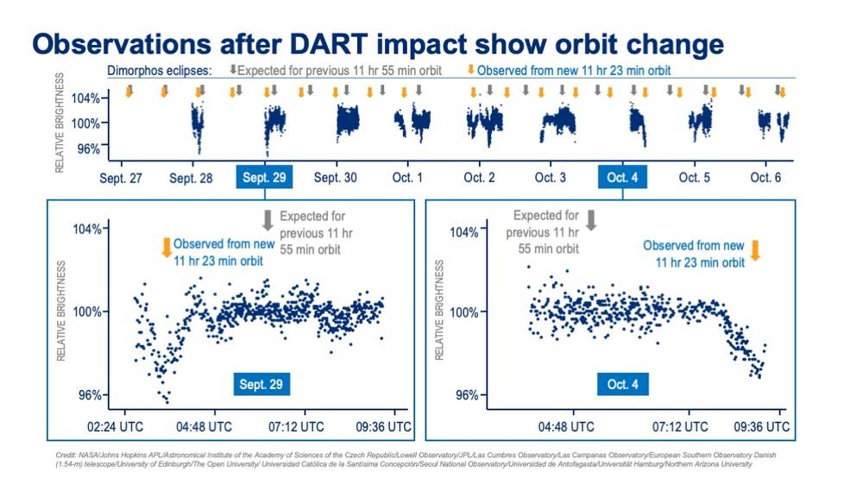

Slide 18
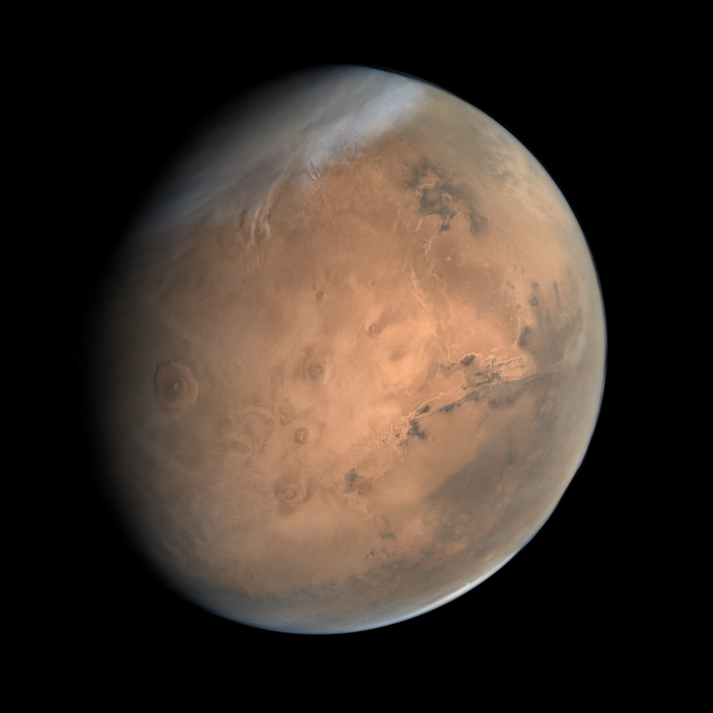
Mars Orbiter Mission ended on October 3
ISRO / ISSDC / Cowart

Slide 19
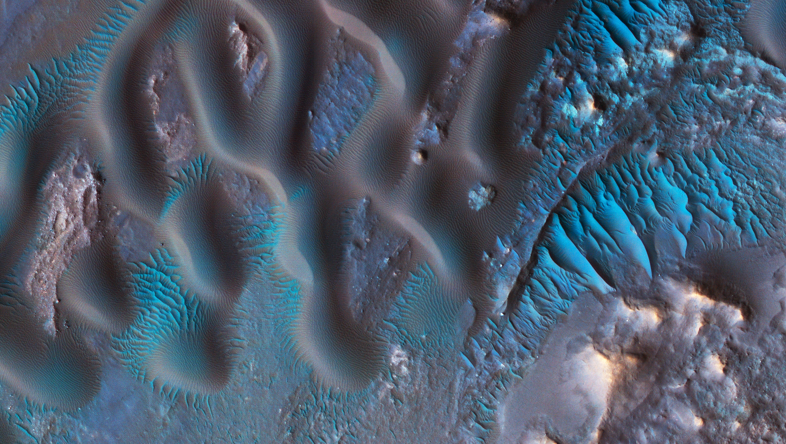
False color HiRISE image of Mars dunes

Slide 20
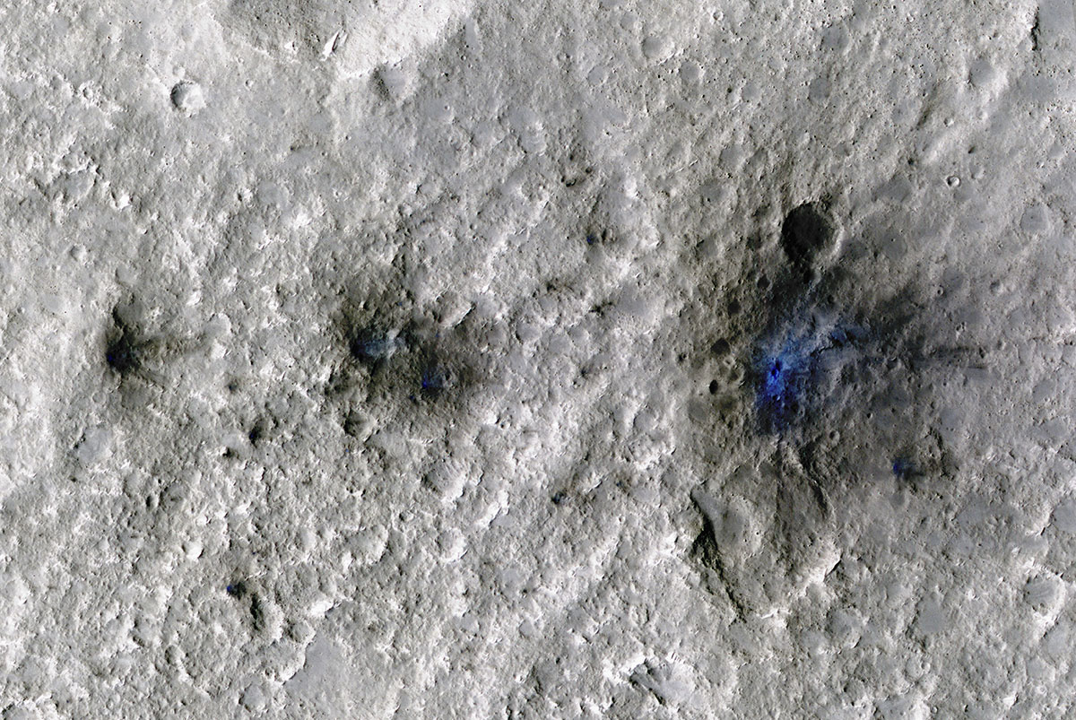
False color HiRISE image of fresh impacts detected by InSight.

Slide 21
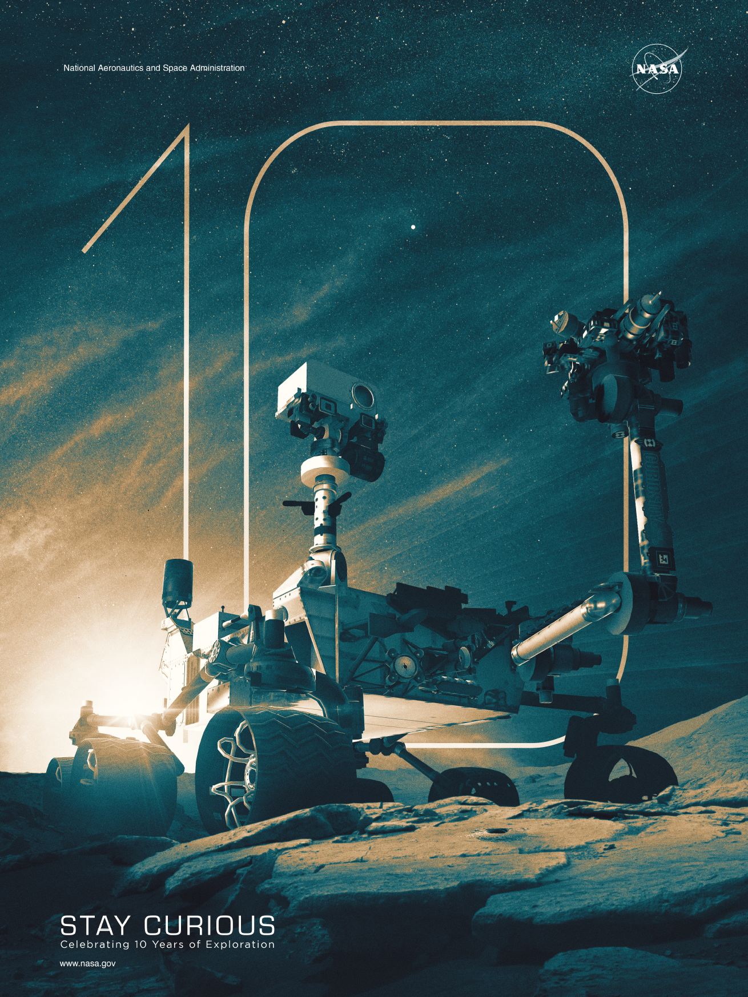

Slide 22
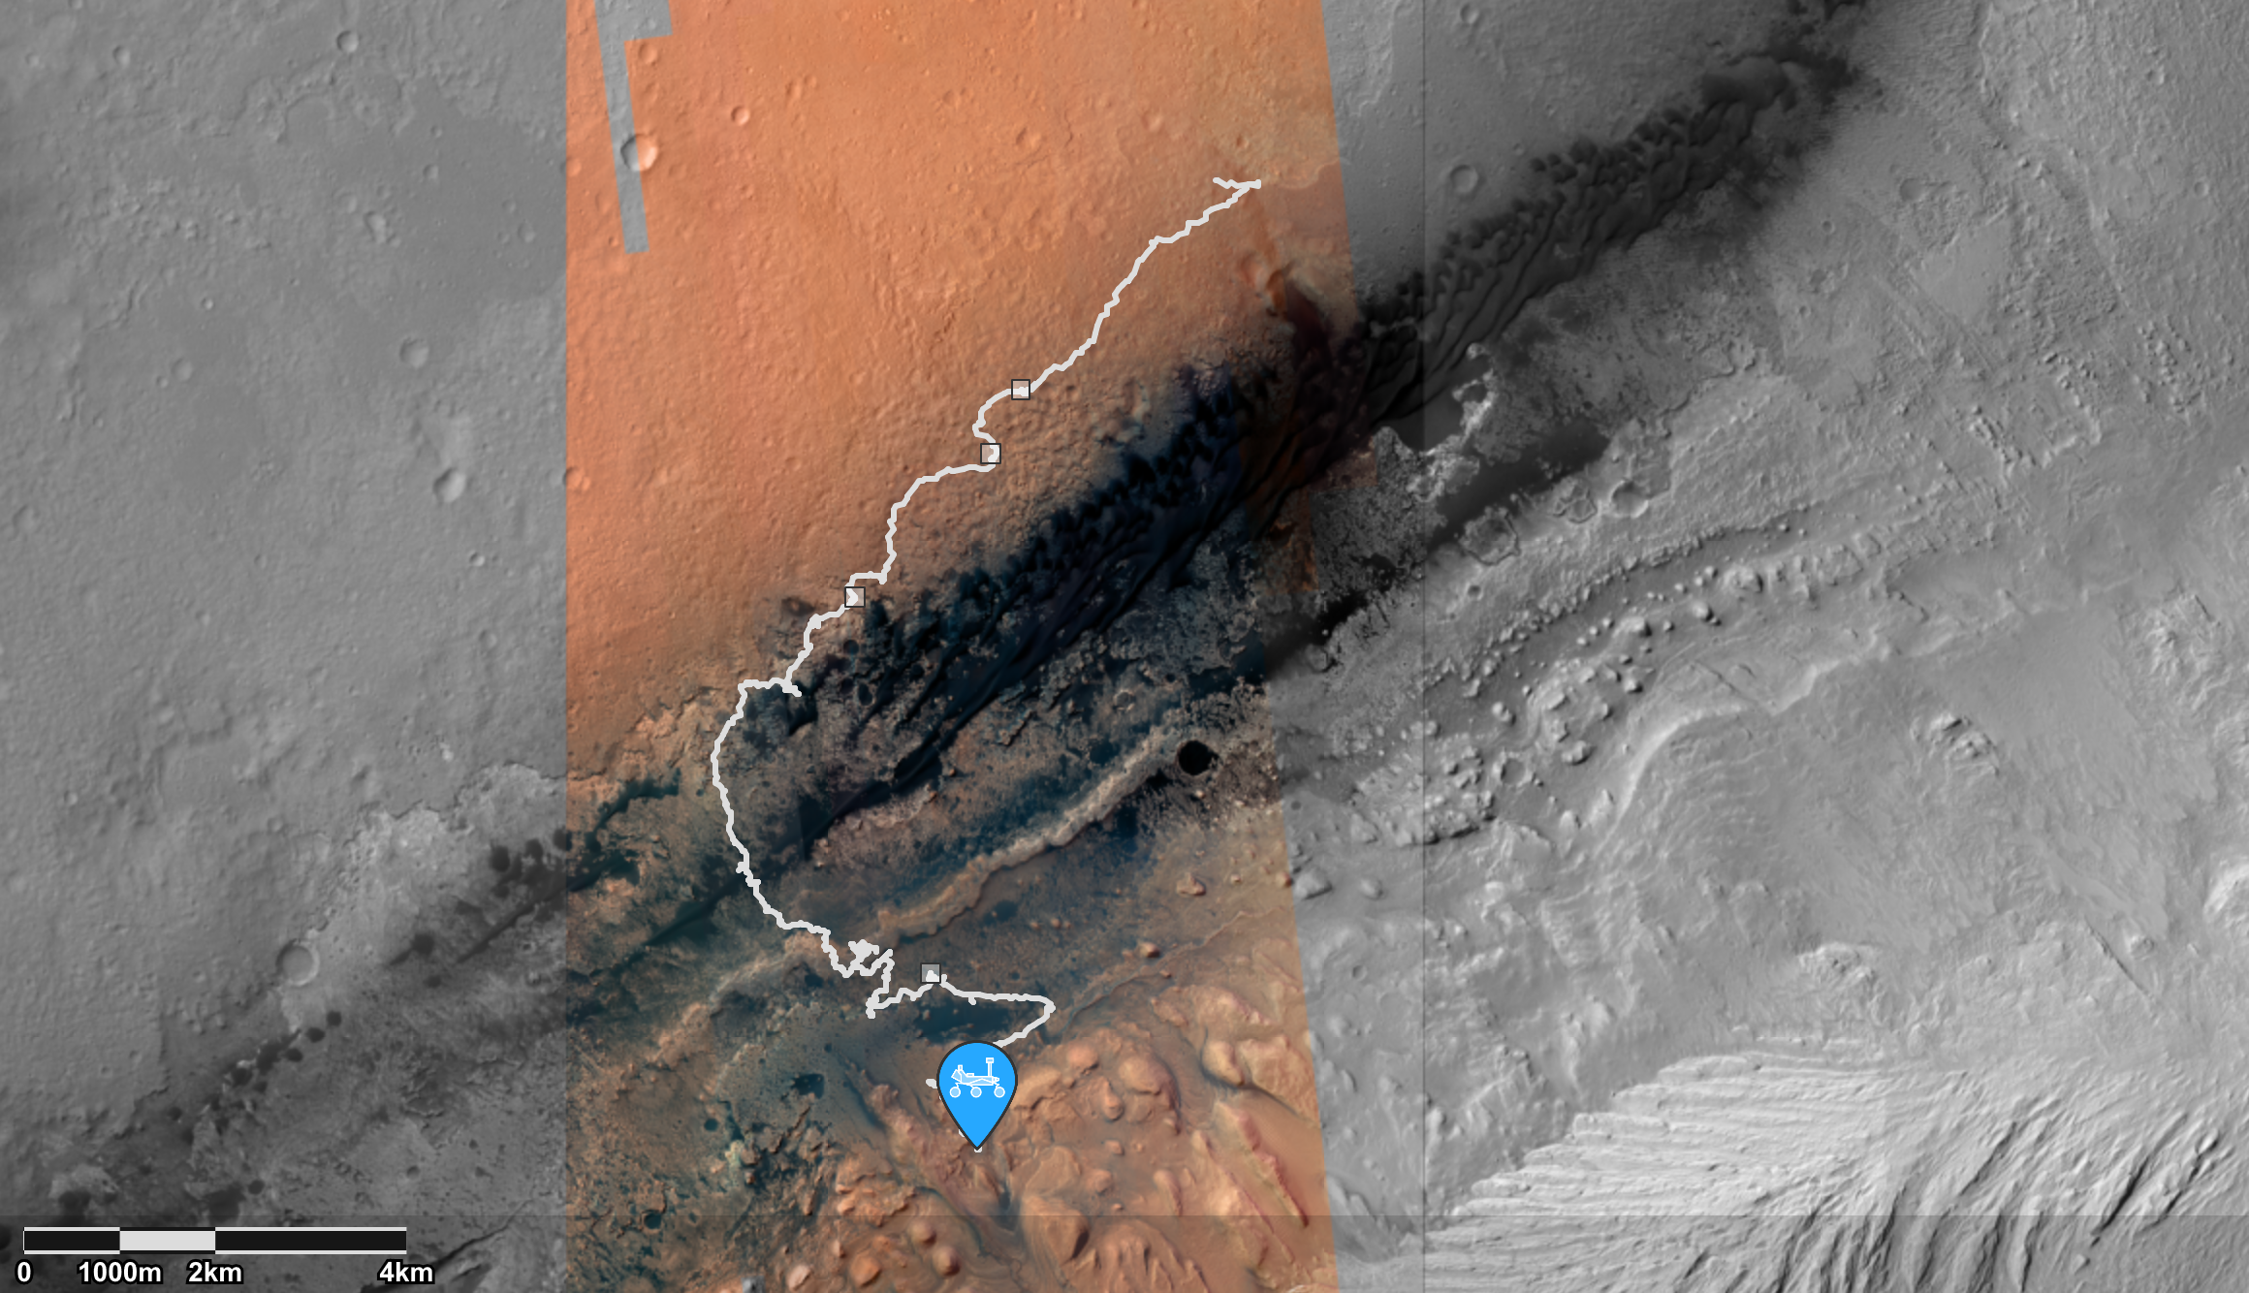

Slide 23
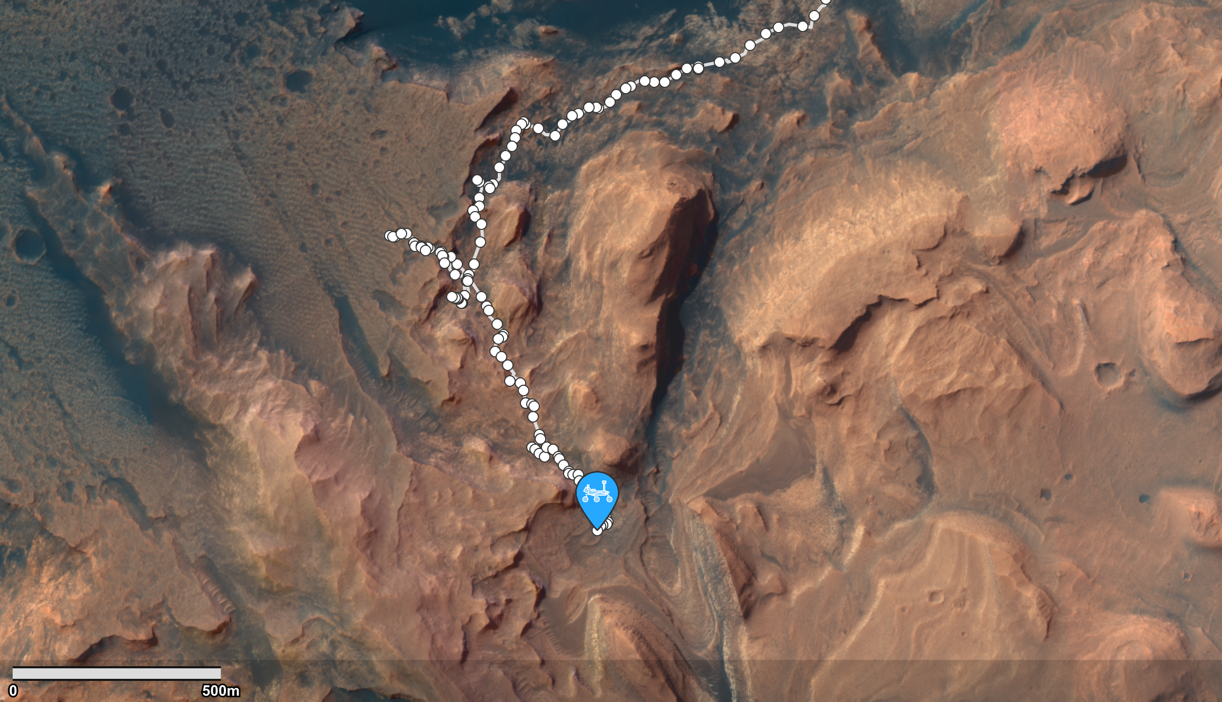

Slide 24
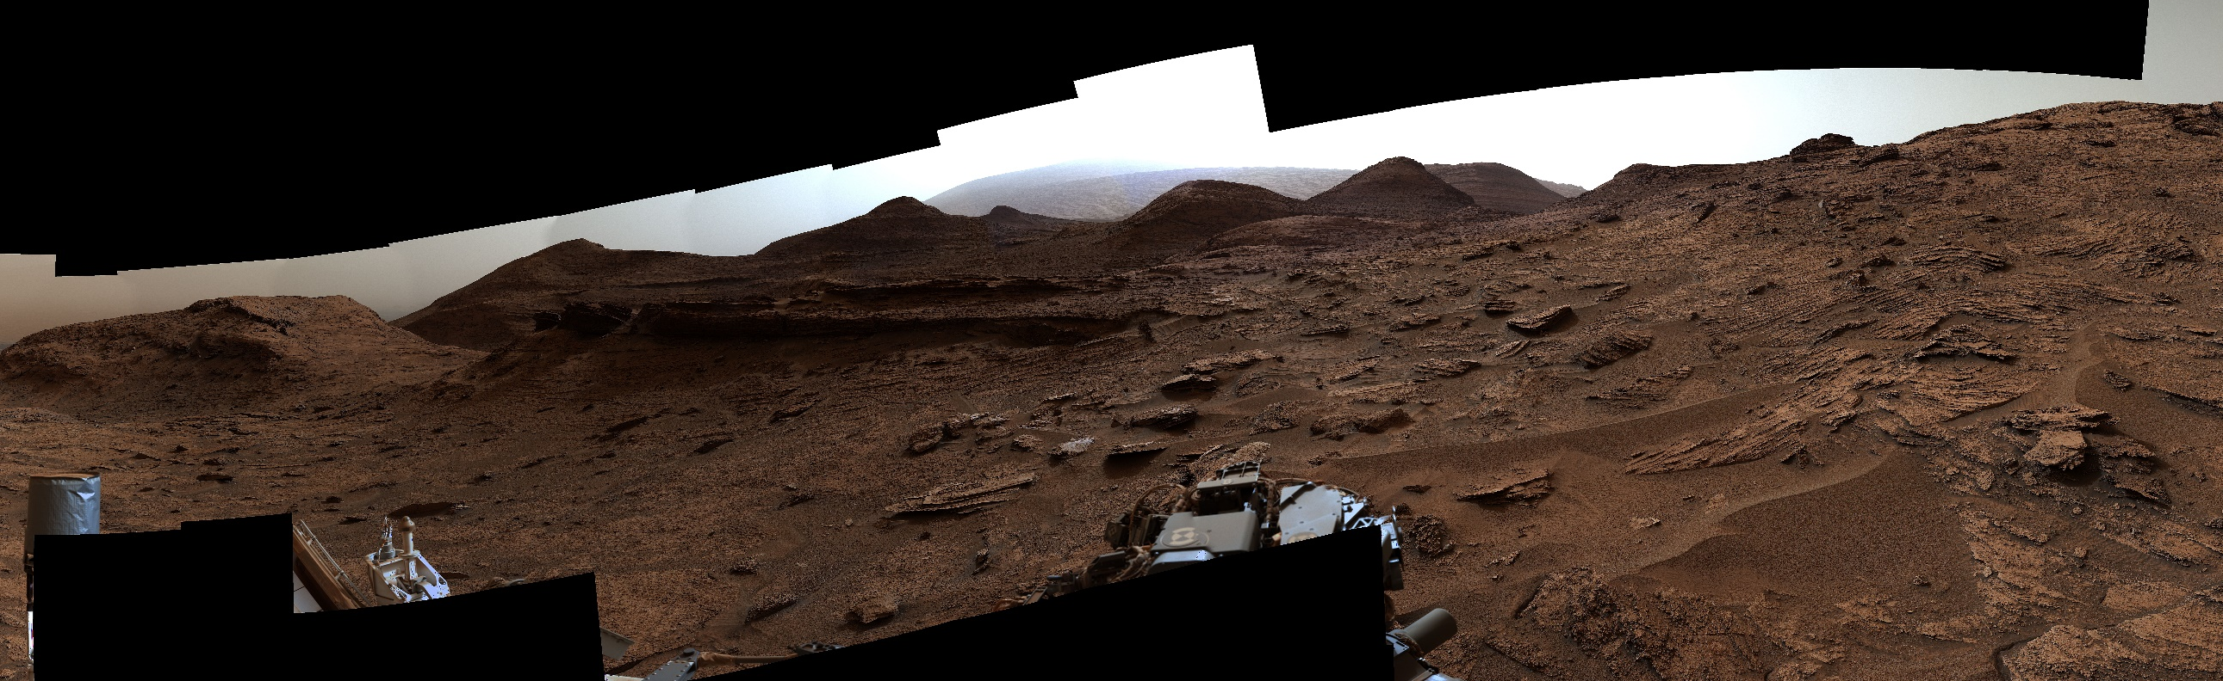
Panorama near Sierra Maigualida
May 22, 2022 (Sol 3481)
NASA/JPL-Caltech/MSSS

Slide 25
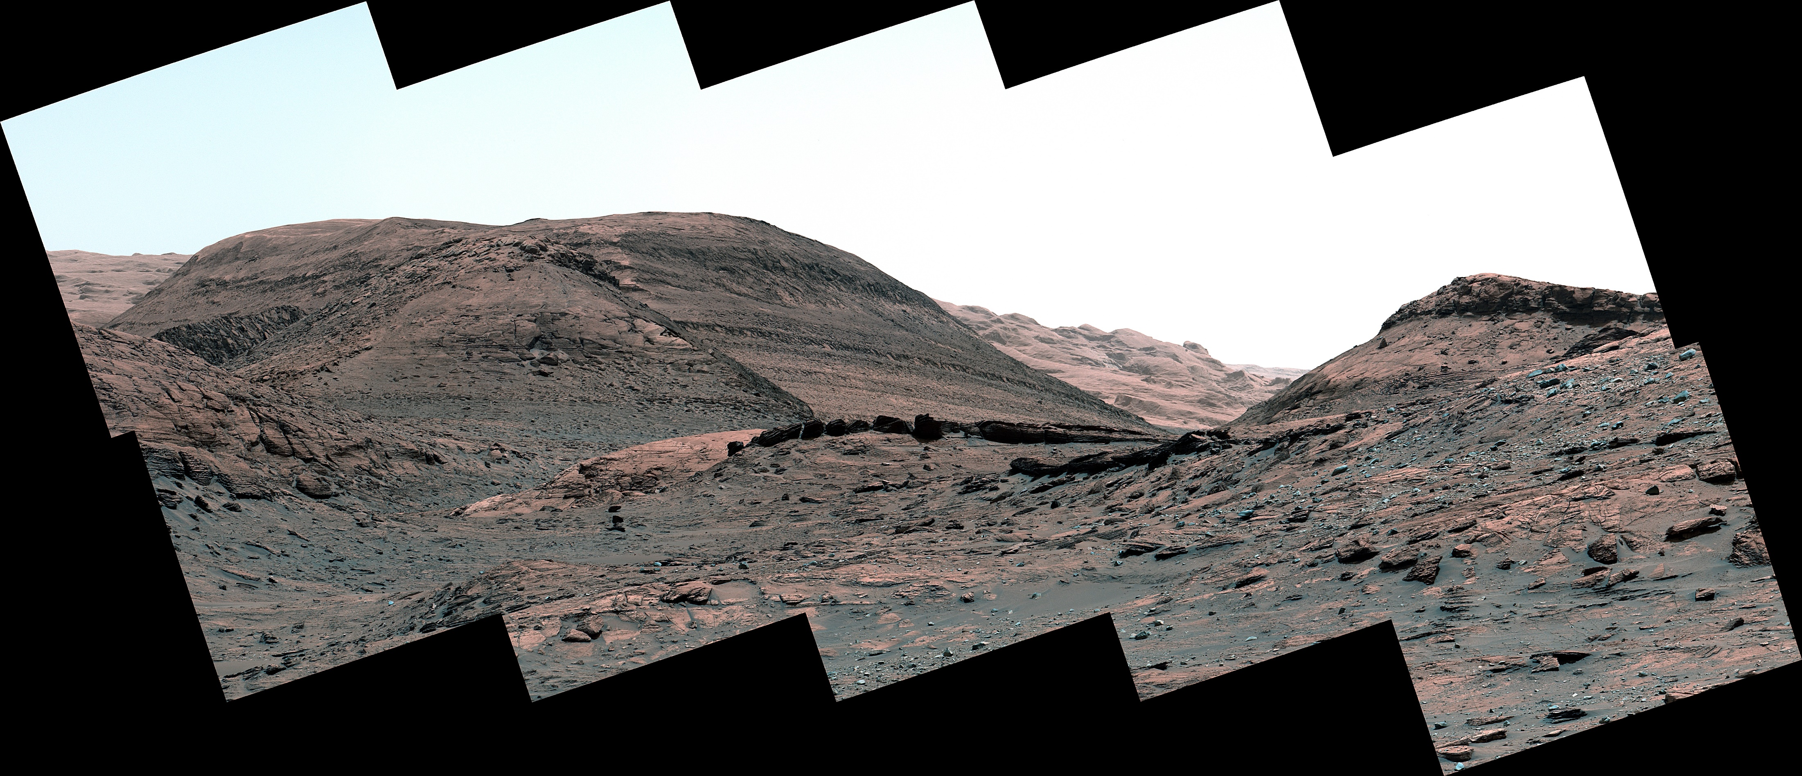
NASA/JPL-Caltech/MSSS

Slide 26
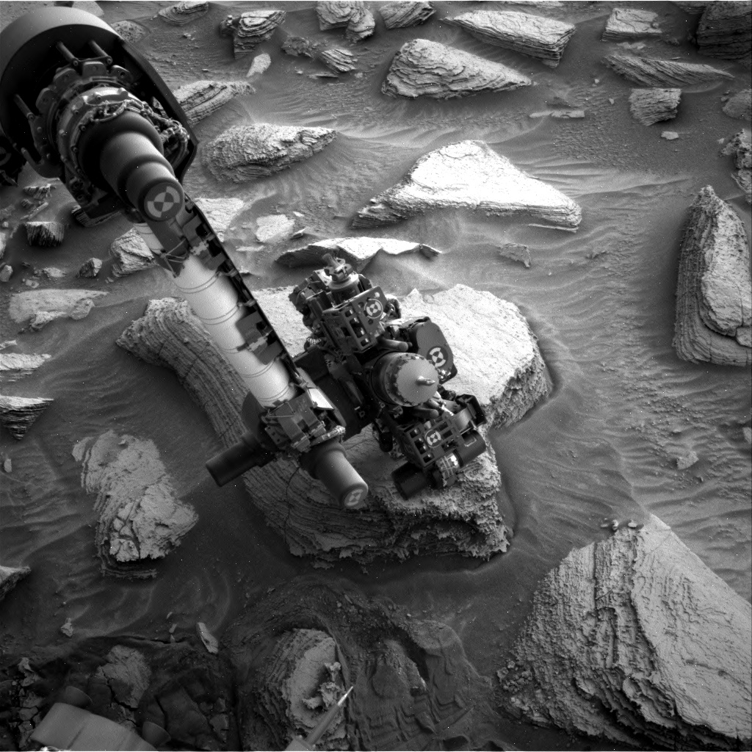
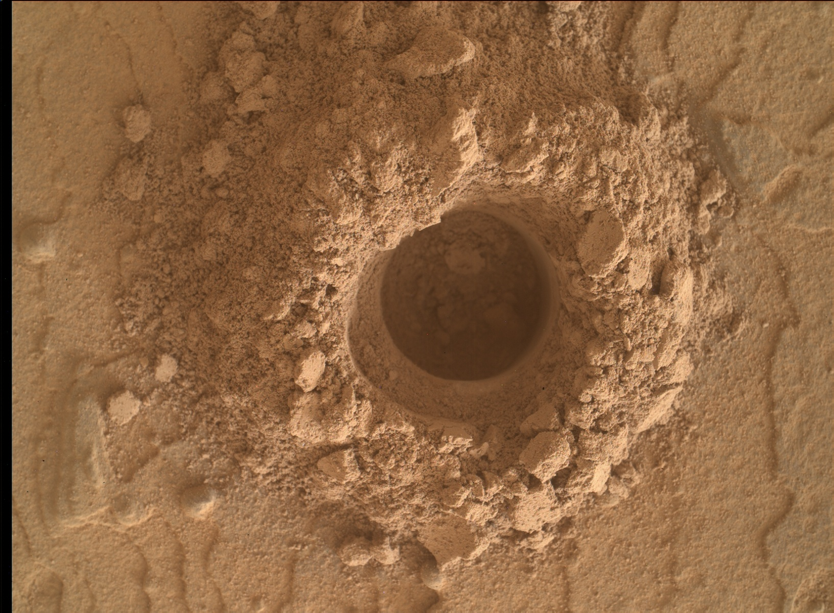

Slide 27
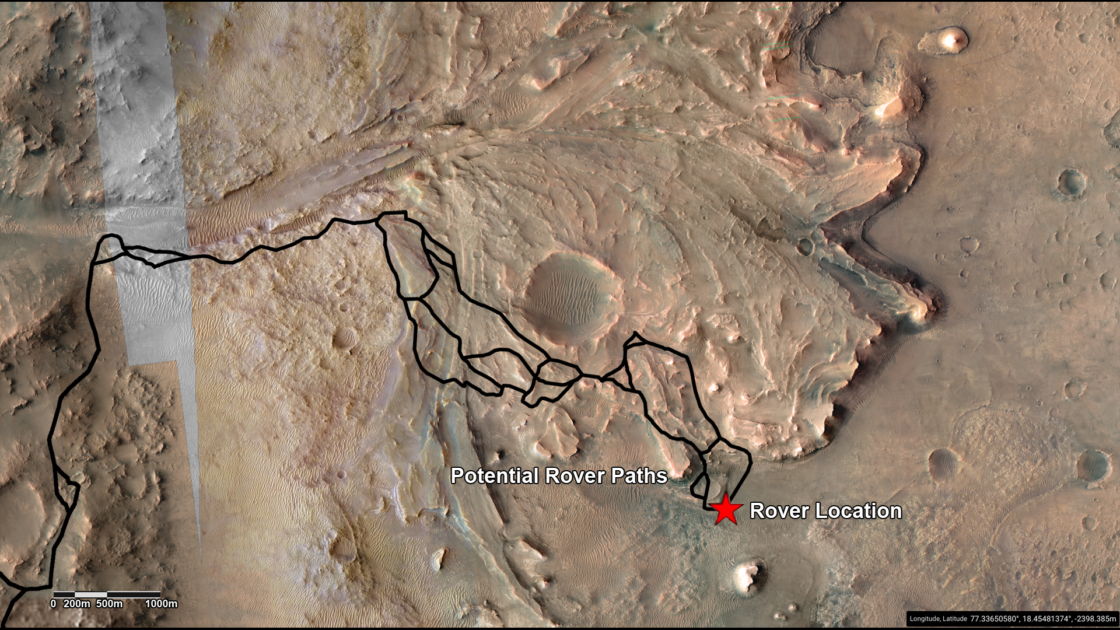

Slide 28
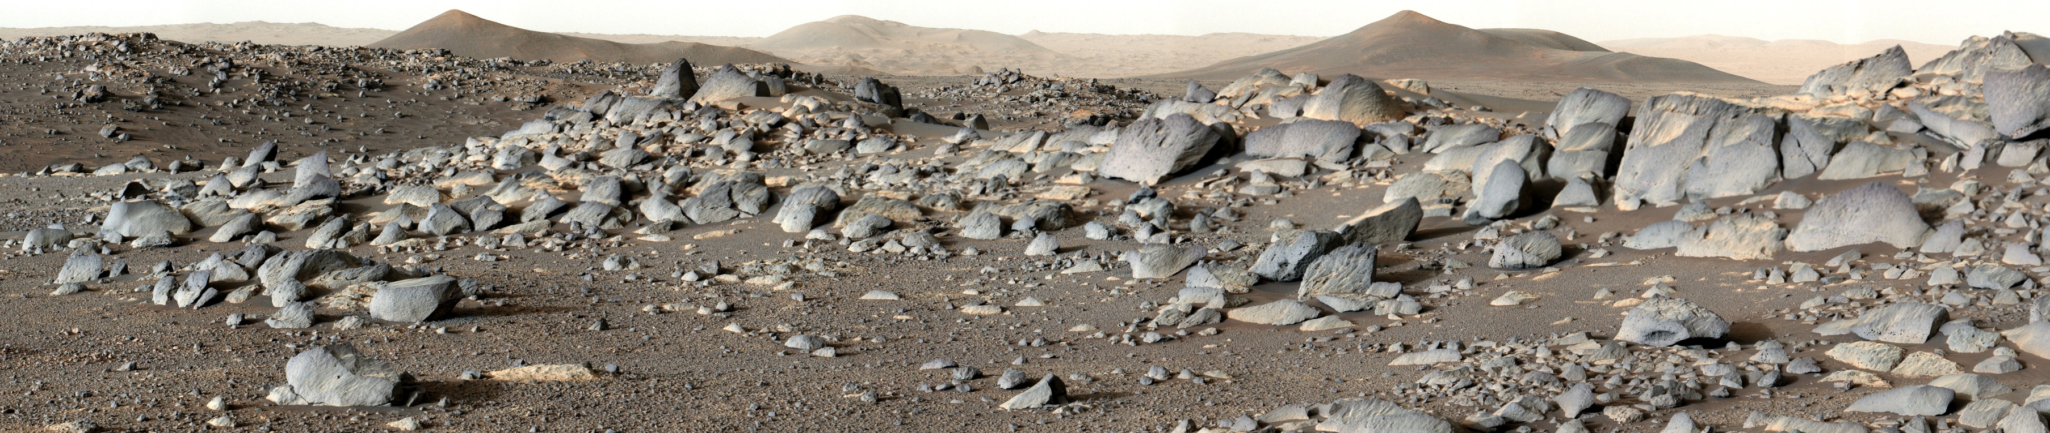
Igneous rocks on the floor of Jezero crater.
NASA/JPL-Caltech/ASU/MSSS

Slide 29
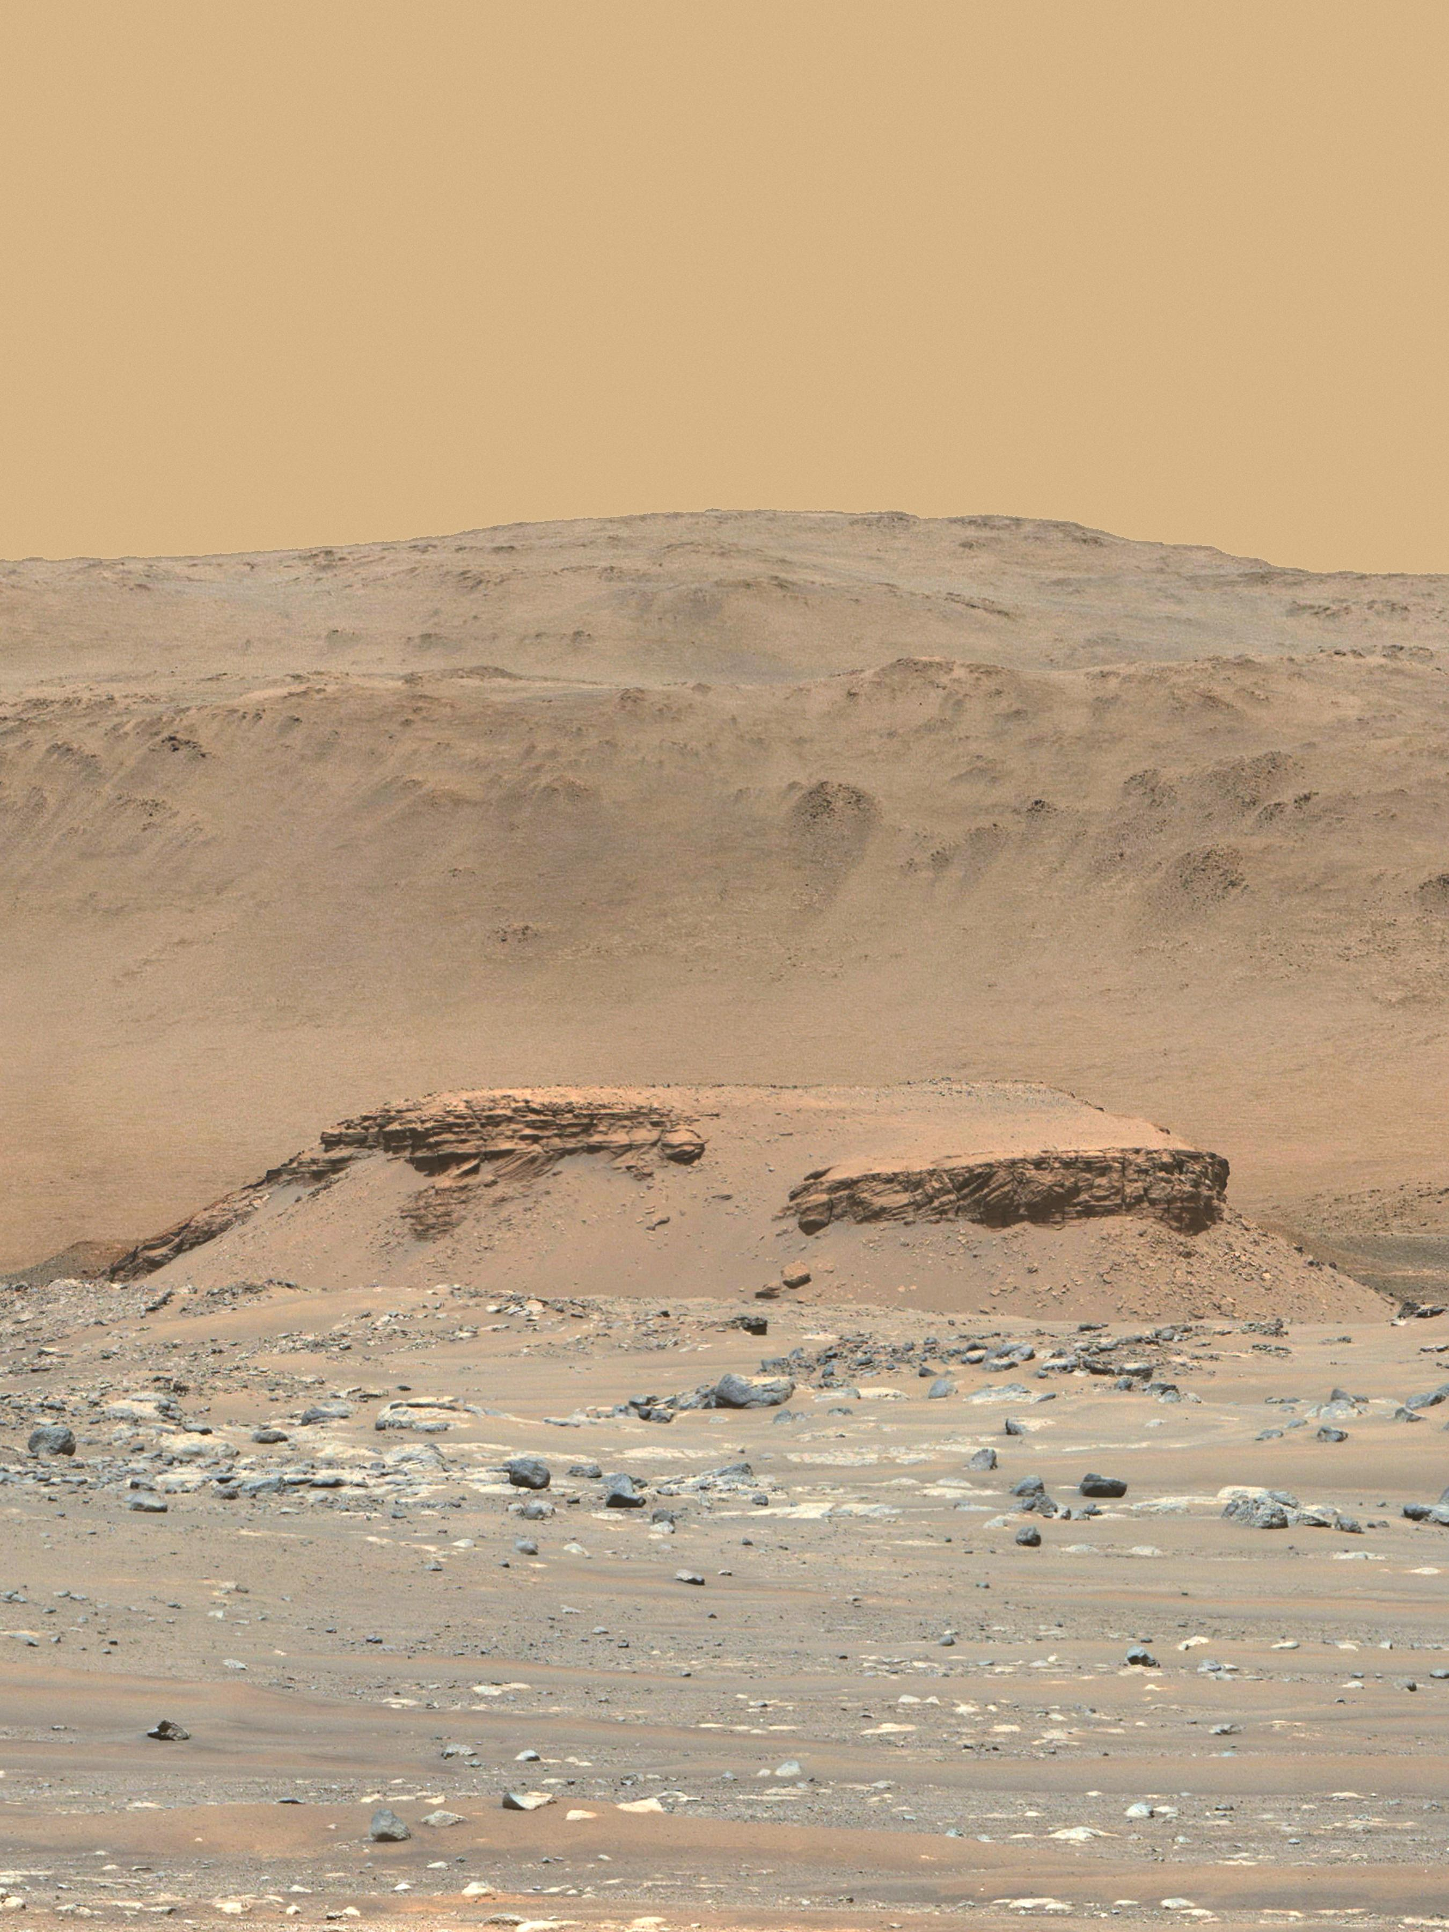
Delta remnant Kodiak, with Jezero crater rim in the background.
NASA/JPL-Caltech/ASU/MSSS

Slide 30
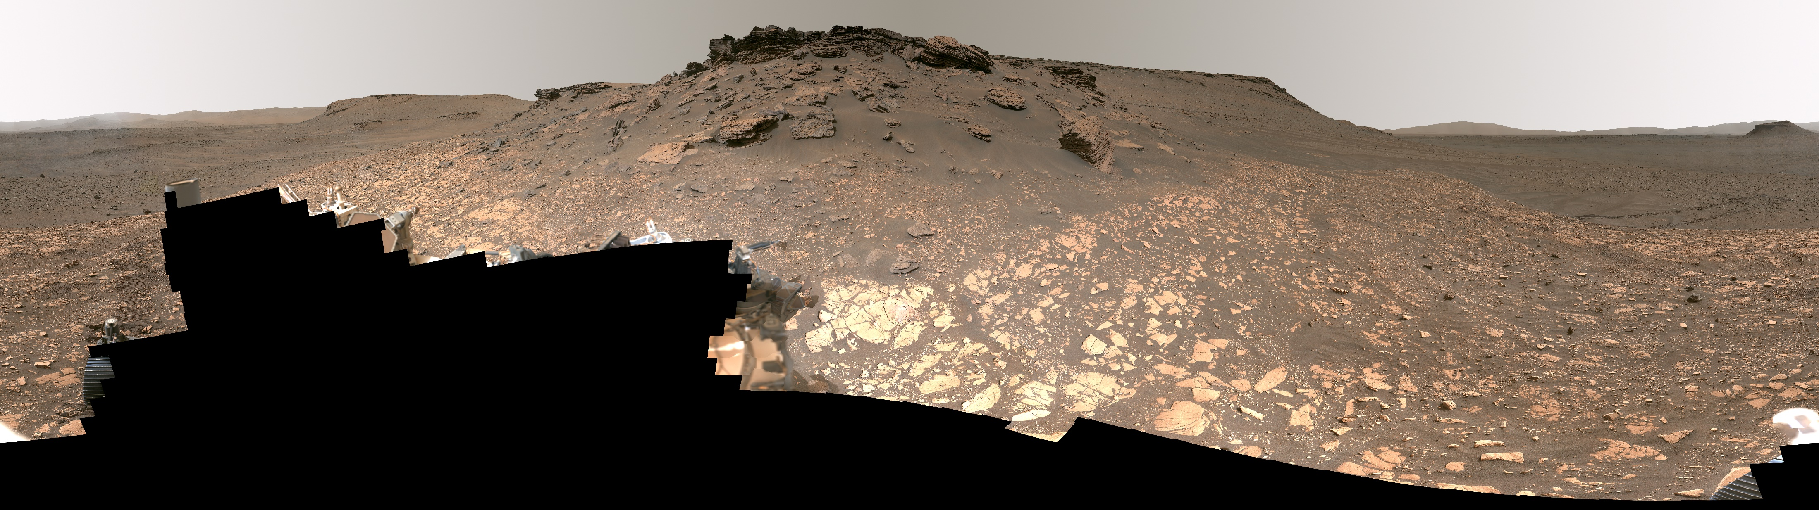
Panorama from the foot of the delta.
NASA/JPL-Caltech/ASU/MSSS

Slide 31
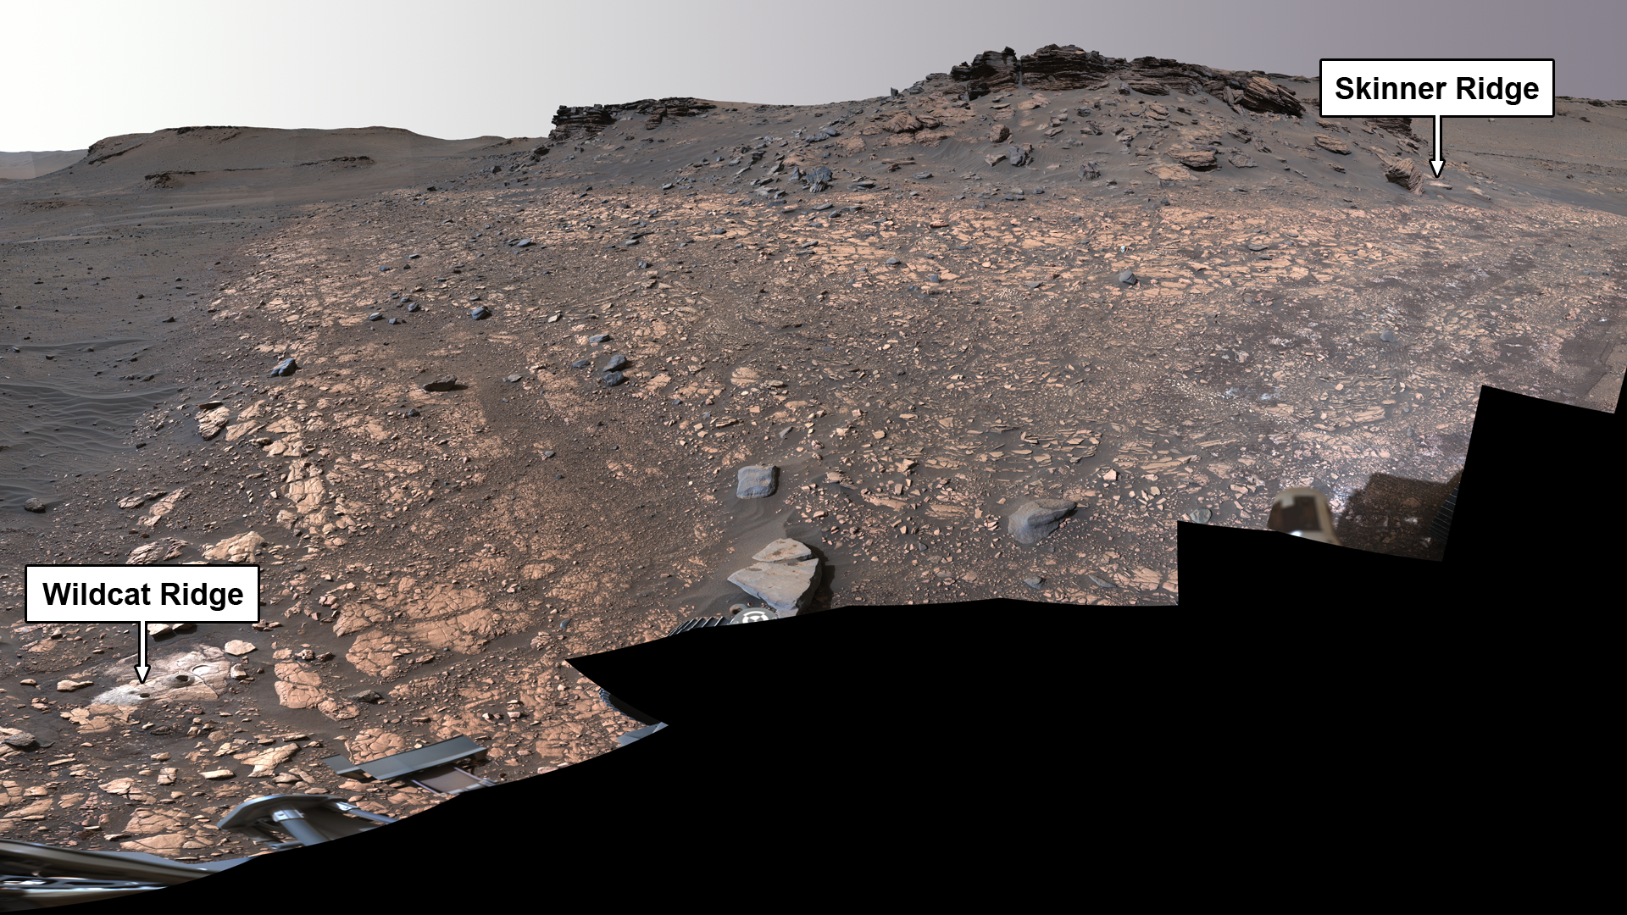
Two sampled locations on the Jezero delta. Wildcat Ridge contains organics.
NASA/JPL-Caltech/ASU/MSSS

Slide 32
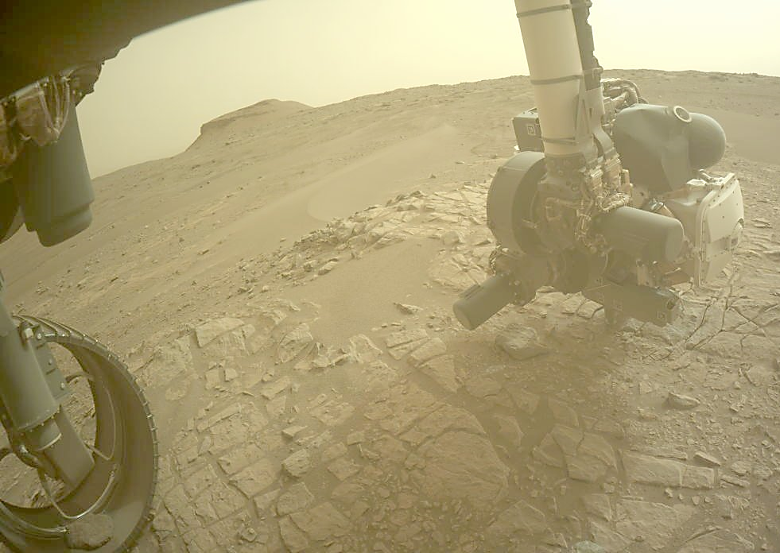
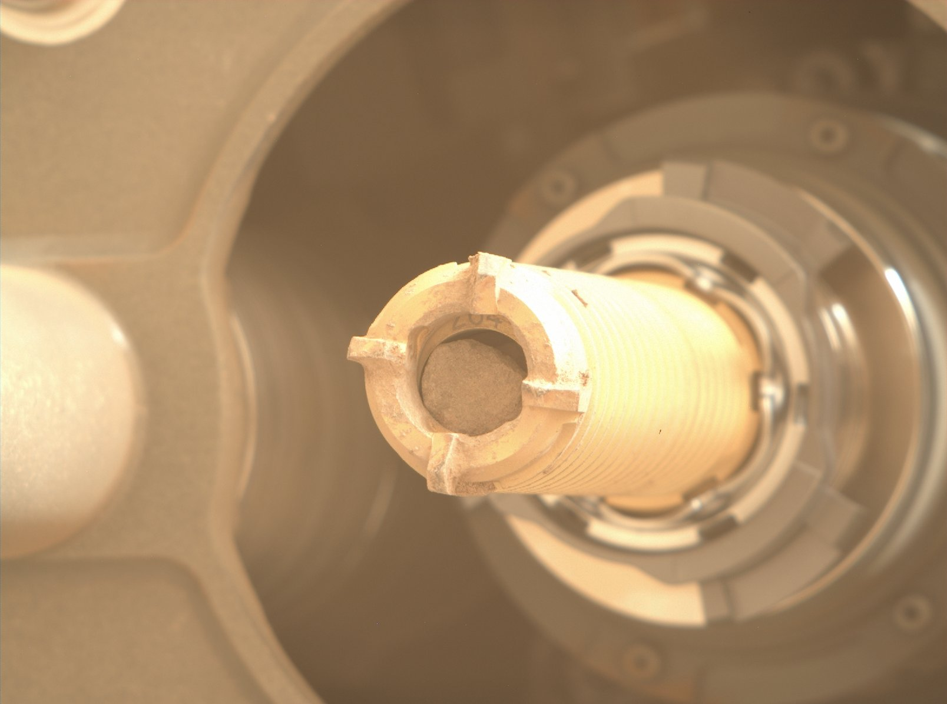

Slide 33
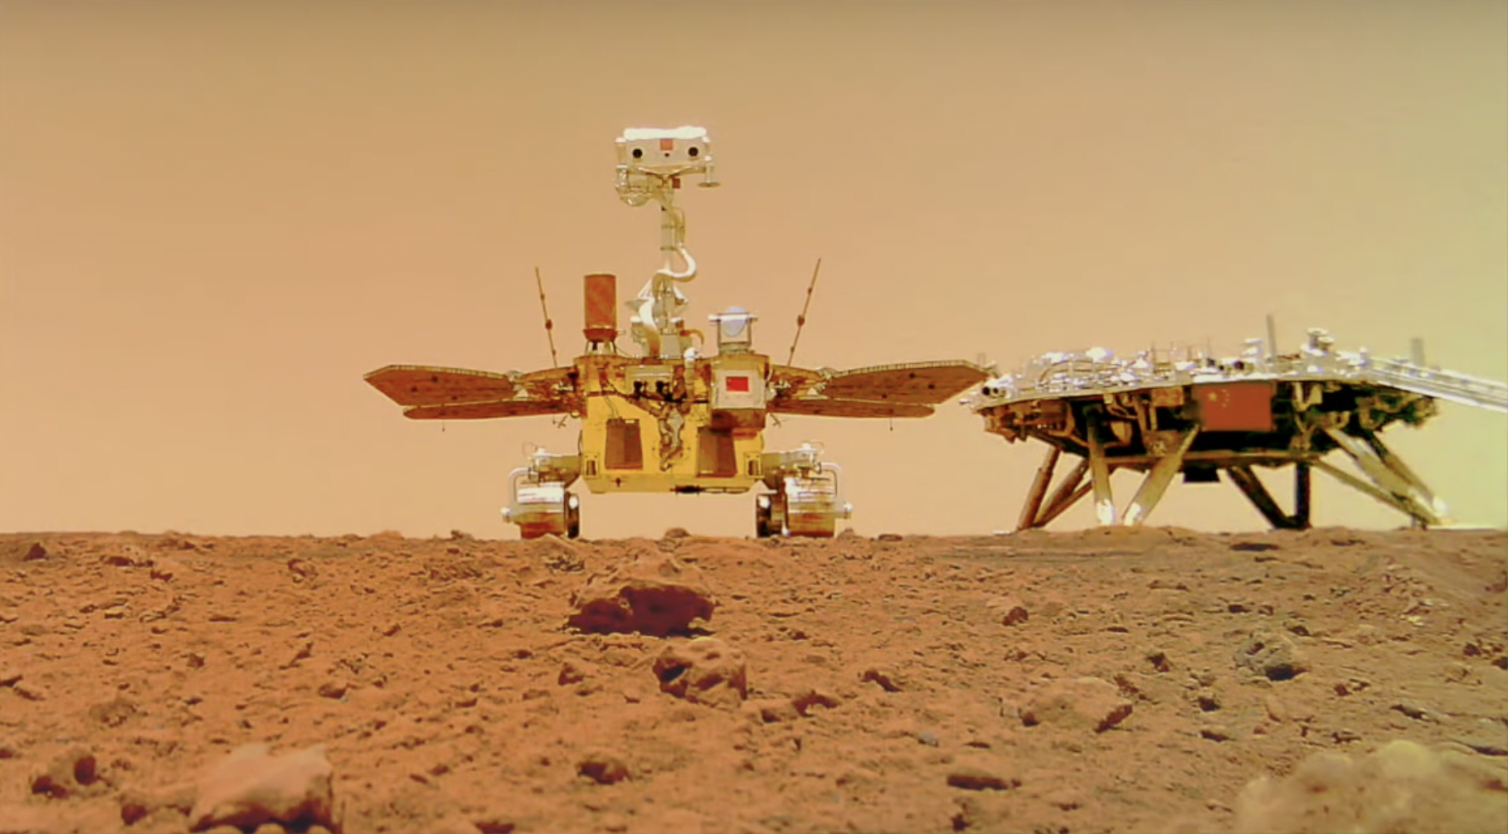
Tianwen-1 lander and Zhurong rover landed May 2021
China News Service

Slide 34
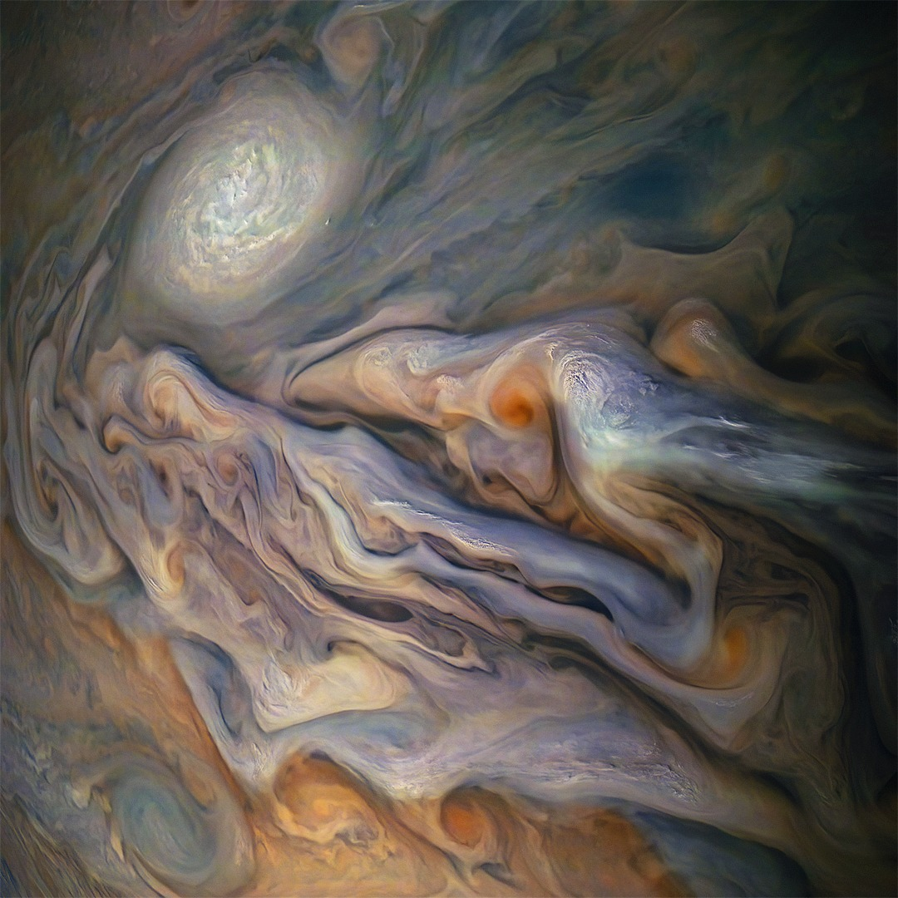
Swirling storms on Jupiter, as seen by JUNO
NASA / JPL-Caltech / MSSS / Seán Doran

Slide 35
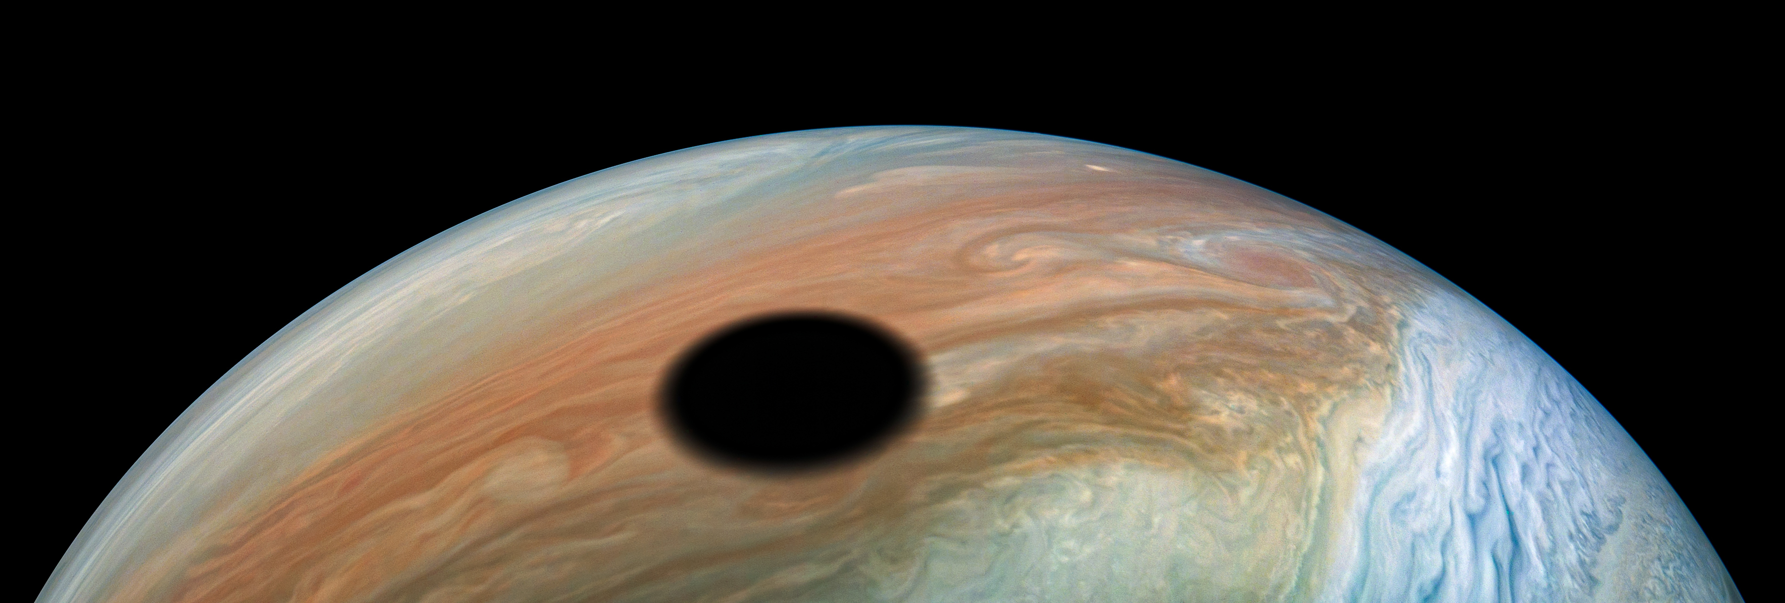
Io’s shadow on Jupiter, as seen by JUNO
NASA/JPL-Caltech/SwRI/MSSS/Kevin M. Gill

Slide 36
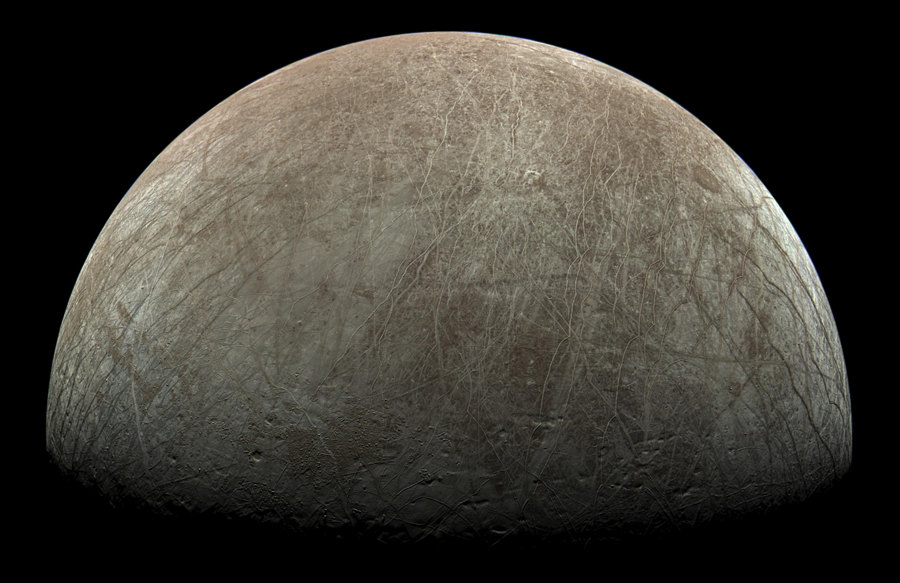
Europa as seen by JUNO on Sept 29
NASA/JPL-Caltech/SwRI/MSSS/Björn Jónsson

Slide 37
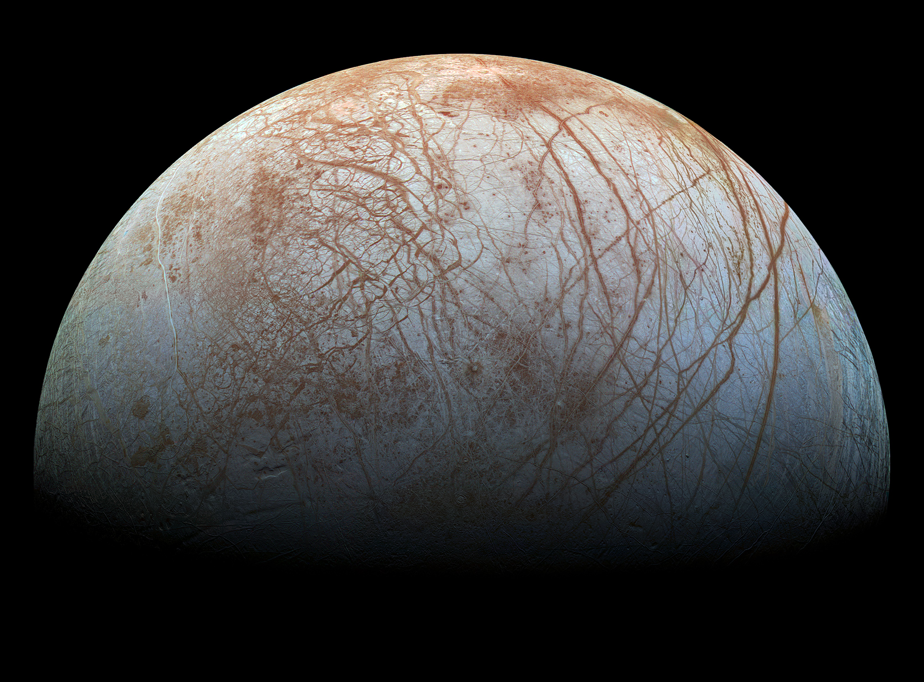
NASA / Jet Propulsion Lab-Caltech / SETI Institute

Slide 38
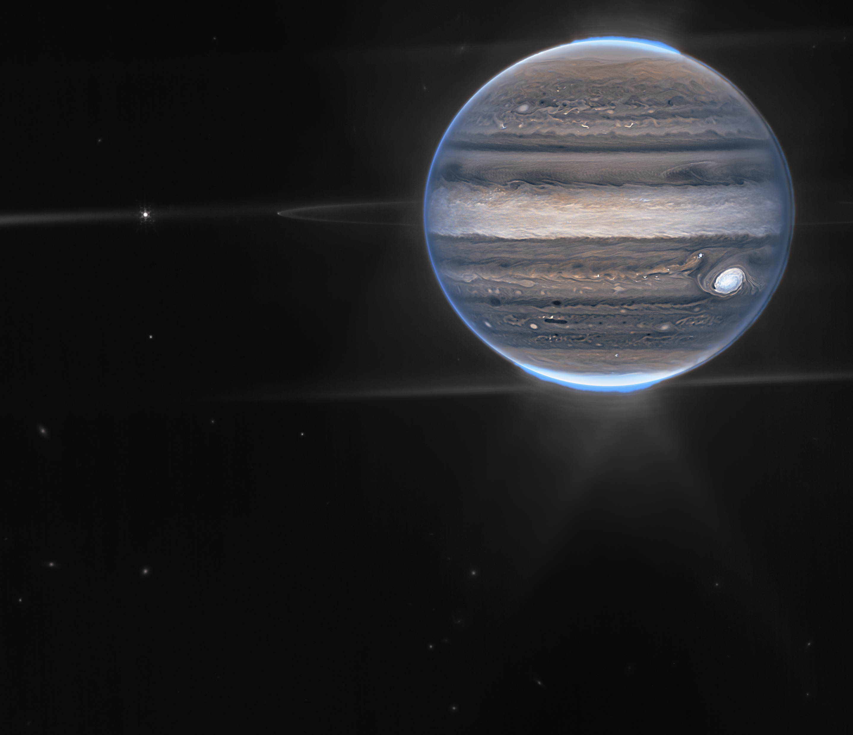
JWST infrared view of Jupiter and moons
NASA/ESA/CSA/Jupiter ERS Team/Ricardo Hueso (UPV/EHU)/Judy Schmidt

Slide 39
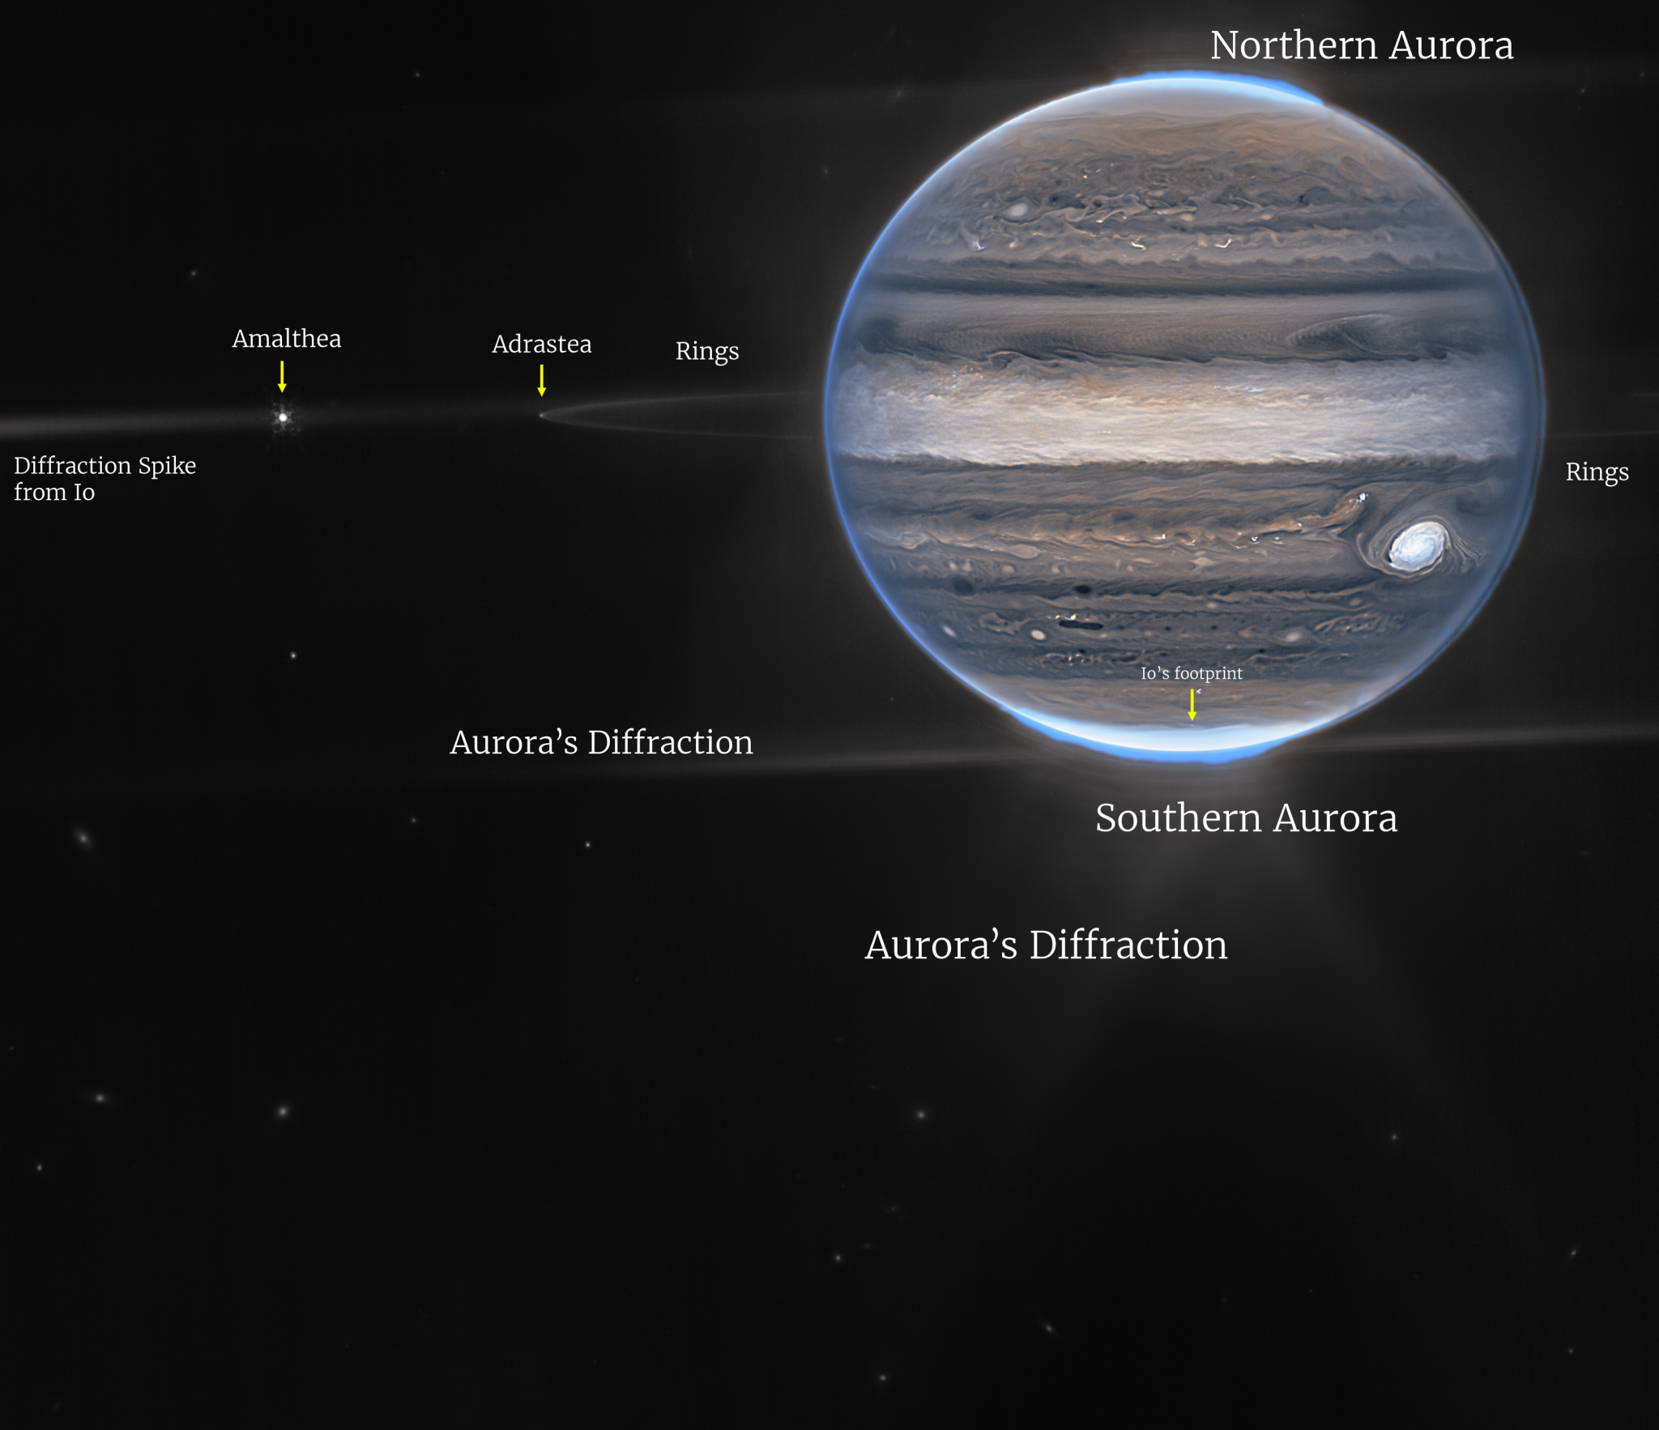
JWST infrared view of Jupiter and moons
NASA/ESA/CSA/Jupiter ERS Team/Ricardo Hueso (UPV/EHU)/Judy Schmidt

Slide 40
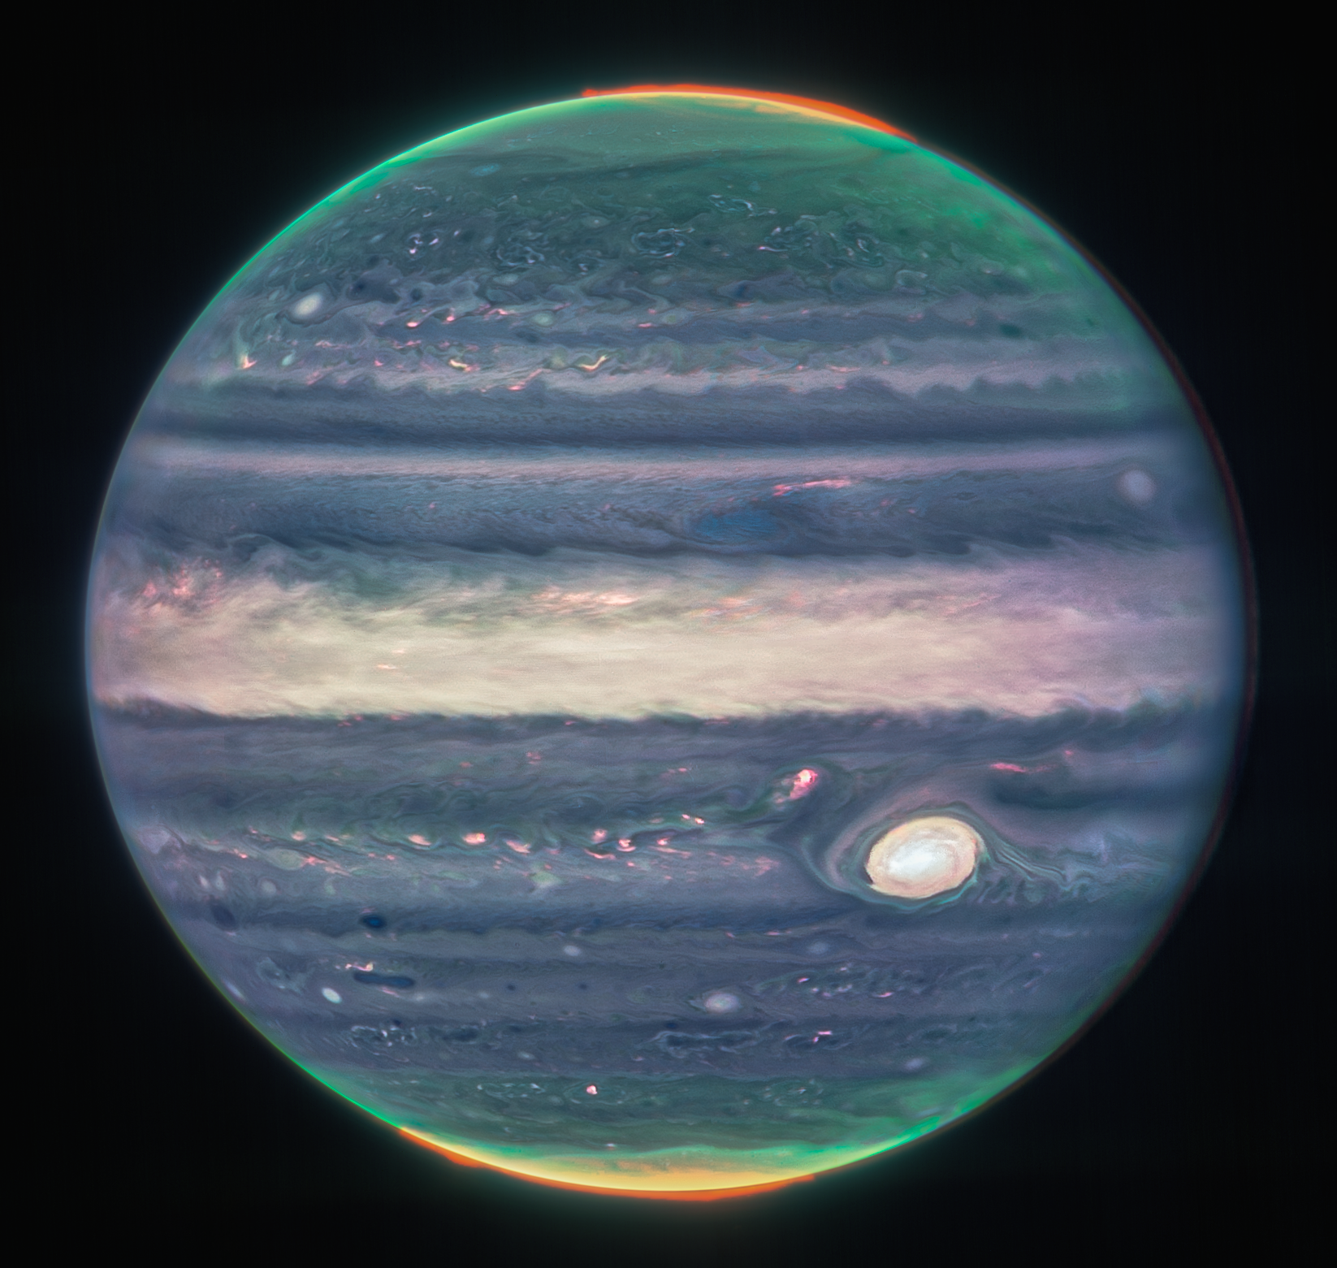
JWST infrared view of Jupiter
NASA/ESA/CSA/Jupiter ERS Team/Judy Schmidt

Slide 41
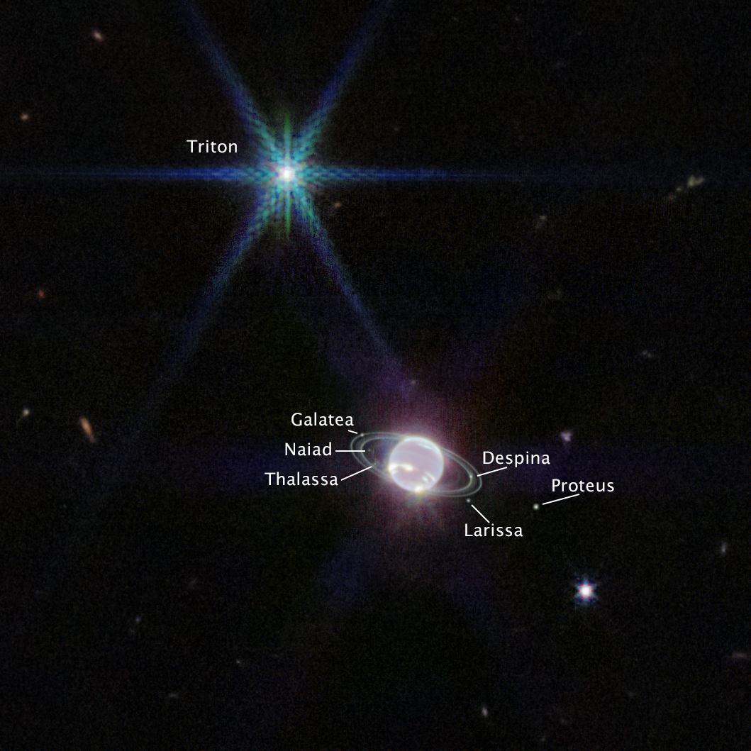
JWST infrared view of Neptune and moons
NASA/ESA/CSA/STScI

Slide 42
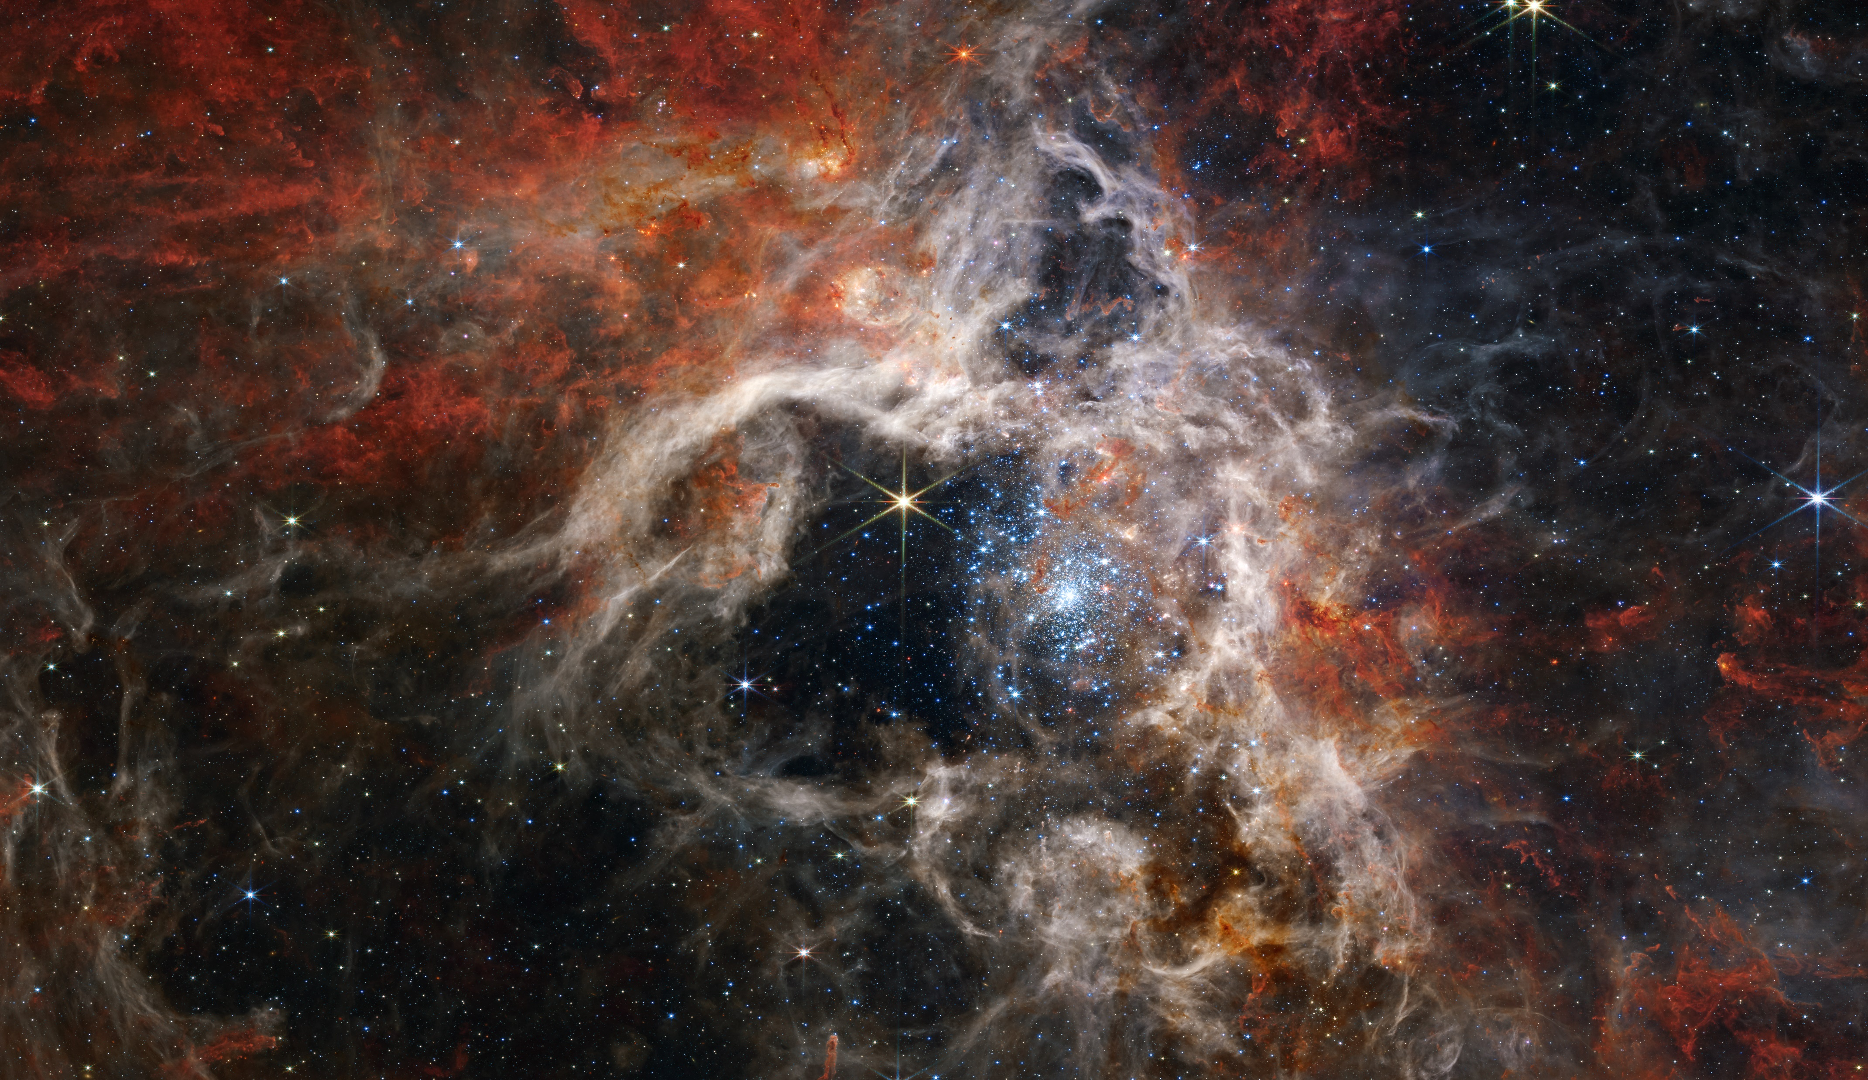
JWST view the Tarantula nebula.
NASA/ESA/CSA/STScI/Webb ERO Production Team

Slide 43
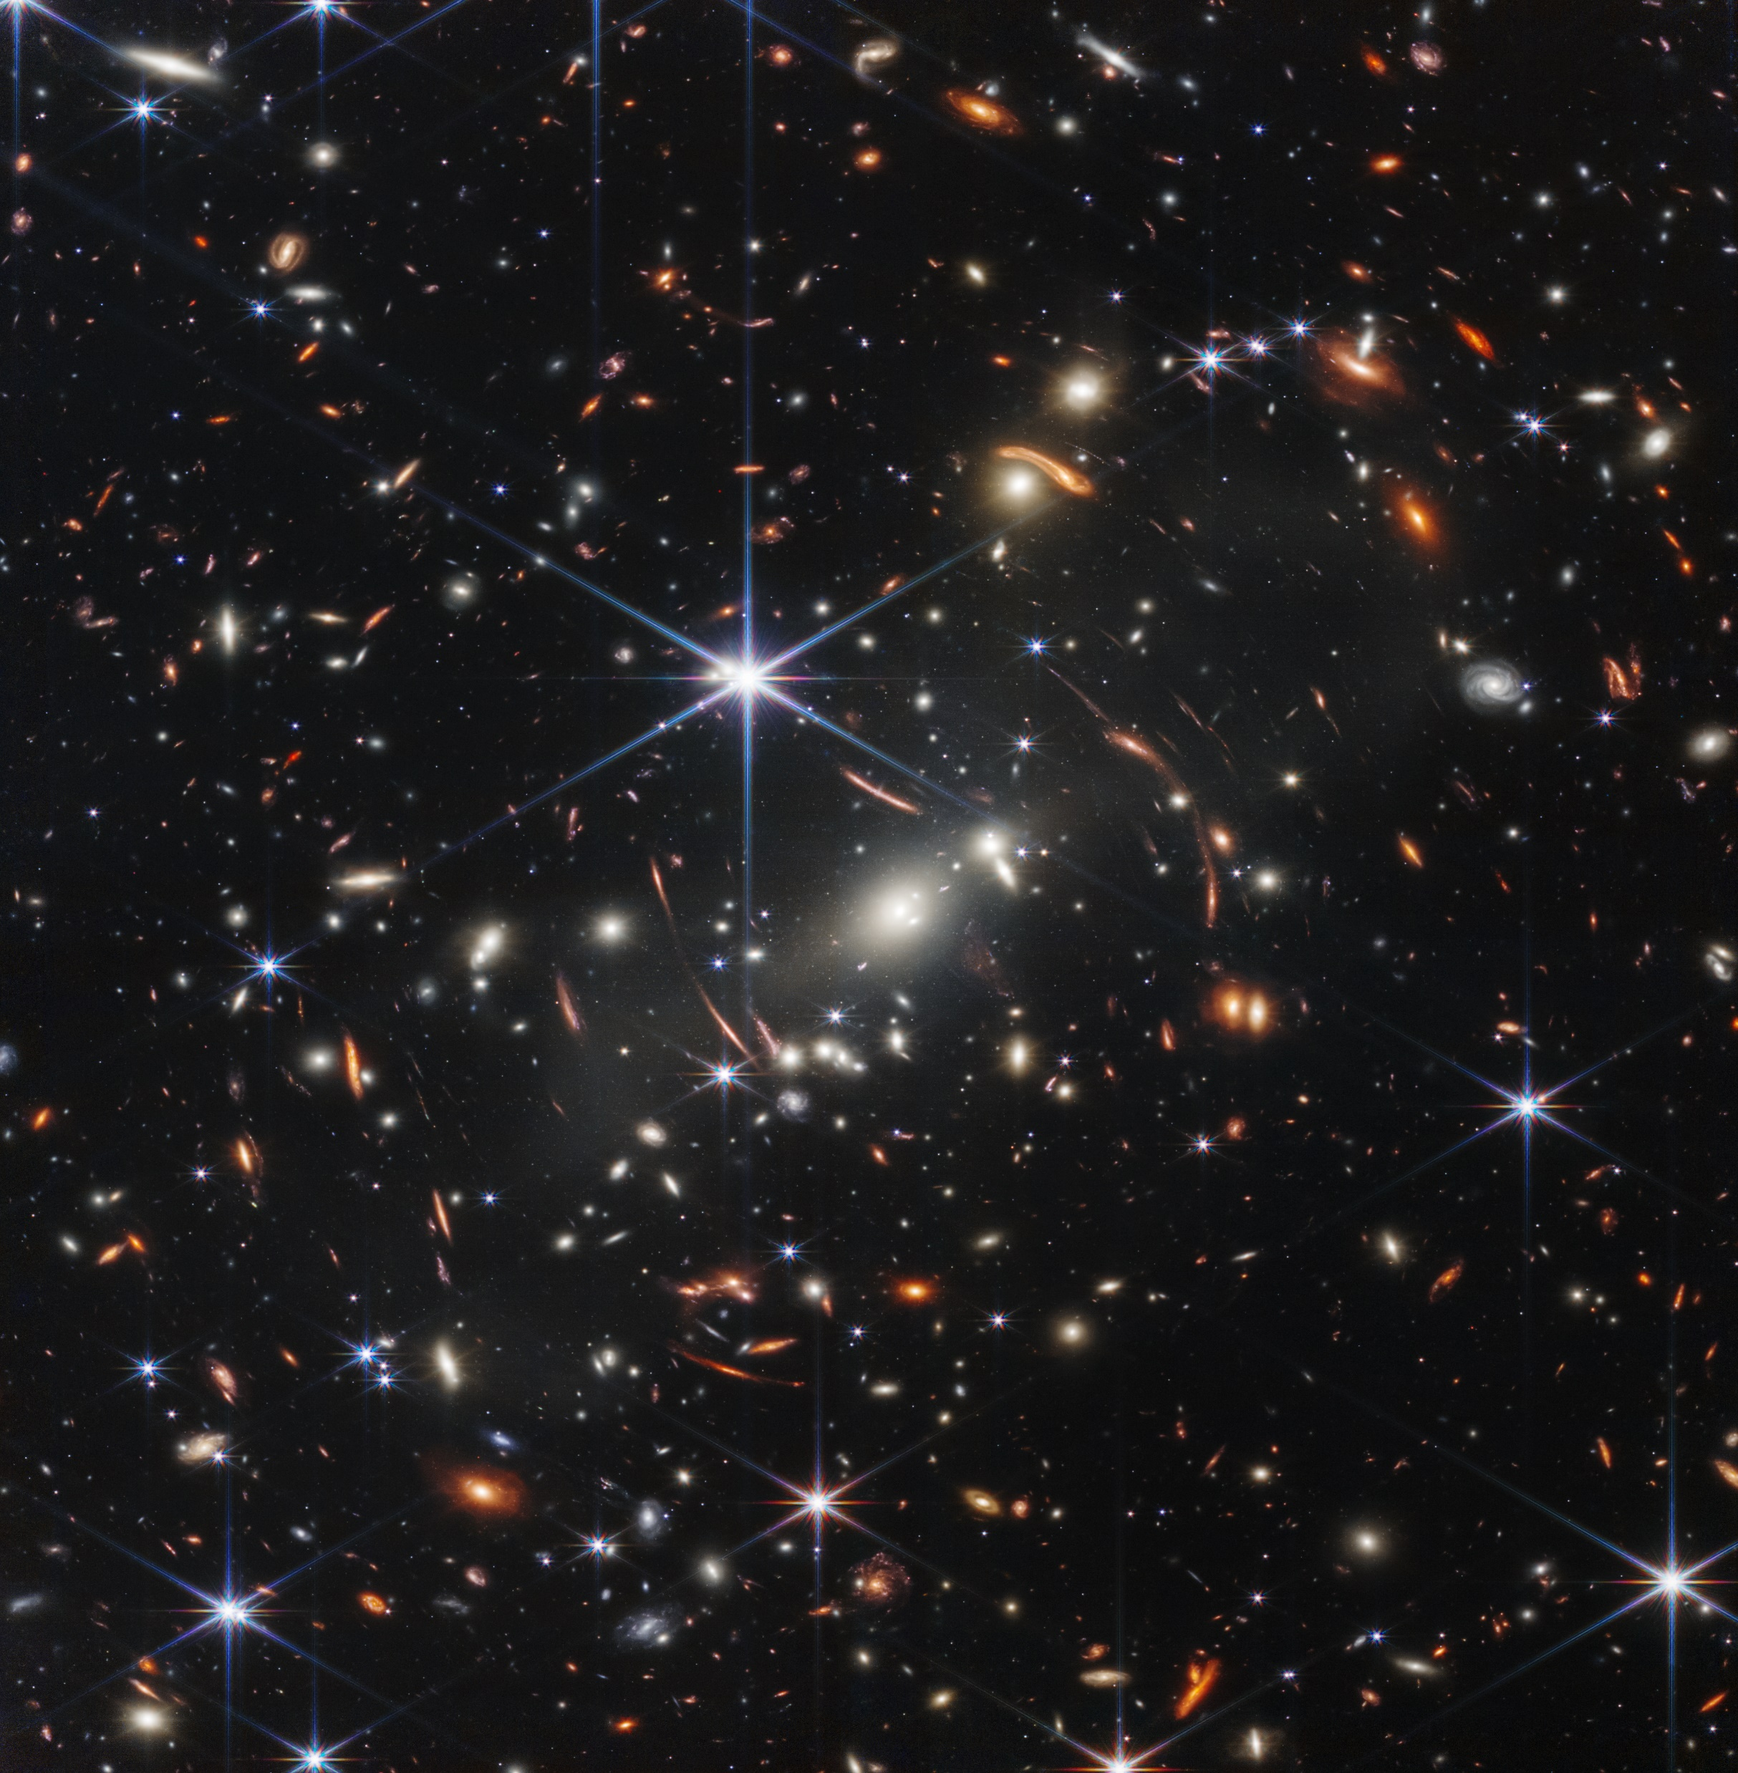
JWST deep field
NASA/ESA/CSA/STScI

